Slide 1
AP Review
Unit 1.1 and 1.2

Slide 2
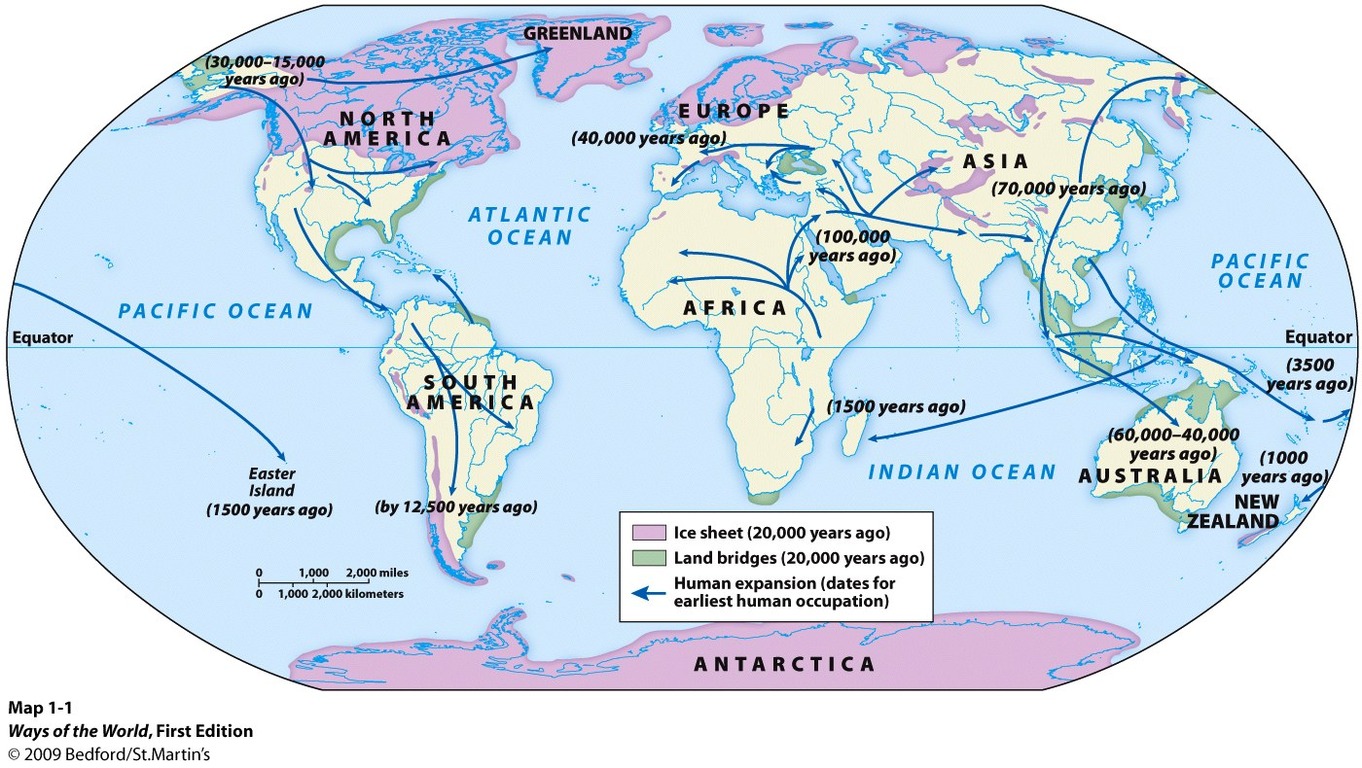
Key Concept 1.1: Big Geography and peopling of the earth
First migrations were out of Africa
Then to Middle East, Asia and Europe, and lastly Americas and Australia
Adaptions to new environments include:
Creation of fire, tools, clothing out of fur
Protection against predators included:
Tools, shelter, and living in small kinship groups
Foraging societies develop
Small kinship groups (15-30 people)
Men hunted
Women gathered
Egalitarian
Most likely animistic (believed in gods that reflected elements of nature-Sun God etc.)

Slide 3
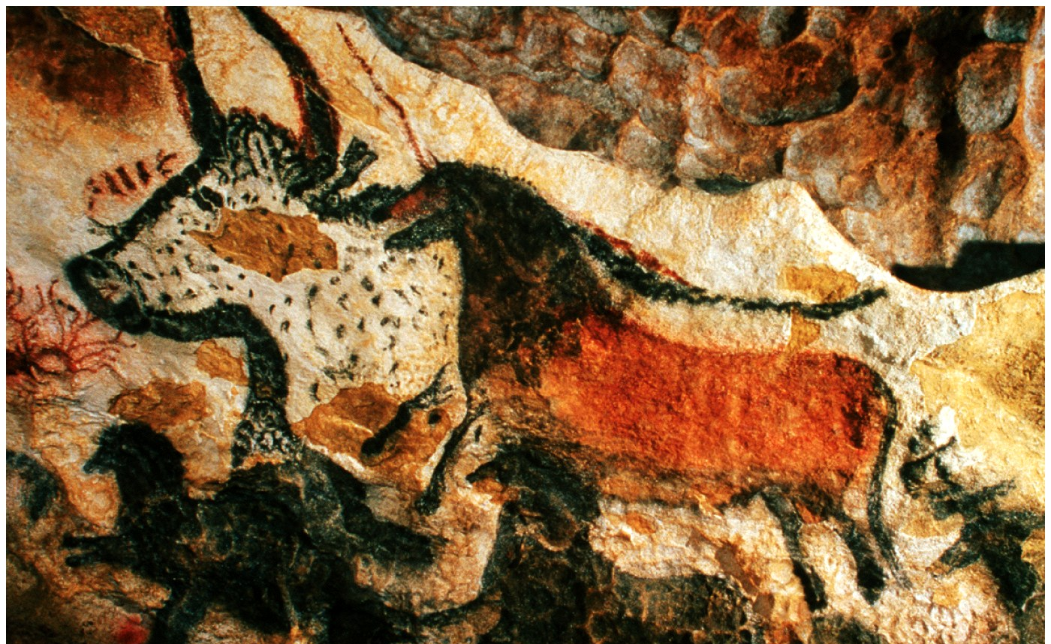
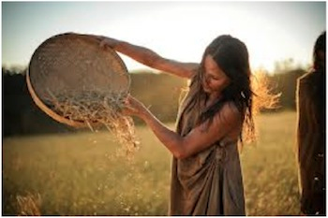
Key Concept 1.2: Neolithic Revolution and Early Agricultural Societies
Neolithic Revolution = invention of farming/Agriculture
Made possibly because of rising global temperatures and end of Ice Ace
Two new types of societies created in addition to foraging societies
Agricultural societies:
Larger populations
Domesticated plants and animals
Sedentary
Overtime become patriarchal
Pastoral societies:
Smaller populations – still larger than foraging groups
Domesticated only animals
Nomadic- move so herds can graze
Trade with agriculturalists for crops
More egalitarian

Slide 4
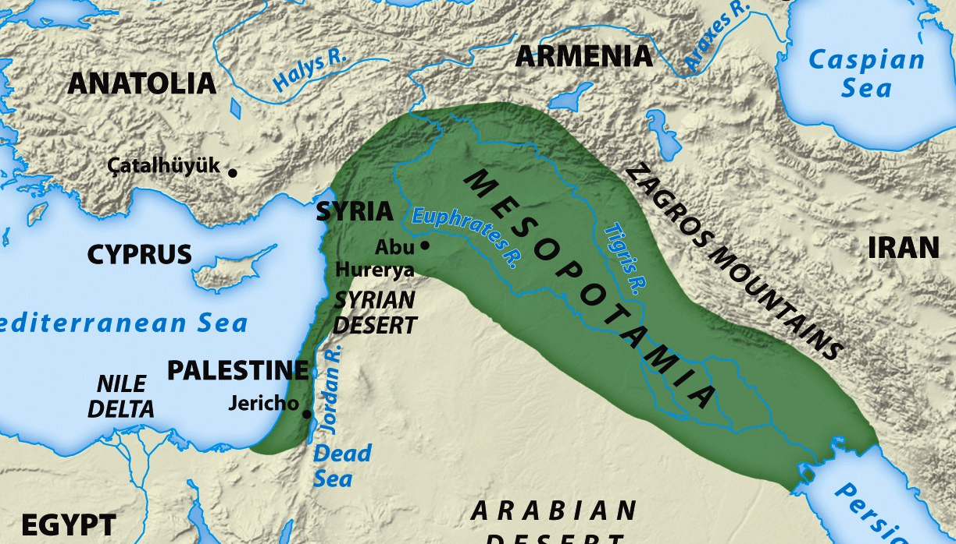
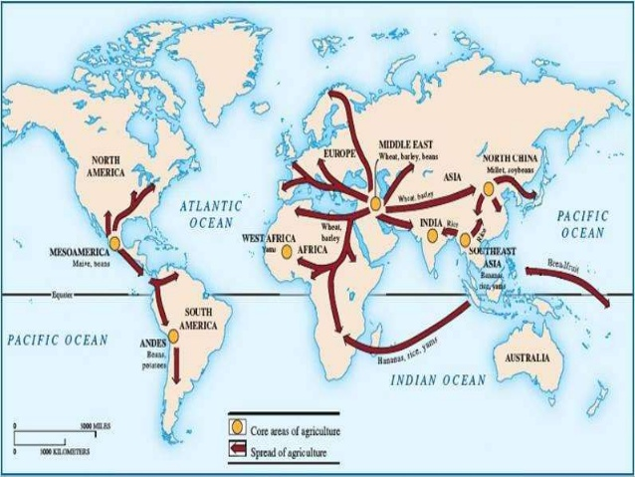
Key Concept 1.2: Neolithic Revolution and Early Agricultural Societies
Economic and Social systems become more complex as result of agriculture
Social stratification (social classes) form
Trade develops on larger scale- provides need for currency and record keeping
First things domesticated
Plants: barley, wheat, millet, maize
Animals: dogs, cows, pigs, sheep

Slide 5
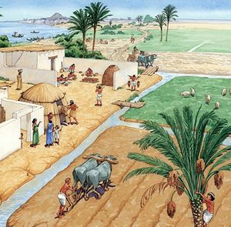
Key Concept 1.2: Neolithic Revolution and Early Agricultural Societies
Changes as a result of farming
Labor
Working collectively
Used irrigation systems to bring water to crops
Environment (negatively)
Irrigation leads to increased salinization of soil
Overgrazing
Population size and food supply
Agriculture created a more reliable food supply
As food supply increased-population increased

Slide 6
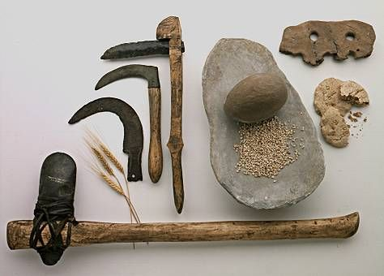
Key Concept 1.2: Neolithic Revolution and Early Agricultural Societies
Changes as a result of farming
Society
More stratified- social classes
Specialized labor occurs because of surplus food
Artisans, warriors, elites, farmers etc.
Technology
Pottery
Plow
Textiles
Metallurgy
wheels
Society (men/women)
Development of patriarchy: a system of society or government in which men hold the power and women are largely excluded from it

