Slide 1
AP Review
Unit 1.3 (pt 1)

Slide 2
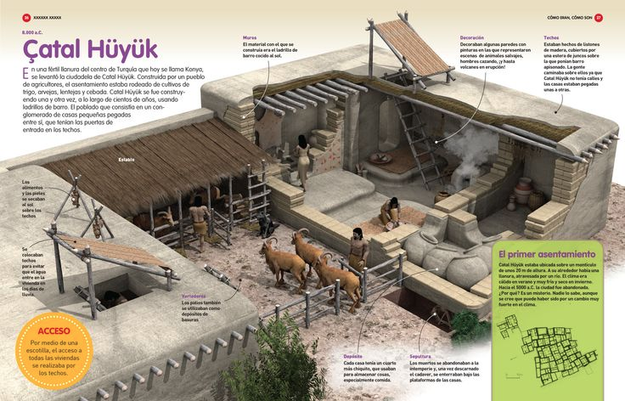
Key Concept 1.3:Development and Interactions of Early Agricultural, pastoral, and Urban societies
Overtime civilizations develop
Civilization: a large-scale agricultural society with the following characteristics:
1. Cities/ Urbanization
2. States (organized political institutions)
3. Hierarchies (religious and social)
4. Organized trade
5. Record keeping systems (writing or counting)
**** Note: most civilizations developed monumental architecture too

Slide 3
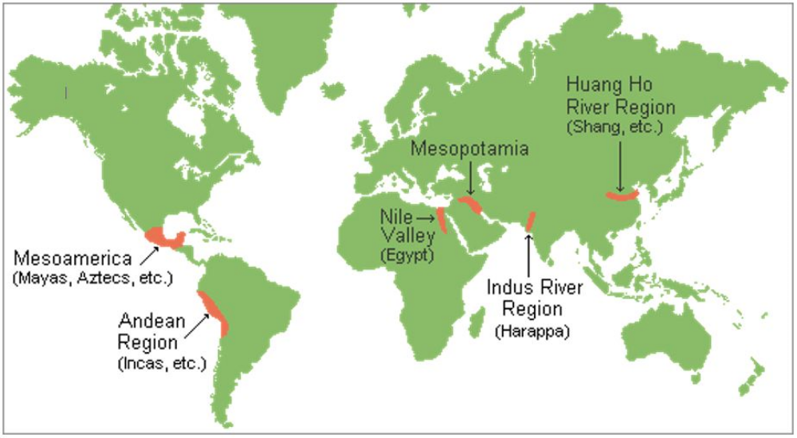

Slide 4
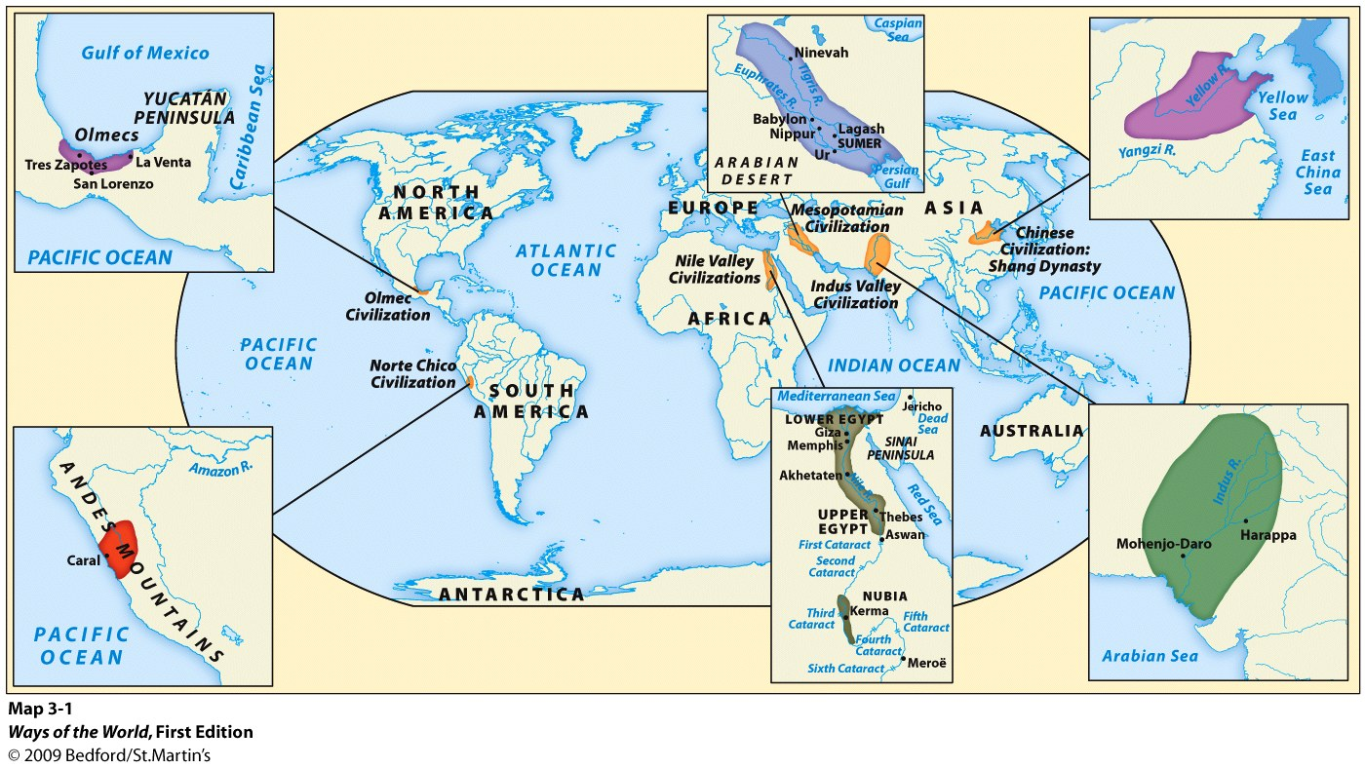

Slide 5
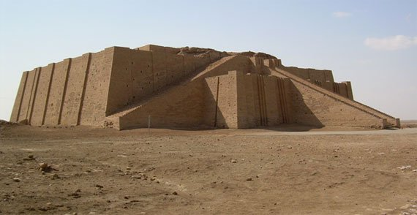
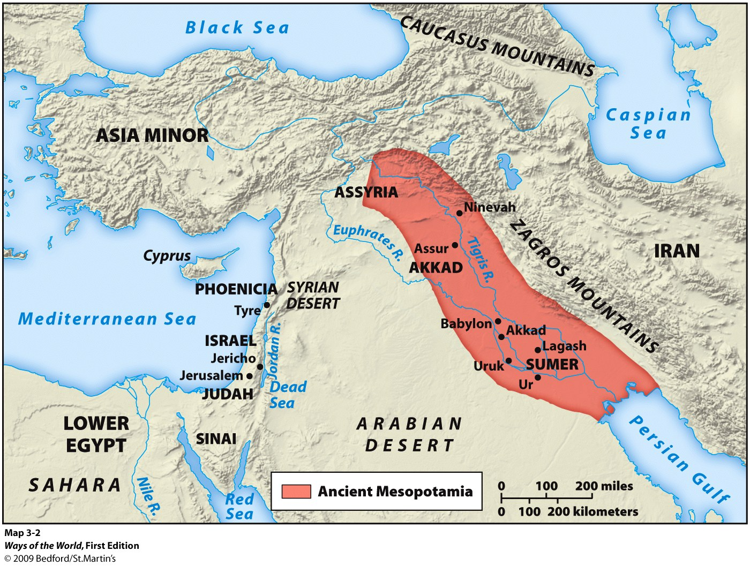
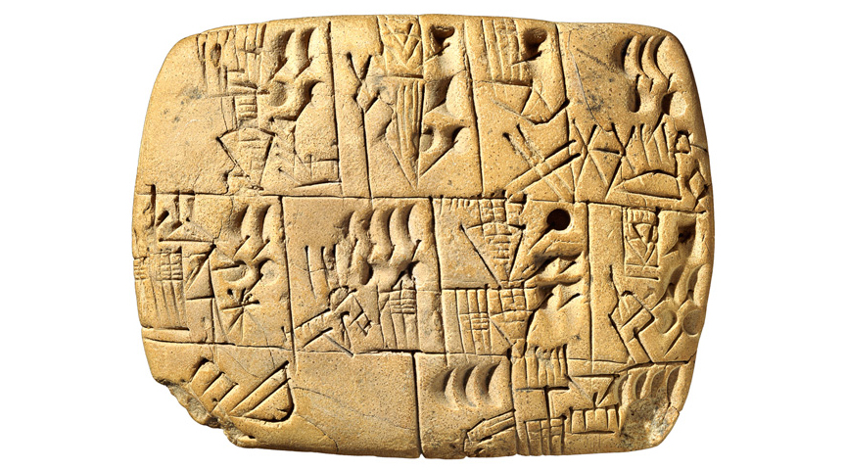
Key Concept 1.3:Development and Interactions of Early Agricultural, pastoral, and Urban societies
Mesopotamia (Sumer)
Politics:
City-states led by Kings
Lack of stability/ frequent invasions
Location
Competition
Culture:
Polytheistic: anthropomorphic gods (human-like)
Pessimistic worldview
Astronomy and math
Cuneiform
Bronze tools, chariots, ziggurats, Epic of Gilgamesh
Society:
Specialized labor (social classes)
Patriarchy

Slide 6
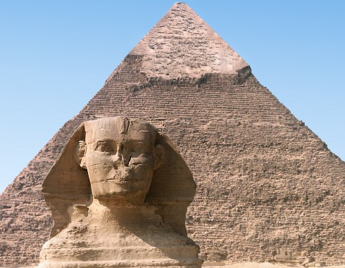
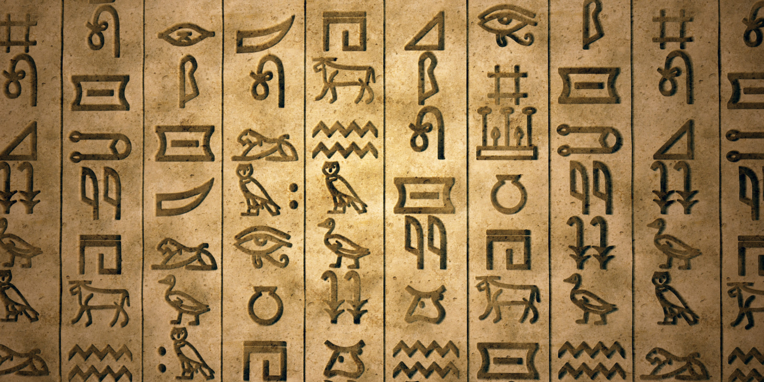
Key Concept 1.3:Development and Interactions of Early Agricultural, pastoral, and Urban societies
Egypt
Politics:
United empire: pharaoh (God-king)
Stable: 3 kingdoms
Extensive bureaucracy: regional governors
Culture:
Polytheistic
Optimistic worldview: belief in after-life
Book of the Dead
Hieroglyphics and pyramids
Society:
Job specialization (social classes)
More mobility
Priests highly elevated
Patriarchal (women higher status than Mesopotamia)
Hatshepsut: female pharaoh

Slide 7
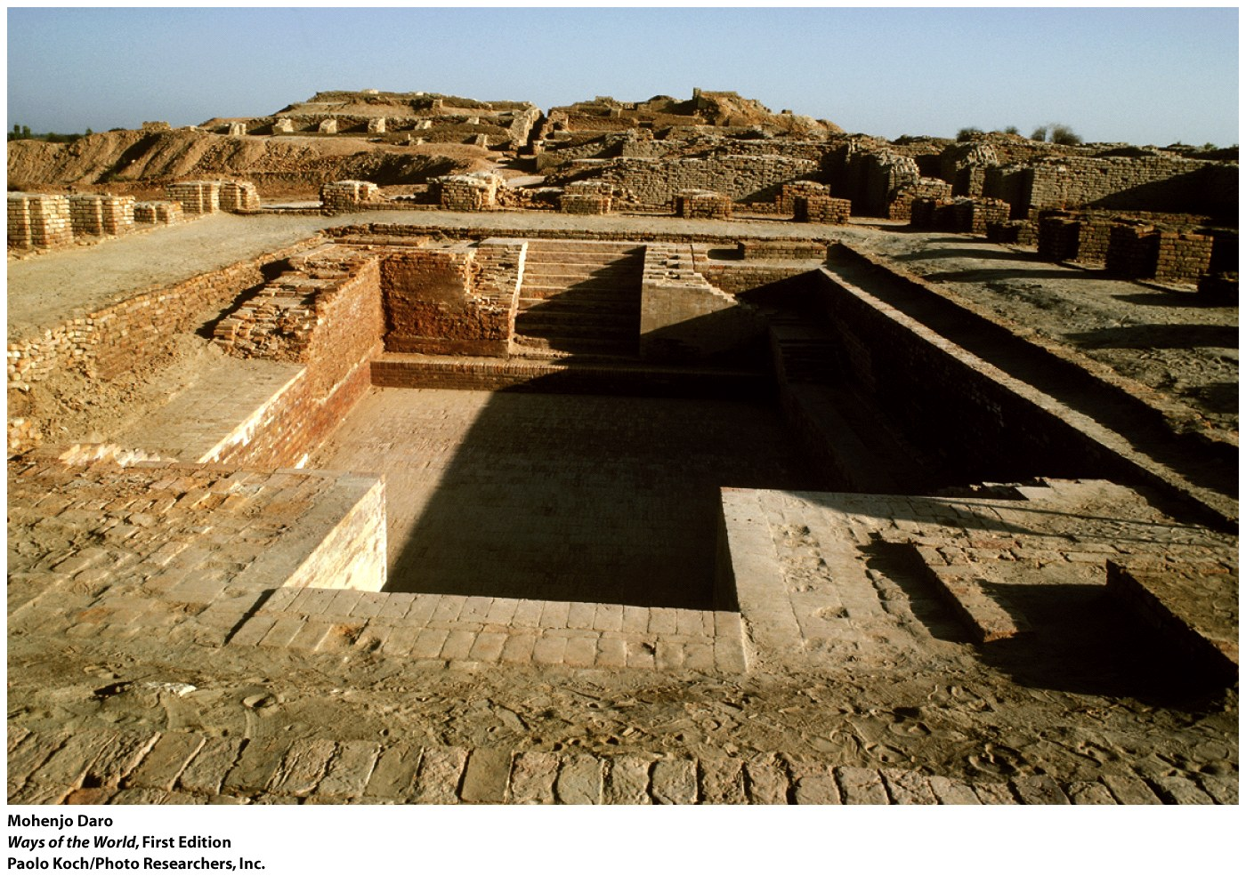
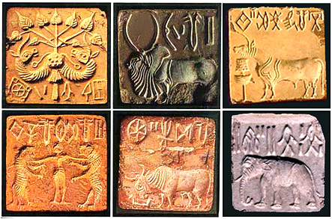
Key Concept 1.3:Development and Interactions of Early Agricultural, pastoral, and Urban societies
Mohenjo-Daro/Harrapa
Politics:
Believed to have centralized control
Culture:
Polytheistic
Tools, baths, seals, and sewage systems
Writing system yet to be deciphered
Society:
Stratified society (social classes)
Priests highly elevated
Assumed to be patriarchal
Strong reverence for female fertility

Slide 8
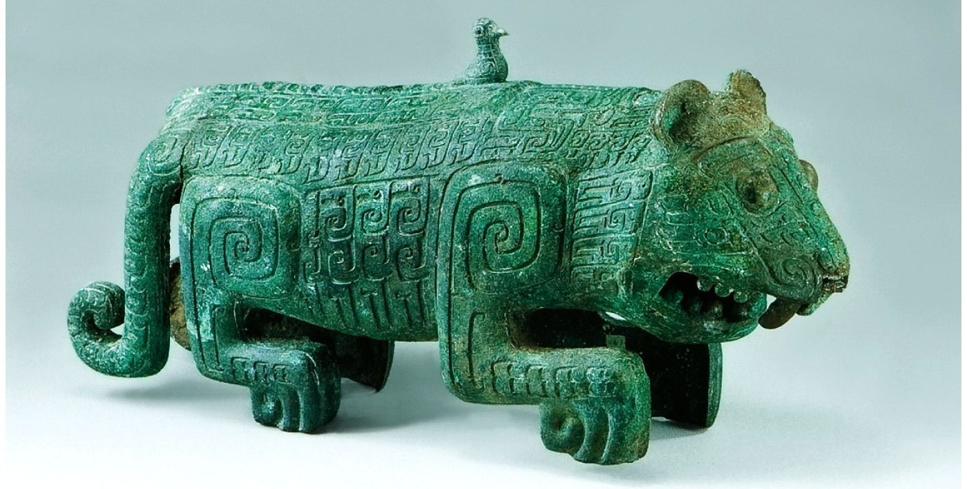
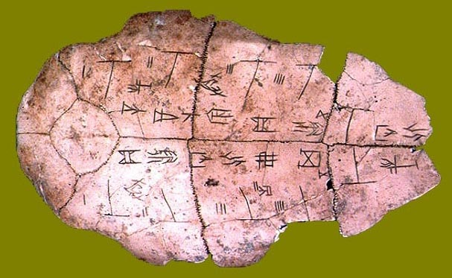
Key Concept 1.3:Development and Interactions of Early Agricultural, pastoral, and Urban societies
Shang China
Politics:
Centralized: led by emperor (appointed by heaven but not divine)
bureaucracy
Culture:
Ancestor veneration: oracle bones
Complex pictorial language
Bronze tools, chariots, and intricate jade figurines
Society:
Stratified society: social classes
Patriarchal

