Slide 1
AP Review
Unit 1.3 (pt 2)

Slide 2
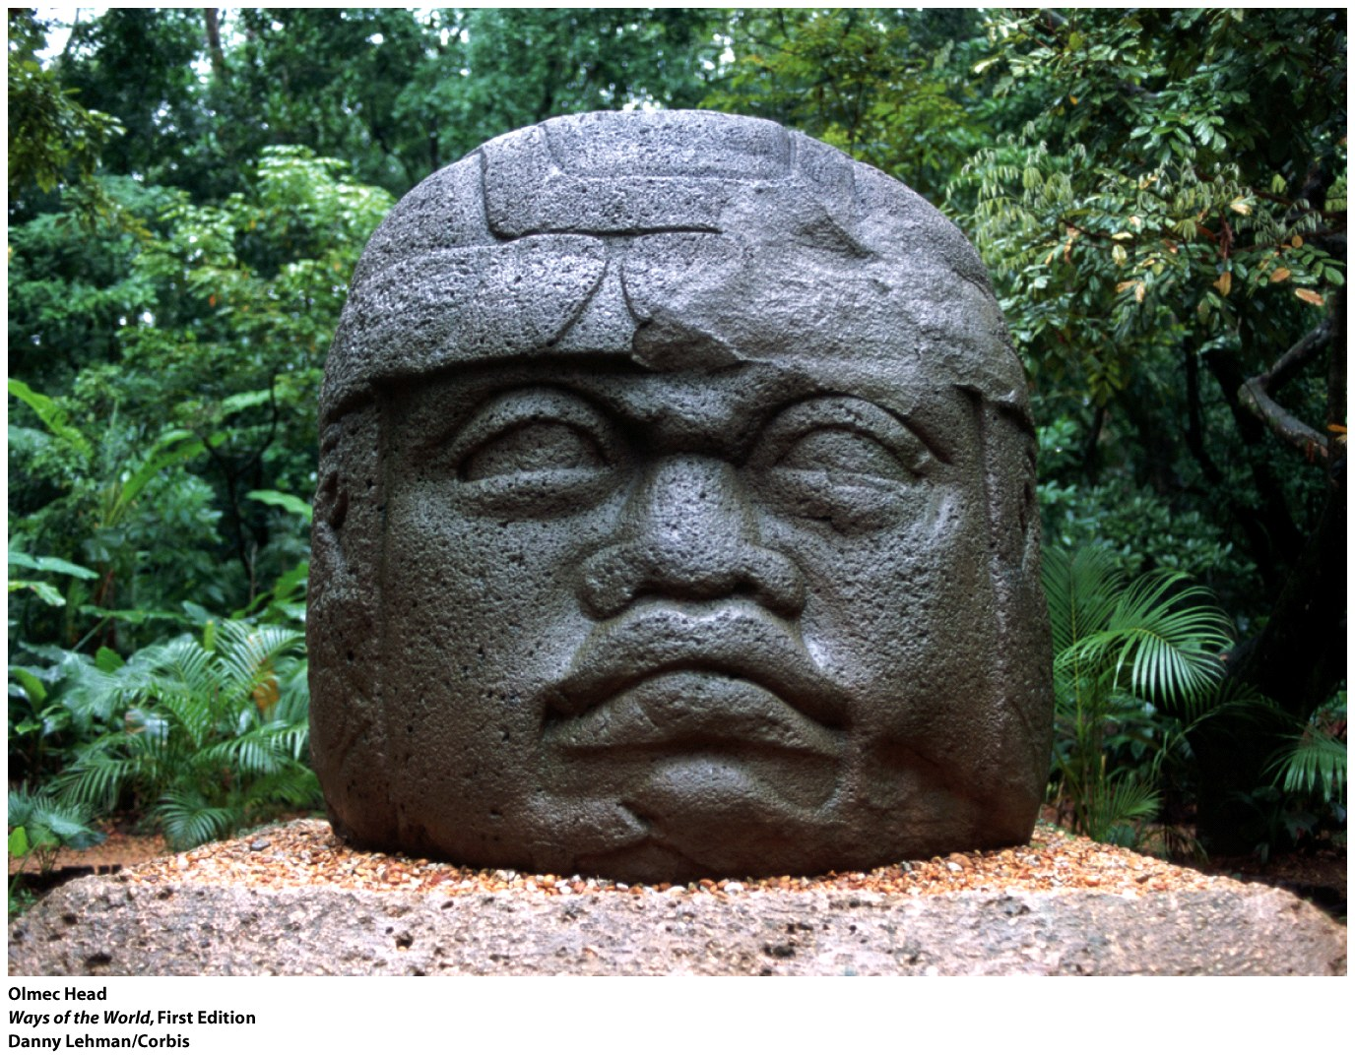
Key Concept 1.3:Development and Interactions of Early Agricultural, pastoral, and Urban societies
Olmecs
Politics:
Centralized
Culture:
Polytheistic: included shamans as healers
Highly advanced astronomy
Irrigation and drainage canals
Jaguar symbol significant
Giant carved stone heads
Society:
Social classes: majority of people were farmers
Priests are highest class

Slide 3
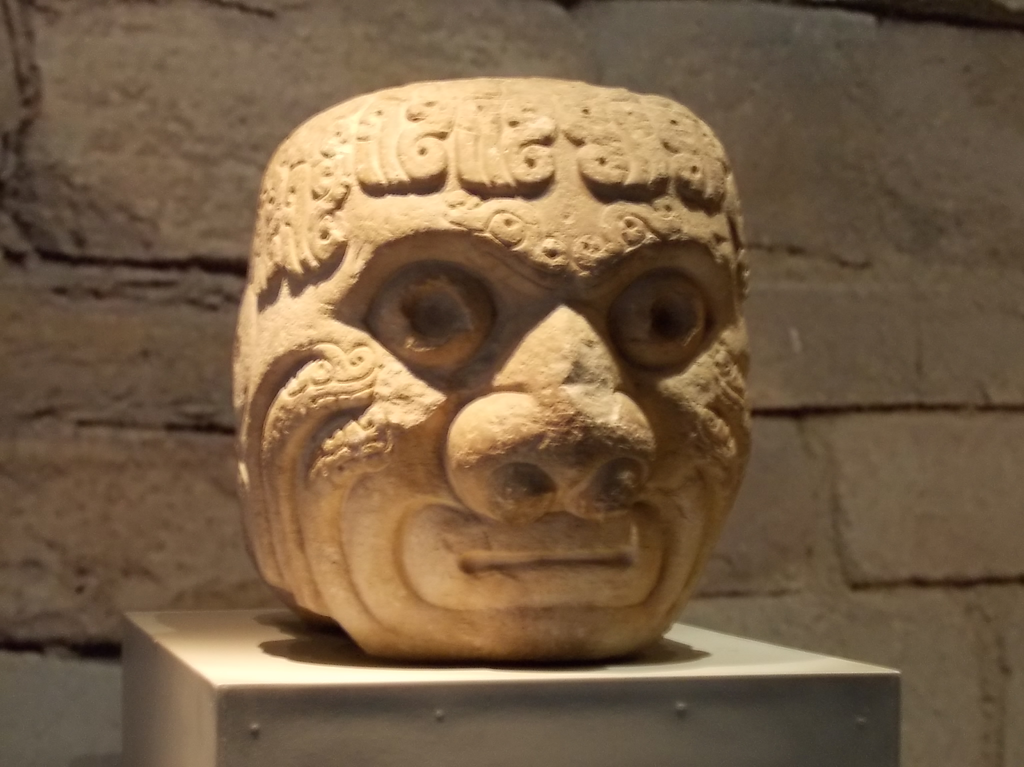
Key Concept 1.3:Development and Interactions of Early Agricultural, pastoral, and Urban societies
Chavin
Politics:
Most likely unified with a capital city
Culture:
Polytheistic
Jaguar is significant symbol
Advanced agricultural techniques
Society:
Social classes: majority of people were farmers
Priests are highest class

Slide 4
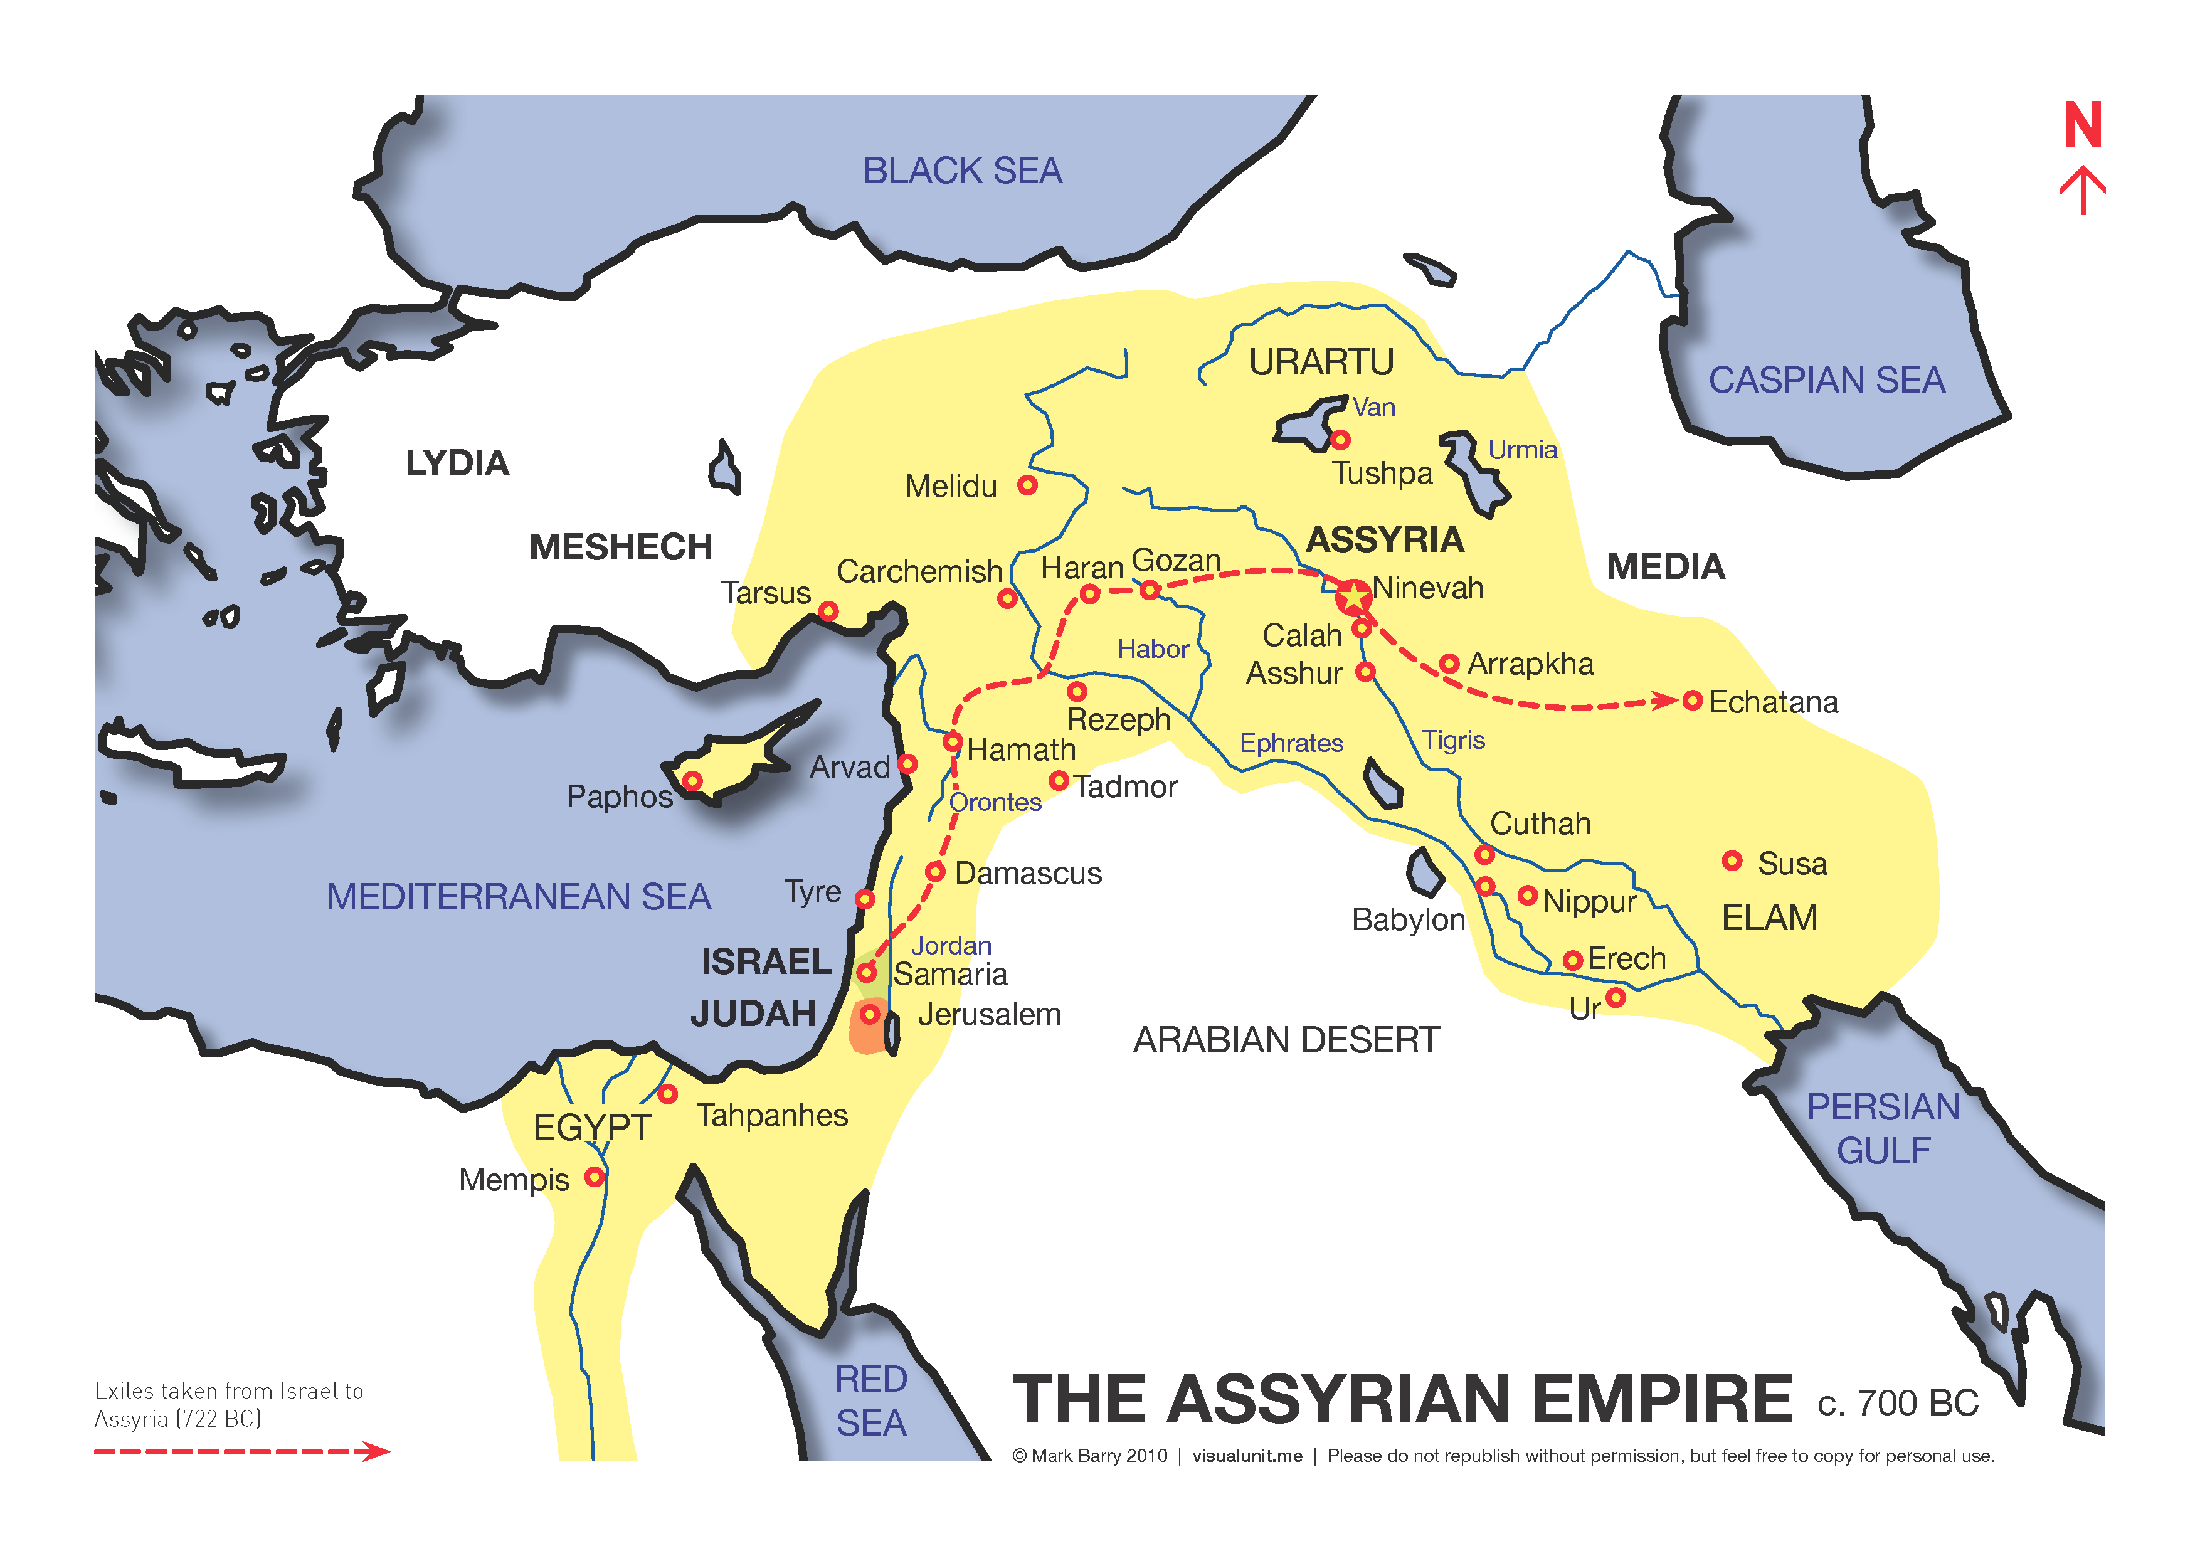
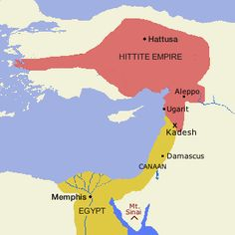
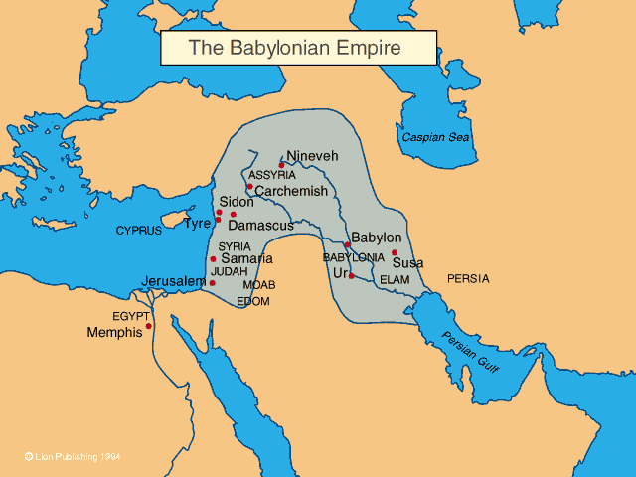
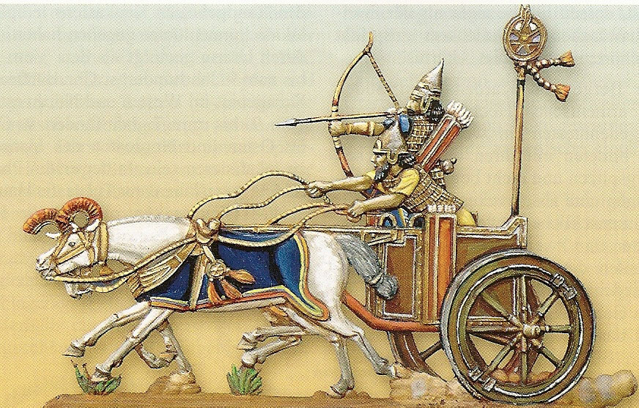
Key Concept 1.3:Development and Interactions of Early Agricultural, pastoral, and Urban societies
States emerged within these civilizations
*State: powerful system of rule (government) that organized surplus labor and resources over large areas
Typically led by ruler with divine authority
Supported by religious elites and military
Some states had greater access to resources, food surplus, or larger population allowing for successful conquest
Example: Hittites and iron
Pastoralists developed and disseminated new weapon and transportation technology between states
Iron weapons, chariots, horseback riding, compound bows

Slide 5
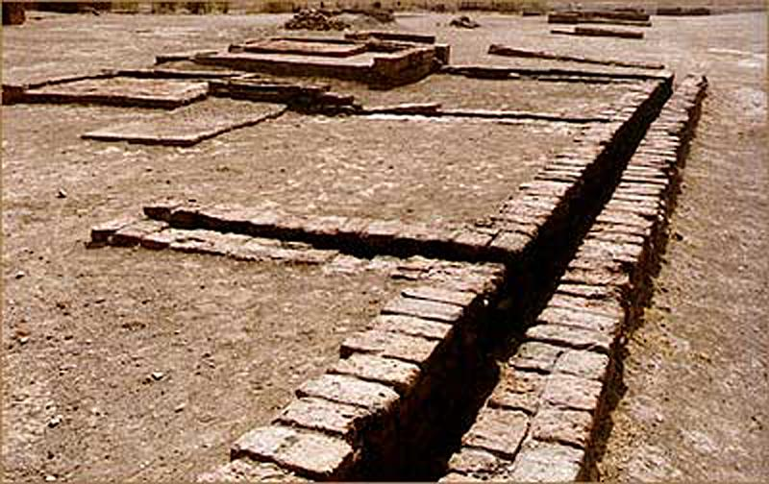
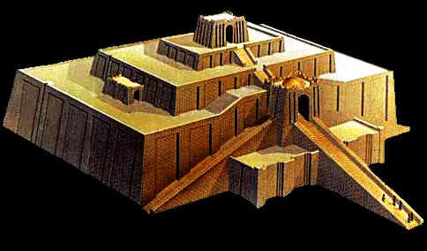
Key Concept 1.3:Development and Interactions of Early Agricultural, pastoral, and Urban societies
Culture helped unify states through:
Laws
Language
Literature
Religion/myths
Art/architecture
Examples of monumental architecture and urban planning include:
Architecture- pyramids, ziggurats, temples
Urban planning- streets, sewage and water systems

Slide 6
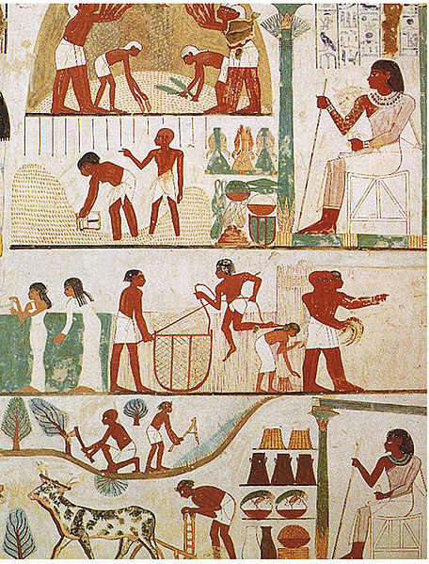
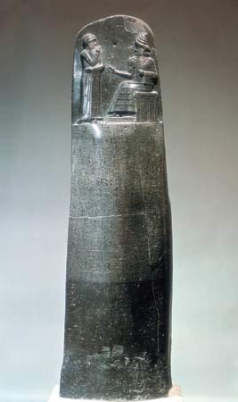
Key Concept 1.3:Development and Interactions of Early Agricultural, pastoral, and Urban societies
Elites (political and religious) sponsored and promoted art such as:
Sculpture
Painting
Weaving
Systems of record keeping arose independently and were diffused
Examples: cuneiform, hieroglyphics, pictographs
States developed legal codes that reflected hierarchies and facilitated rule of governments
Early legal codes: Code of Hammurabi (eye for an eye)

Slide 7
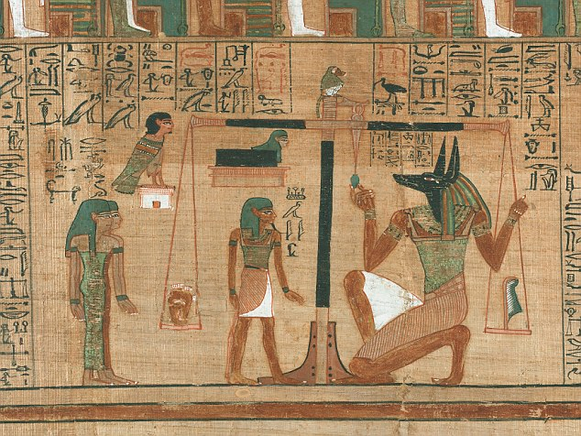
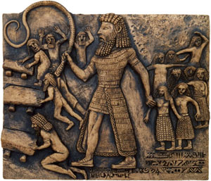
Key Concept 1.3:Development and Interactions of Early Agricultural, pastoral, and Urban societies
New religions developed that influenced later eras
Vedic religion -> Hinduism
Hebrew monotheism
Zoroastrianism
Trade expanded throughout this era from local to regional to trans-regional
Egypt and Nubia
Mesopotamia and Indus Valley
Social and gender hierarchies intensified as cities and states expanded
Literature was created and became a reflection of culture
Examples: Epic of Gilgamesh, Book of the Dead, Rig Veda

