Slide 2
Unit 4.1 pt.1
Early Modern
1450 CE- 1750 CE

Slide 3
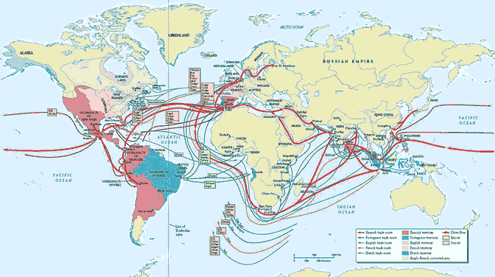
Key Concept 4.1: Globalizing networks of communication and exchange
A key change in this period was the interconnection of Western and Eastern hemispheres that was made possible by transoceanic voyages
The effects of this increased interconnectedness led to:
Global circulation of goods
Increased spread of religion/culture
Increased migration of peoples
Germs/disease ravaging indigenous populations (esp. in the Americas)
Altered diets, populations, and agriculture as a result of exchanging plants and animals
This new global circulation of goods led to the increased prosperity of existing trade networks and economic disruption to merchants and governments operating in those networks

Slide 4
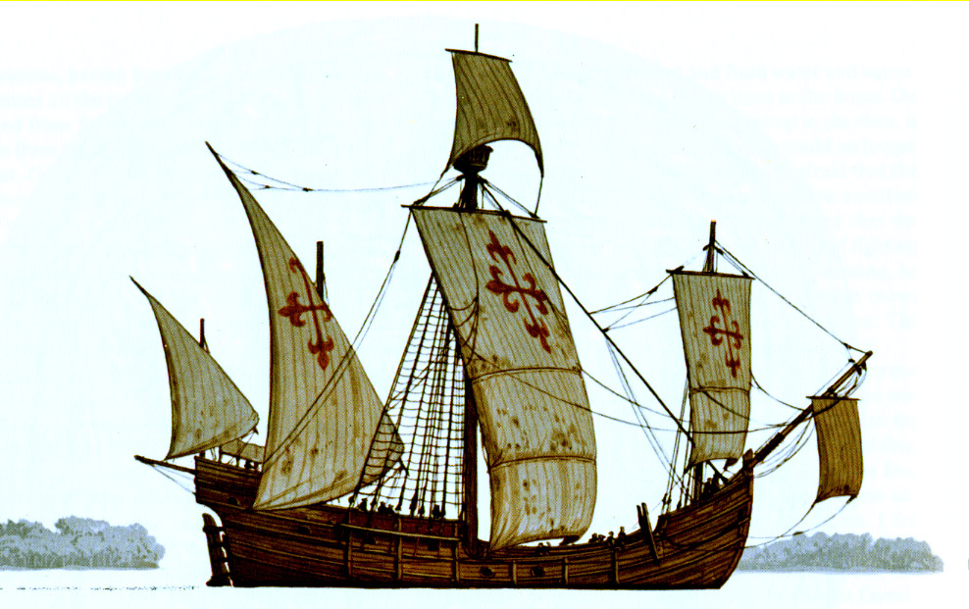
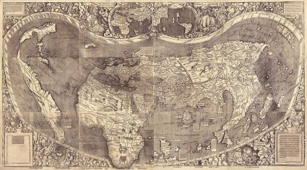
Key Concept 4.1: Globalizing networks of communication and exchange
European technology built on previous knowledge by Asian and Arab scholars and included:
Production of new tools (astrolabe, more accurate maps)
Innovations in ship design (caravel)
Improved understanding of wind and ocean currents

Slide 5
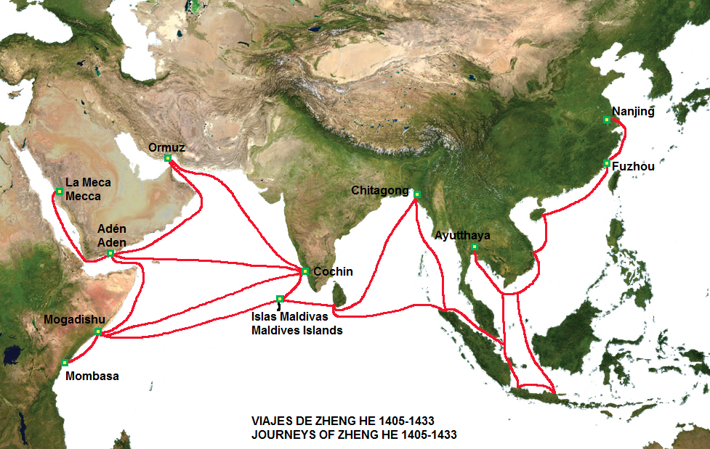
Key Concept 4.1: Globalizing networks of communication and exchange
There were many notable trans-oceanic maritime voyages during this period
Zheng He and Chinese fleets: largest fleets during this era, expanded into Indian Ocean and enhanced Chinese prestige
Portuguese Explorers: developed school for navigation, increased travel and trade with West Africa and resulted in trading post empires
Columbus and Spanish explorers: made first successful voyages across Atlantic and Pacific oceans and increased European interest in transoceanic travel

Slide 6
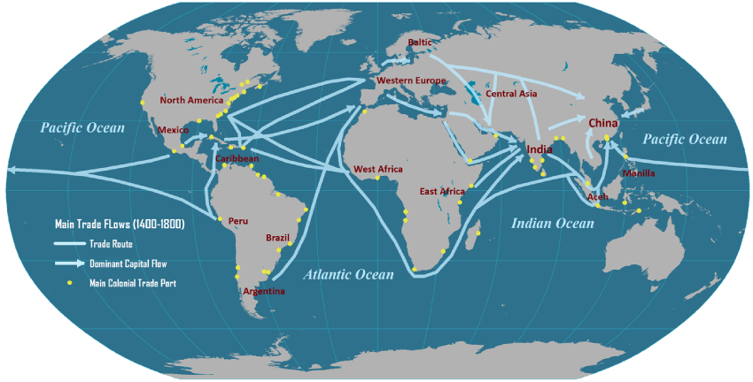
Key Concept 4.1: Globalizing networks of communication and exchange
Europeans were motivated to make these voyages because
Constantinople was conquered by the Muslim Ottoman Turks
Europeans needed new routes to Asian markets
Oceania and Polynesia were surprisingly not dramatically affected by these voyages because of Europeans infrequent incursions into the Pacific Ocean

Slide 7
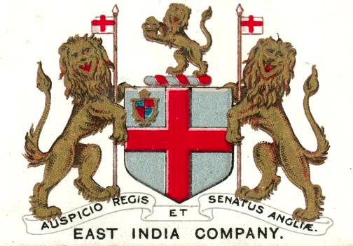
Key Concept 4.1: Globalizing networks of communication and exchange
The new global circulation of goods was facilitated by:
Royal charted European monopoly companies
And was accomplished by…
Taking silver from Spanish colonies in America to purchase Asian goods for Atlantic markets
Regional markets in Afro-Eurasia continued to flourish in spite of Trans-Atlantic trade because of new trans-oceanic shipping services developed by Europeans

Slide 8
Key Concept 4.1: Globalizing networks of communication and exchange
European merchant’s role in Asian trading markets was as intermediaries transporting goods from one Asian market to another in the Indian ocean.
Commercialization and global trade was facilitated by silver from the Americas being used as the first global currency
Pesos de ocho

Slide 9
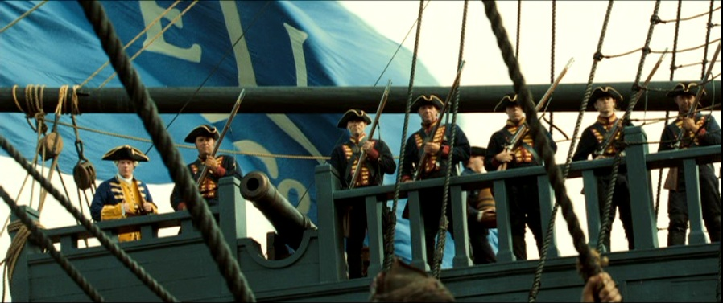
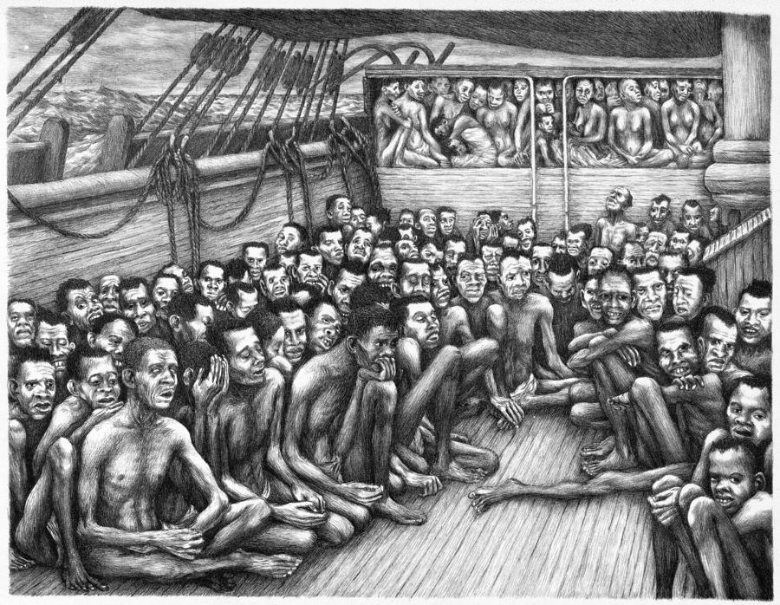
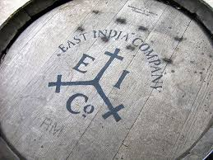
Key Concept 4.1: Globalizing networks of communication and exchange
Influenced by mercantilism
*mercantilism: an economic system in which a country tries to amass wealth by exporting more than it imports in order to increase its supply of gold and silver bullion (coinage)
European rulers used joint-stock companies to control their domestic and colonial economies
Example: British east India company
The global flow of goods in the Atlantic system led to an increase in both free and un-free migrants
Mixing of African, American, and European peoples and cultures
Trans-Atlantic slavery

