Slide 1
AP Review
Unit 2.1

Slide 2
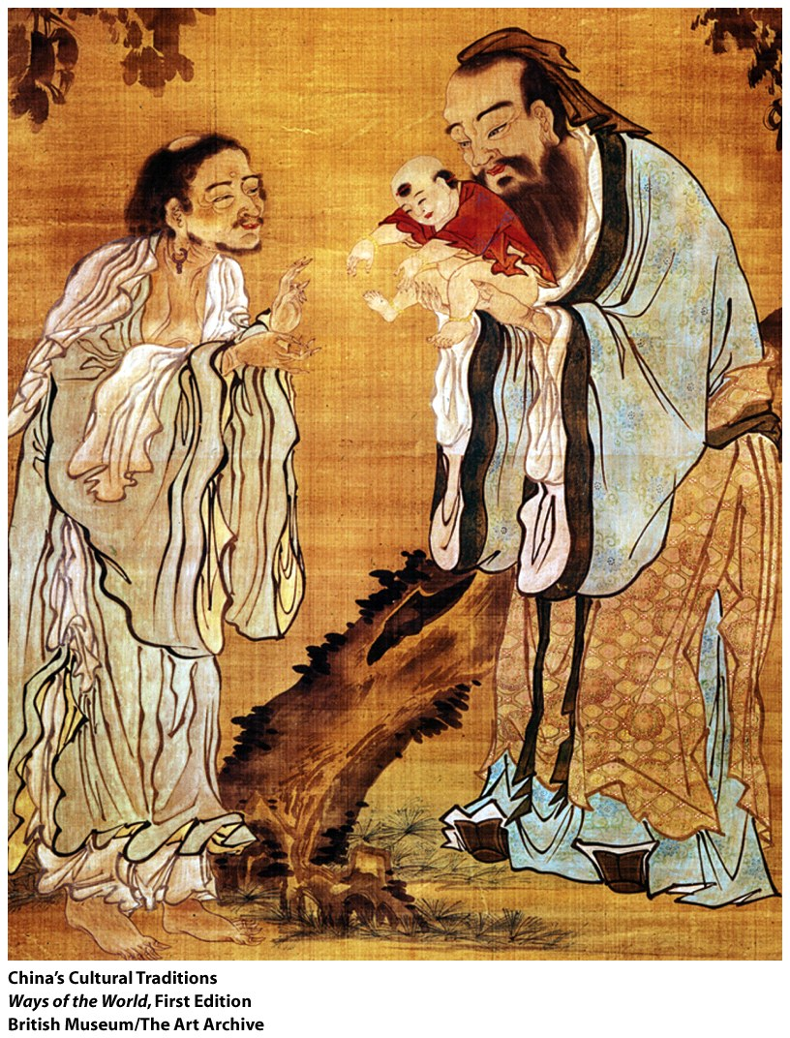
Key Concept 2.1: The development and codification of religious and cultural traditions
Religions continued to become more complicated as states increased in size
Religions also promoted unity in the following ways
Political bonds:
Religious and political authority often merged as rulers
Cultural bonds:
Created bond between people and a code to live by
Economic bonds:
Usually reinforced social stratification

Slide 3
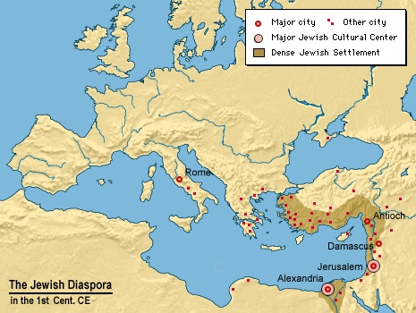
Key Concept 2.1: The development and codification of religious and cultural traditions
Judaism
Origin/ Founder:
Palestine
Abraham
Core teachings:
Monotheism
Heaven/Hell
Israel is chosen nation
Emphasis on daily prayer and sacrifices
Holy text: Torah (1st 5 books of Bible)
Method and Location of diffusion:
Jewish Diaspora communities within Mediterranean world

Slide 4
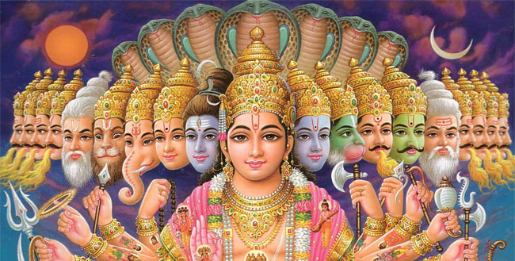
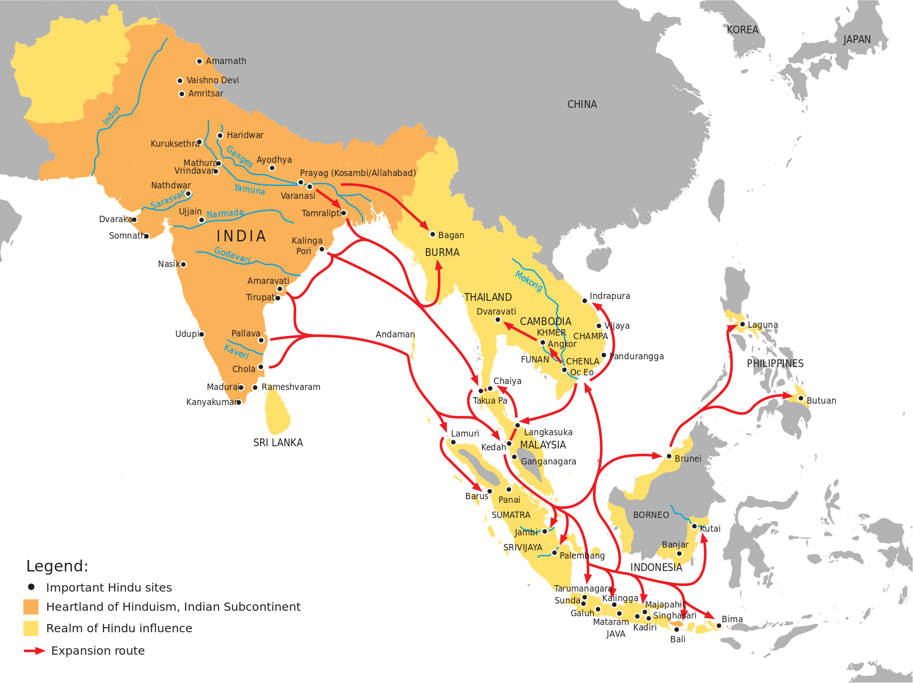
Key Concept 2.1: The development and codification of religious and cultural traditions
Hinduism
Origin/ Founder:
South Asia (India)
Founder unknown- rooted in Vedic texts
Core teachings:
Multiple expressions of deities
Reincarnation
Karma
Caste system
Moksha
Holy text: Vedas, Bhaghvad Gita, and Laws of Manu
Method and Location of diffusion:
South and Southeast Asia
Missionary efforts and merchants

Slide 5
Key Concept 2.1: The development and codification of religious and cultural traditions
New belief systems and cultural systems emerged and spread that often asserted universal truths
Universal religion: a religion for all people (anyone can join)

Slide 6
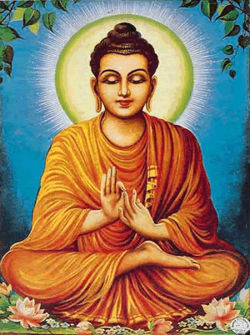
Key Concept 2.1: The development and codification of religious and cultural traditions
Buddhism
Origin/ Founder:
South Asia (India)
Siddhartha Gautama (Buddha)
Core teachings:
Overcome worldly desires
8 fold path
Meditation
Reincarnation
Nirvana
Method and Location of diffusion:
South Asia, Southeast Asia, and East Asia
Missionary efforts and merchants

Slide 7
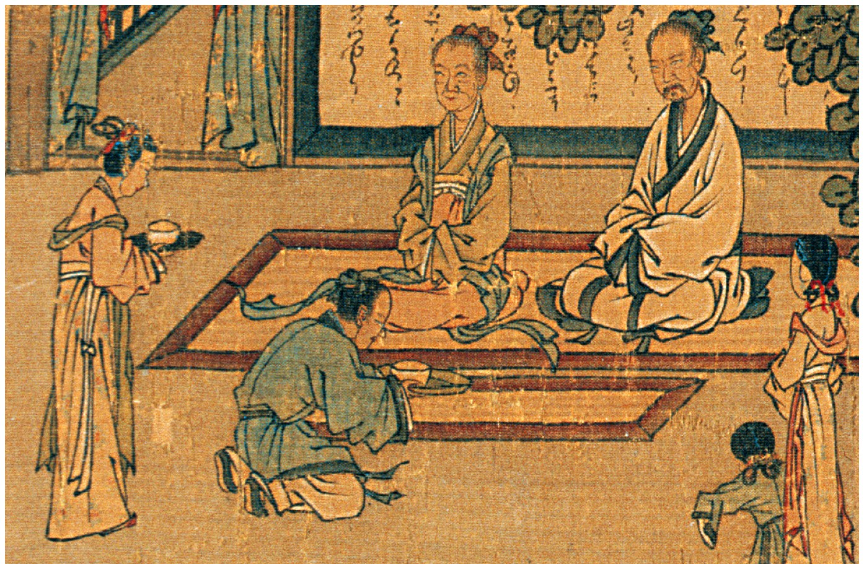
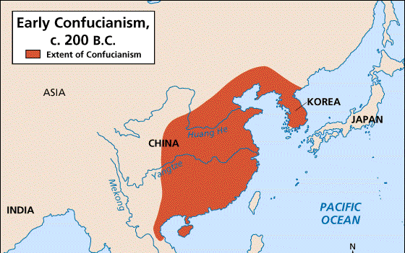
Key Concept 2.1: The development and codification of religious and cultural traditions
Confucianism
Origin/ Founder:
East Asia
Confucius
Core teachings:
Five relationships (filial piety)
Mandate of Heaven
Obedience and ancestor veneration
Education
Method and Location of diffusion:
East Asia
State support

Slide 8
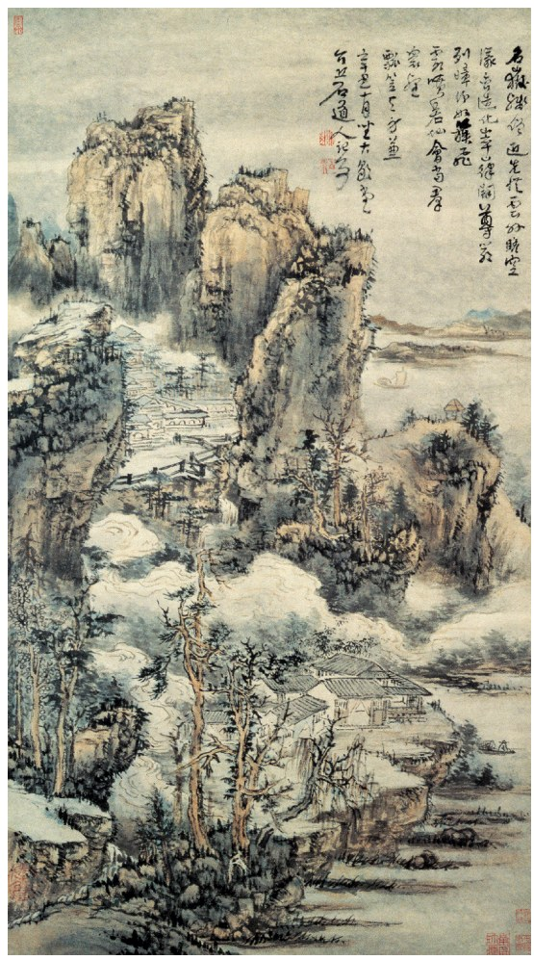
Key Concept 2.1: The development and codification of religious and cultural traditions
Daoism
Origin/ Founder:
East Asia
Laozi
Core teachings:
Ying-Yang
Balance in nature
Method and Location of diffusion:
East Asia

Slide 9
Key Concept 2.1: The development and codification of religious and cultural traditions
Christianity
Origin/ Founder:
Palestine (Roman empire)
Jesus of Nazareth
Core teachings:
Monotheism
Jesus is savior
Emphasis on gospels and the saints
Method and Location of diffusion:
Roman empire (Afro Eurasia)
Roman hostility towards faith- Paul and other missionaries continued to spread message
Merchants
Emperor Constantine made religion illegal and state helped it spread

Slide 10
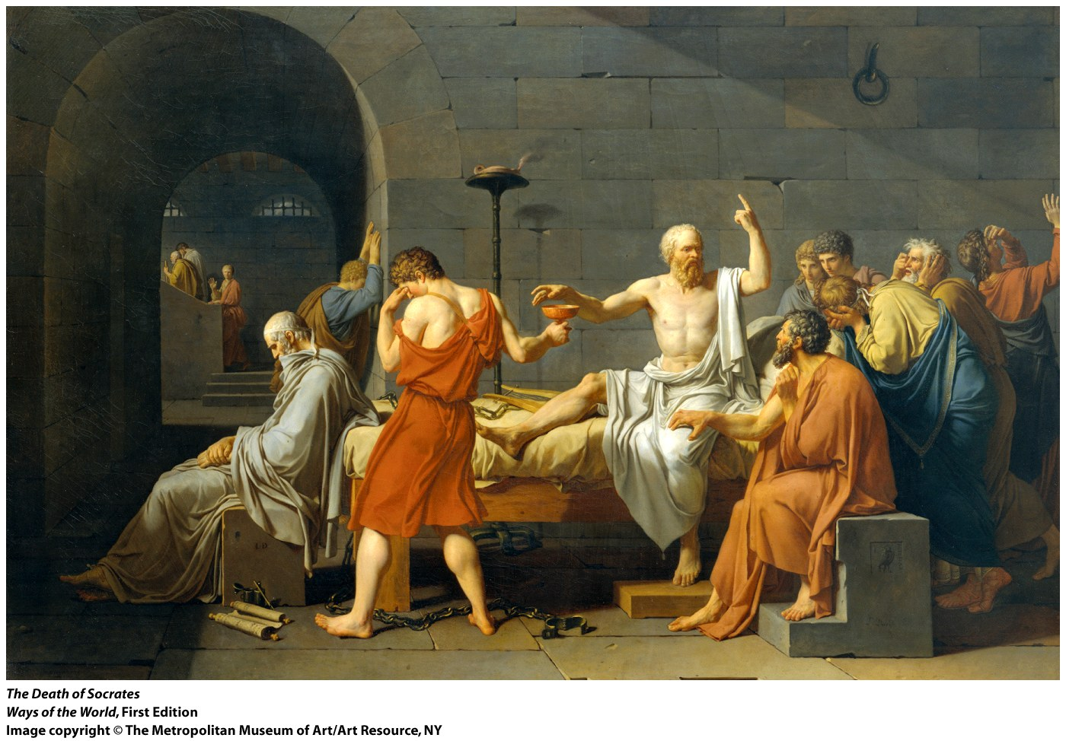
Key Concept 2.1: The development and codification of religious and cultural traditions
Greco-Roman philosophy
Origin/ Founder:
Greece -> Roman empire
No one founder- Socrates
Core teachings:
Emphasized logic and reasoning
Empirical observation
Political power and hierarchy
Method and Location of diffusion:
Mediterranean world and South Asia
Alexander the Great -> Hellenism
Trade

Slide 11
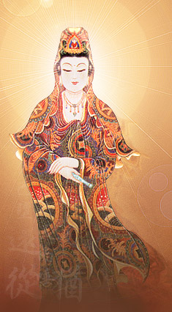
Key Concept 2.1: The development and codification of religious and cultural traditions
Belief systems often had effects on gender roles within states
Buddhism: encouraged women to join monastic life and rejected the caste system
Confucianism: emphasized filial piety and five relationships that placed men as the head of household
Christianity: allowed women to enter monastic life, preached salvation for all
Hinduism: caste system limits women from achieving moksha

Slide 12
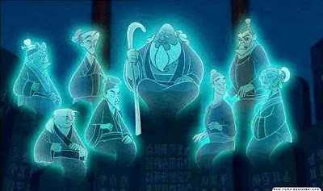
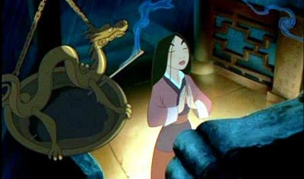
Key Concept 2.1: The development and codification of religious and cultural traditions
Other religions and cultural traditions continued parallel to the codified, written belief systems in core civilizations
Shamanism: “medicine man” who interacts with spirit world through altered states of consciousness
Animism: attribution of souls to plants, animals, and inanimate objects
Ancestor veneration: spirits of deceased ancestors look after the family and bring good fortune

Slide 13
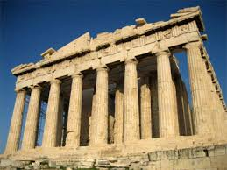
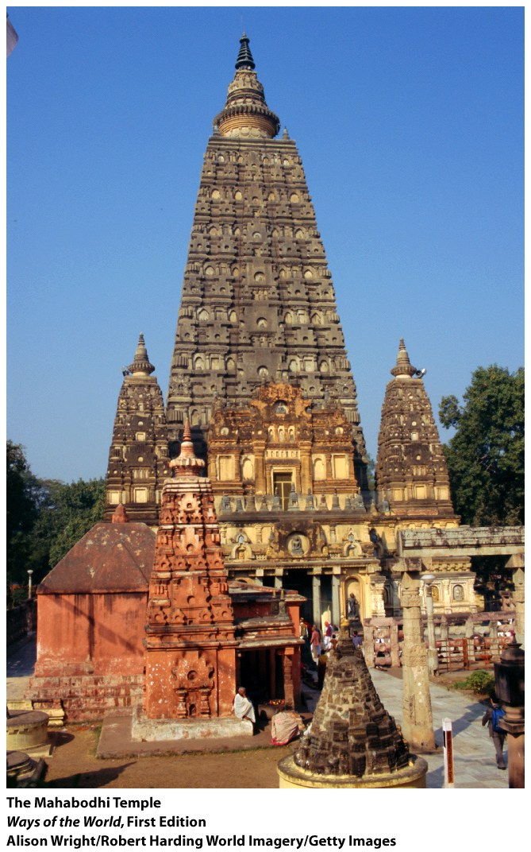
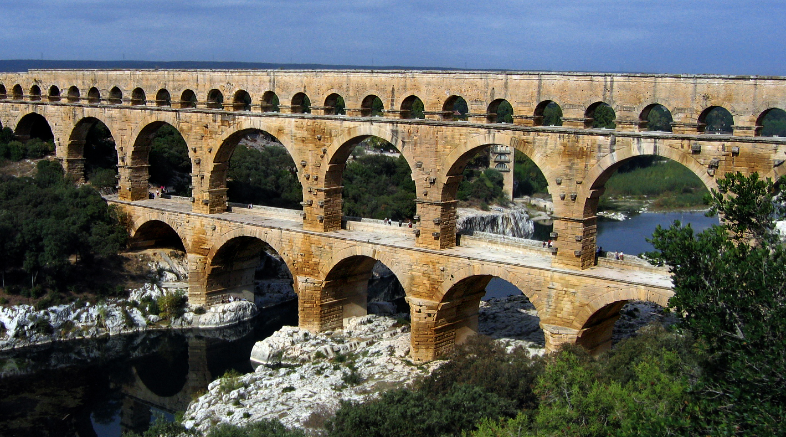
Key Concept 2.1: The development and codification of religious and cultural traditions
There were distinctive developments in literature, art, and architecture during this era
Literature: Greek plays and Indian epics
Architecture: Roman arches, Greek/Roman columns, aqueducts
Some religions and belief systems merged with local customs during this era
Syncretism: blending of different religions or cultures
Example: Greco-Roman philosophy and Buddhism

