Slide 1
AP Review
Unit 2.2

Slide 2
Key Concept 2.2: The Development of States and Empires in the Classical Period
Empire: a political unit made up of a number of territories or peoples under a single sovereign authority
The number and size of states and empires increased during the classical period

Slide 3
Key Concept 2.2: The Development of States and Empires in the Classical Period
Names and Locations of major classical empires:
Southwest Asia: Persian empire
East Asia: Qin dynasty and Han dynasty
South Asia: Mauryan Empire and Gupta Empire
Mediterranean: Phoenicia, Greek city states, Hellenistic empire, Roman empire
Mesoamerica: Teotihuacan and Maya city states
Andean South America: Moche

Slide 4
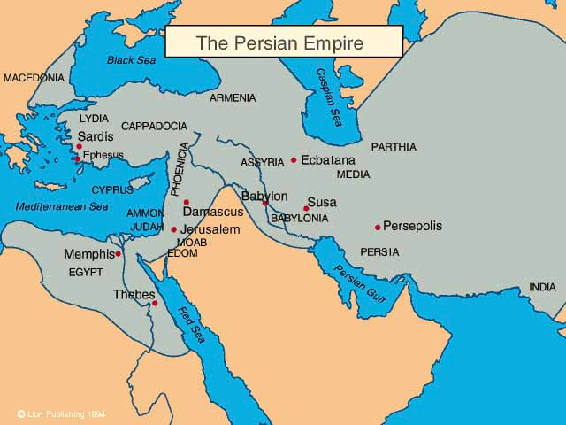
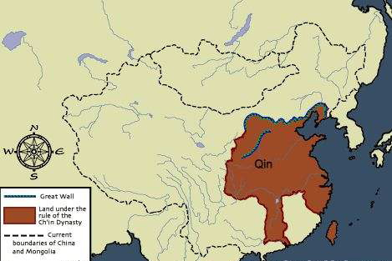
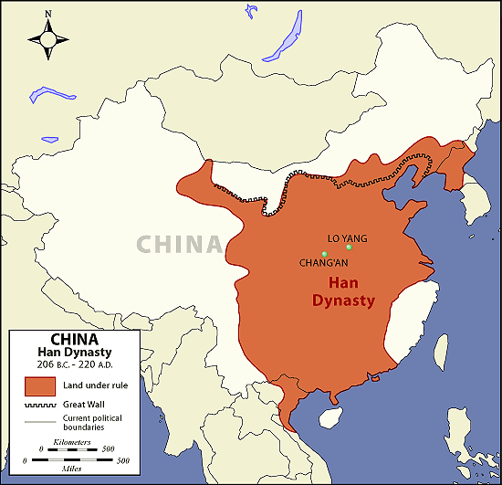
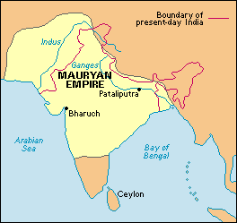
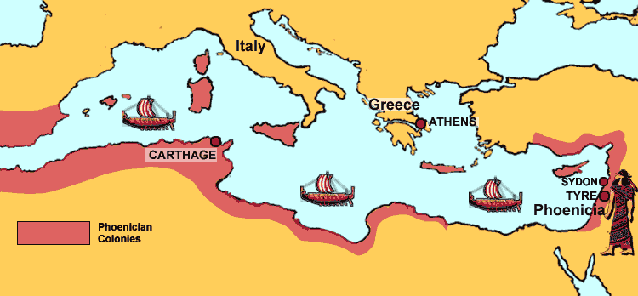
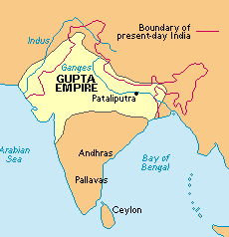

Slide 5
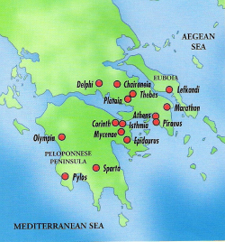
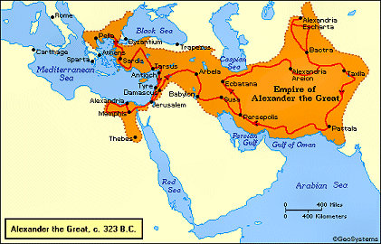
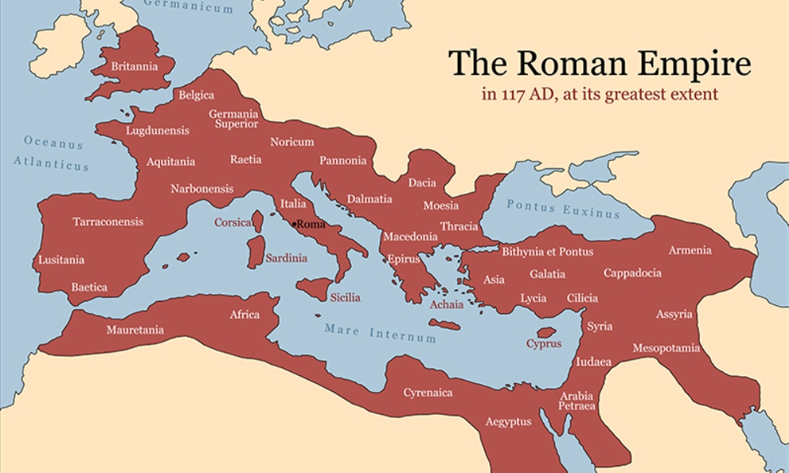
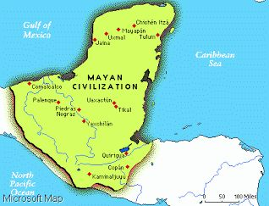
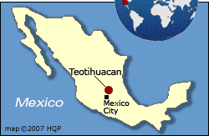

Slide 6
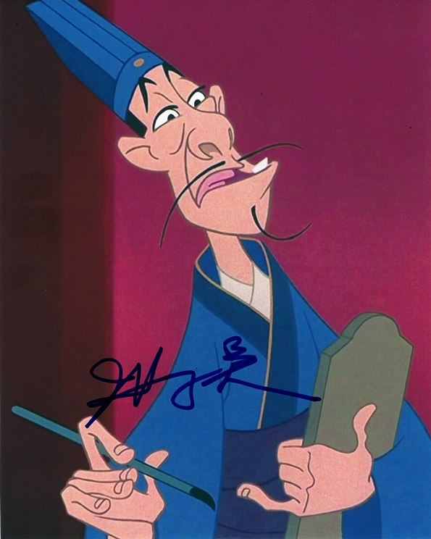
Key Concept 2.2: The Development of States and Empires in the Classical Period
Empires and states developed new techniques of imperial administration including:
Administrative systems:
1. centralized government: authority of governing rests in small group at highest level of government
2. bureaucracy: non-elective government officials
Military power:
Diplomacy
Developing supply lines
Building fortifications, defensive walls and roads
Drawing new military officers from conquered peoples
Trade:
Infrastructure: the basic physical structures and facilities needed for the operation of society
Public works: the work of building things such as roads, schools, an reservoirs by the government
Public work projects and standardized currencies created unity between diverse people groups within empires

Slide 7
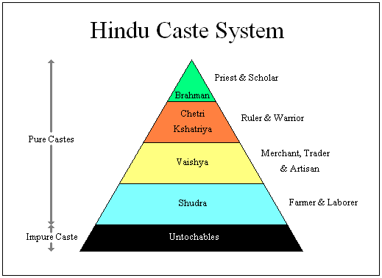
Key Concept 2.2: The Development of States and Empires in the Classical Period
The societies of all empires displayed hierarchies that included:
Cultivators
Laborers
Slaves
Artisans
Merchants
Elites
Cities served as centers for trade, religious rituals, and political administration
Examples: Athens, Rome, Carthage, Constantinople
Empires relied on slaves, family production, peasant communities, and rents/tributes for production of food sources
Patriarchy still defined gender roles in all classical empires

Slide 8
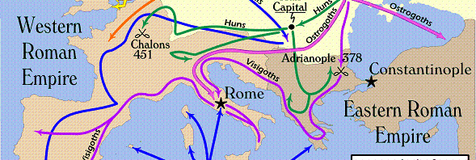
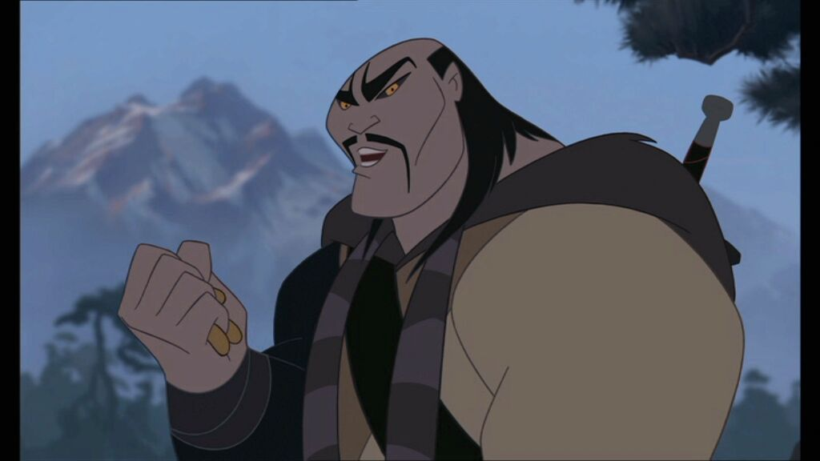
Key Concept 2.2: The Development of States and Empires in the Classical Period
Classical empires created political, cultural and administrative difficulties that they could not manage- eventually leading to their collapse
Social and Environmental problems:
Deforestation
Desertification
Soil erosion
Too much wealth in hands of elites
External Problems:
Security issues on their frontiers (threat of invasions)
Rome: Germanic Gothic tribes to the North
Han China: Xiongnu
Gupta: White Huns

Slide 9
Key Concept 2.2: The Development of States and Empires in the Classical Period
Differences
Similarities in Fall of Gupta, Han, and Roman empires
Attacks from outside invaders
All were at one time attacked by the Huns
Deterioration of political institutions (corruption and weak rulers)
Moral decline
Borders too large to defend
Population loss from disease
Guptas had regional princes that were allied together- those alliances broke apart contributing to collapse
Roman empire split in half before collapse and only the western half collapsed
Despite collapse of Han dynasty, the cycle of the Mandate of Heaven continued and built foundations for another empire that was largely similar to the Han in structure

