Slide 1
AP Review
Unit 2.3 - Trade

Slide 2
Key Concept 2.3: The emergence of trans-regional networks of communication and exchange
Trade networks of the classical period were larger in size and scope than those of the foundations era.
Things exchanged:
Tangible: goods (luxury goods), people, food crops, domesticated animals
Intangible: technology, religious/cultural beliefs, diseases

Slide 3
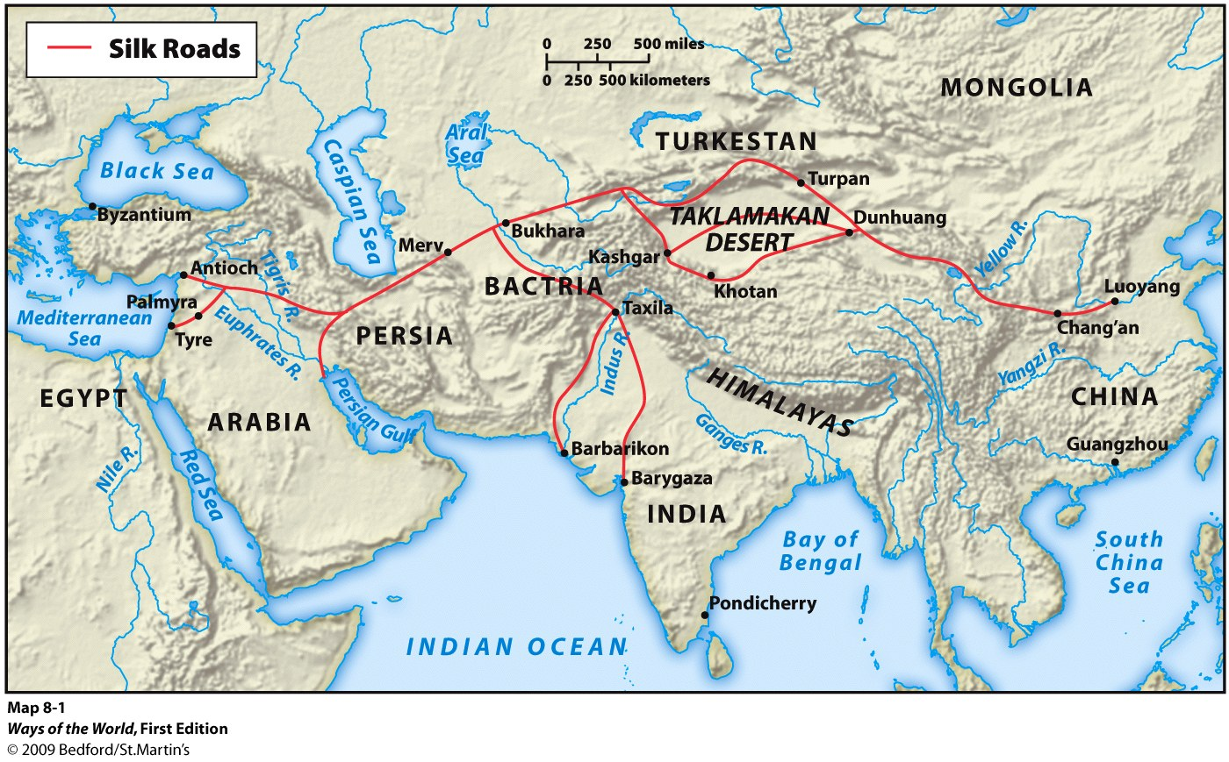
Key Concept 2.3: The emergence of trans-regional networks of communication and exchange
Empires:
Persian
Greek city-states
Hellenistic
Roman
Mauryan
Gupta
Qin dynasty
Han dynasty
Mongols
Items exchanged:
Luxury goods (silk, cotton, spices, slaves)
Ideas (Buddhism, Christianity)
Diseases
Technology (printing, gunpowder, paper, numerals)

Slide 4
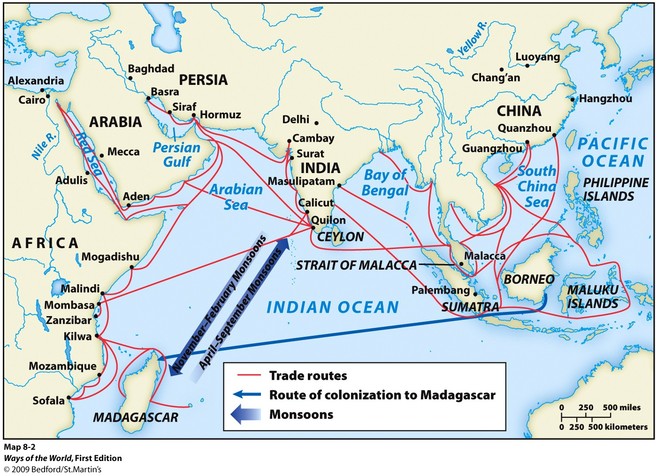
Key Concept 2.3: The emergence of trans-regional networks of communication and exchange
Empires:
Persian
Hellenistic
Roman
Mauryan
Gupta
East African city-states
Qin dynasty
Han dynasty
Southeast Asia
Items exchanged:
Luxury goods (silk, cotton, spices, slaves, exotic animals, gold)
Ideas (Buddhism, Christianity, Islam)
Diseases
Technology (compass, astrolabe)

Slide 5
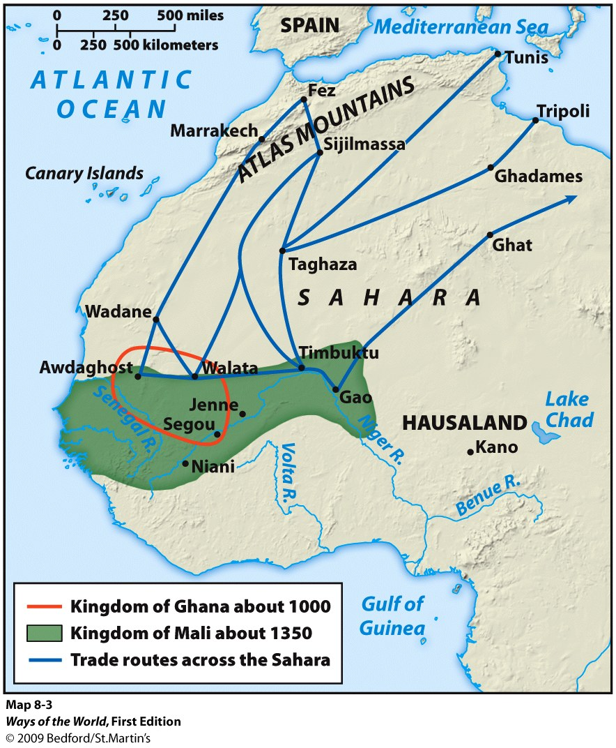
Key Concept 2.3: The emergence of trans-regional networks of communication and exchange
Empires:
Roman
Ghana
Mali
Songhai
Umayyad
Abbasid
Items exchanged:
Luxury goods (gold, salt, slaves, exotic animals, gold)
Ideas (Christianity, Islam)
Diseases
Technology (caravan)

Slide 6
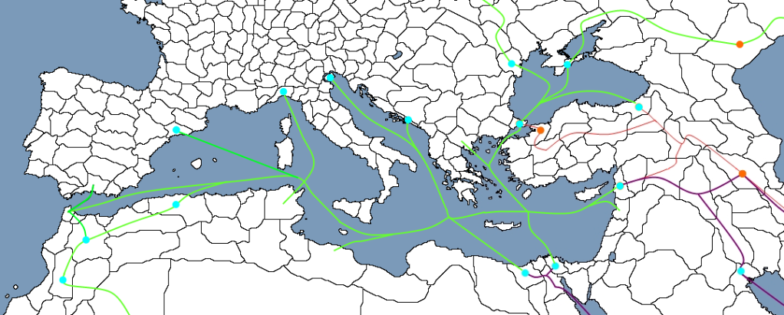
Key Concept 2.3: The emergence of trans-regional networks of communication and exchange
Empires:
Persian
Hellenistic
Roman
Phoenicia
Ghana, Mali, Songhai
Items exchanged:
Luxury goods (olives, wine, silk, slaves, exotic animals, gold)
Ideas (Christianity, Islam)
Diseases
Technology (caravan, philosophy, numerals)

Slide 7
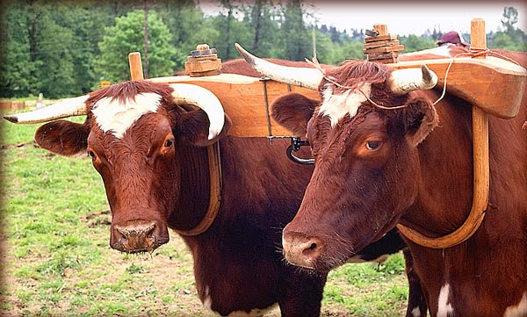
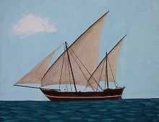
Key Concept 2.3: The emergence of trans-regional networks of communication and exchange
New technologies facilitated long distance overland communication and exchange including:
Yokes
Saddles
Stirrups
Permitting the use of domesticated pack animals such as:
Horses
Oxen
Llamas
Camels
New technologies facilitated long distance maritime travel such as:
Lateen sails
Dhow ships
Increased knowledge of monsoon winds

Slide 8
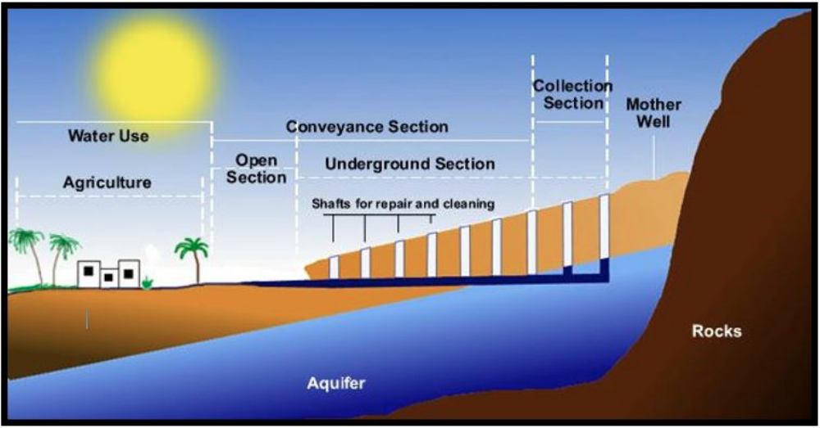
Key Concept 2.3: The emergence of trans-regional networks of communication and exchange
Crops spread along trade routes
Rice and cotton: S. Asia -> M. East
Sugar and citrus: SE. Asia -> S. Asia-> M. East -> N. Africa
New farming techniques developed because of trade
Example : Qanat system
New diseases spread through classical empires
Diminished populations (mostly in urban areas)
Deepened social divisions within empires
In some cases caused the collapse of empire

Slide 9
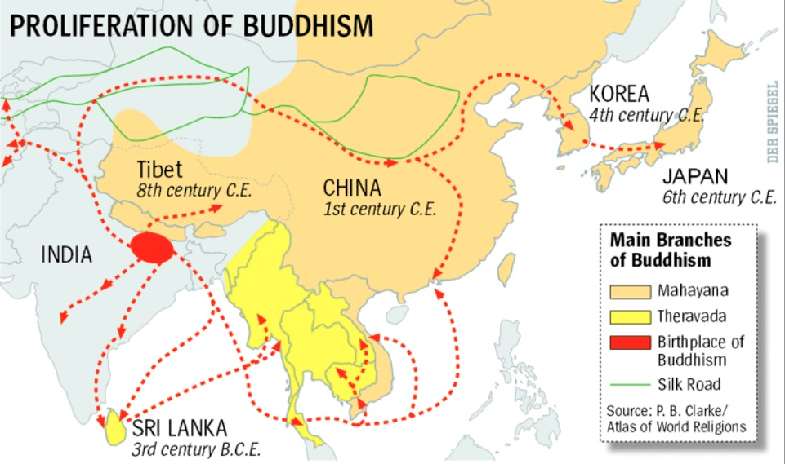
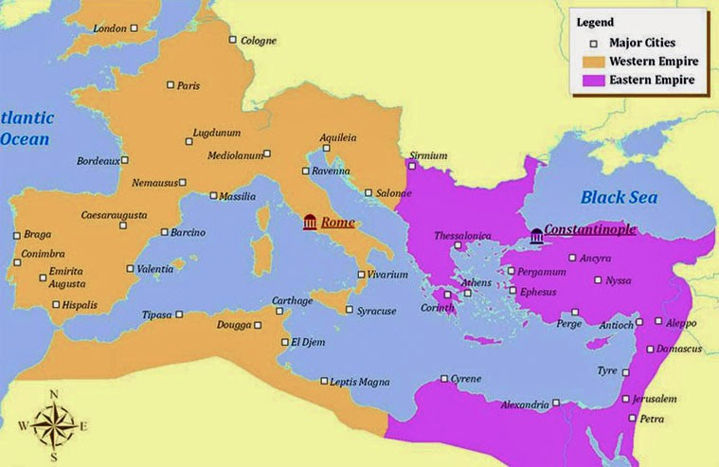
Key Concept 2.3: The emergence of trans-regional networks of communication and exchange
Religions transformed as they spread across trade routes:
Christianity:
Creation of formal church hierarchies with pope and bishops
New testament is written
Monasticism develops
Two sects created: Roman Catholic (western half of Roman empire) and Eastern Orthodox (Eastern half)
Buddhism:
Splits into 2 sects: Mahayana and Theravada
Adopts idea of Bodhisattvas (“saints” who have already achieved enlightenment but stay in this world as an example and helper for others)
Blends with Confucianism in China: becomes more patriarchal
Hinduism:
Addition of more personal, devotional gods (Bhakti)
Closer relationship between deity and worshipper

