Slide 1
AP Review: Unit 3 (Economy)
Post- Classical Era
600 CE- 1450 CE

Slide 2
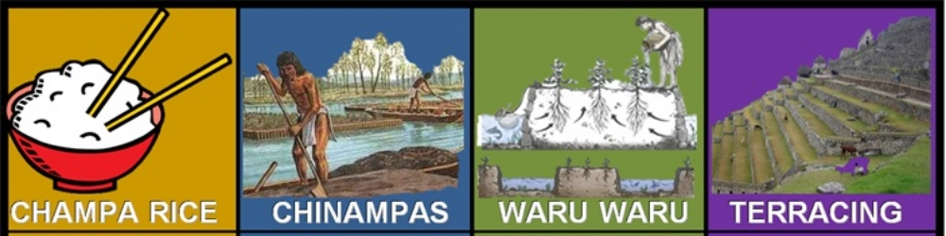
Key Concept 3.3: Increased economic productive capacity and its consequences
Economic trends of the Post-Classical period:
Productivity in agriculture and industry
Population growth led to urbanization and strained economic resources
Rise of new labor practices- especially coerced labor
Agricultural production increased significantly due to the following
Regions began to specialize in the export of specific goods
Textiles: China, India, and Persia
Porcelain: China
Steel and Iron: China

Slide 3
Key Concept 3.3: Increased economic productive capacity and its consequences
The fate of cities varied greatly, while cities in general continued to play the roles they had played in the past as governmental, religious, commercial centers, many older cities declined at the same time that new cities took on these established roles

Slide 4
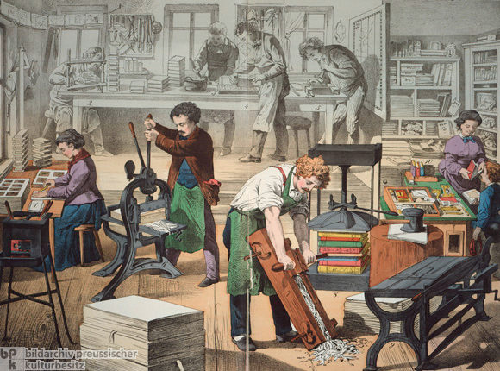
Key Concept 3.3: Increased economic productive capacity and its consequences
As in the previous period, there were many form of labor organization
1. Free peasant agriculture
2. Nomadic pastoralism
3. Craft production and guild organization
4. Coerced/ un-free labor
5. Government imposed labor taxes
6. Military obligations
Social status was largely still determined by class and patriarchy persisted
Women exercise more authority in the Mongol civilization, West Africa, Japan, and Southeast Asia

Slide 5
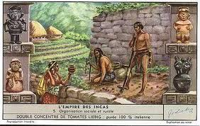
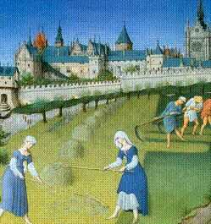
Key Concept 3.3: Increased economic productive capacity and its consequences
New forms of coerced labor developed during this era:
Serfdom in Europe and Japan
Mit’a in the Incan Empire
Free peasants resisted attempts to raise taxes by staging revolts in
China
Byzantine Empire

Slide 6
The diffusion of Buddhism, Christianity, Neo-Confucianism and Islam often led to significant changes in gender relations and family structure

