Slide 1
Unit 3
Post-Classical

Slide 2
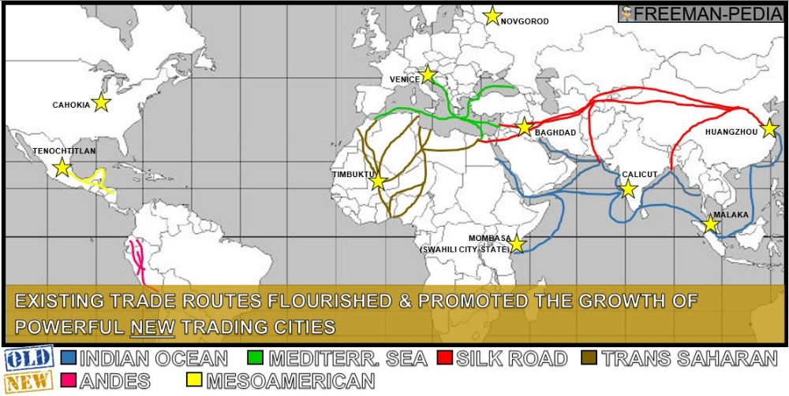
Key Concept 3.1: Regional and Trans-regional Interactions
Transportation technologies improved leading to: increased volume of trade AND expanded geographical range of existing trade networks

Slide 3
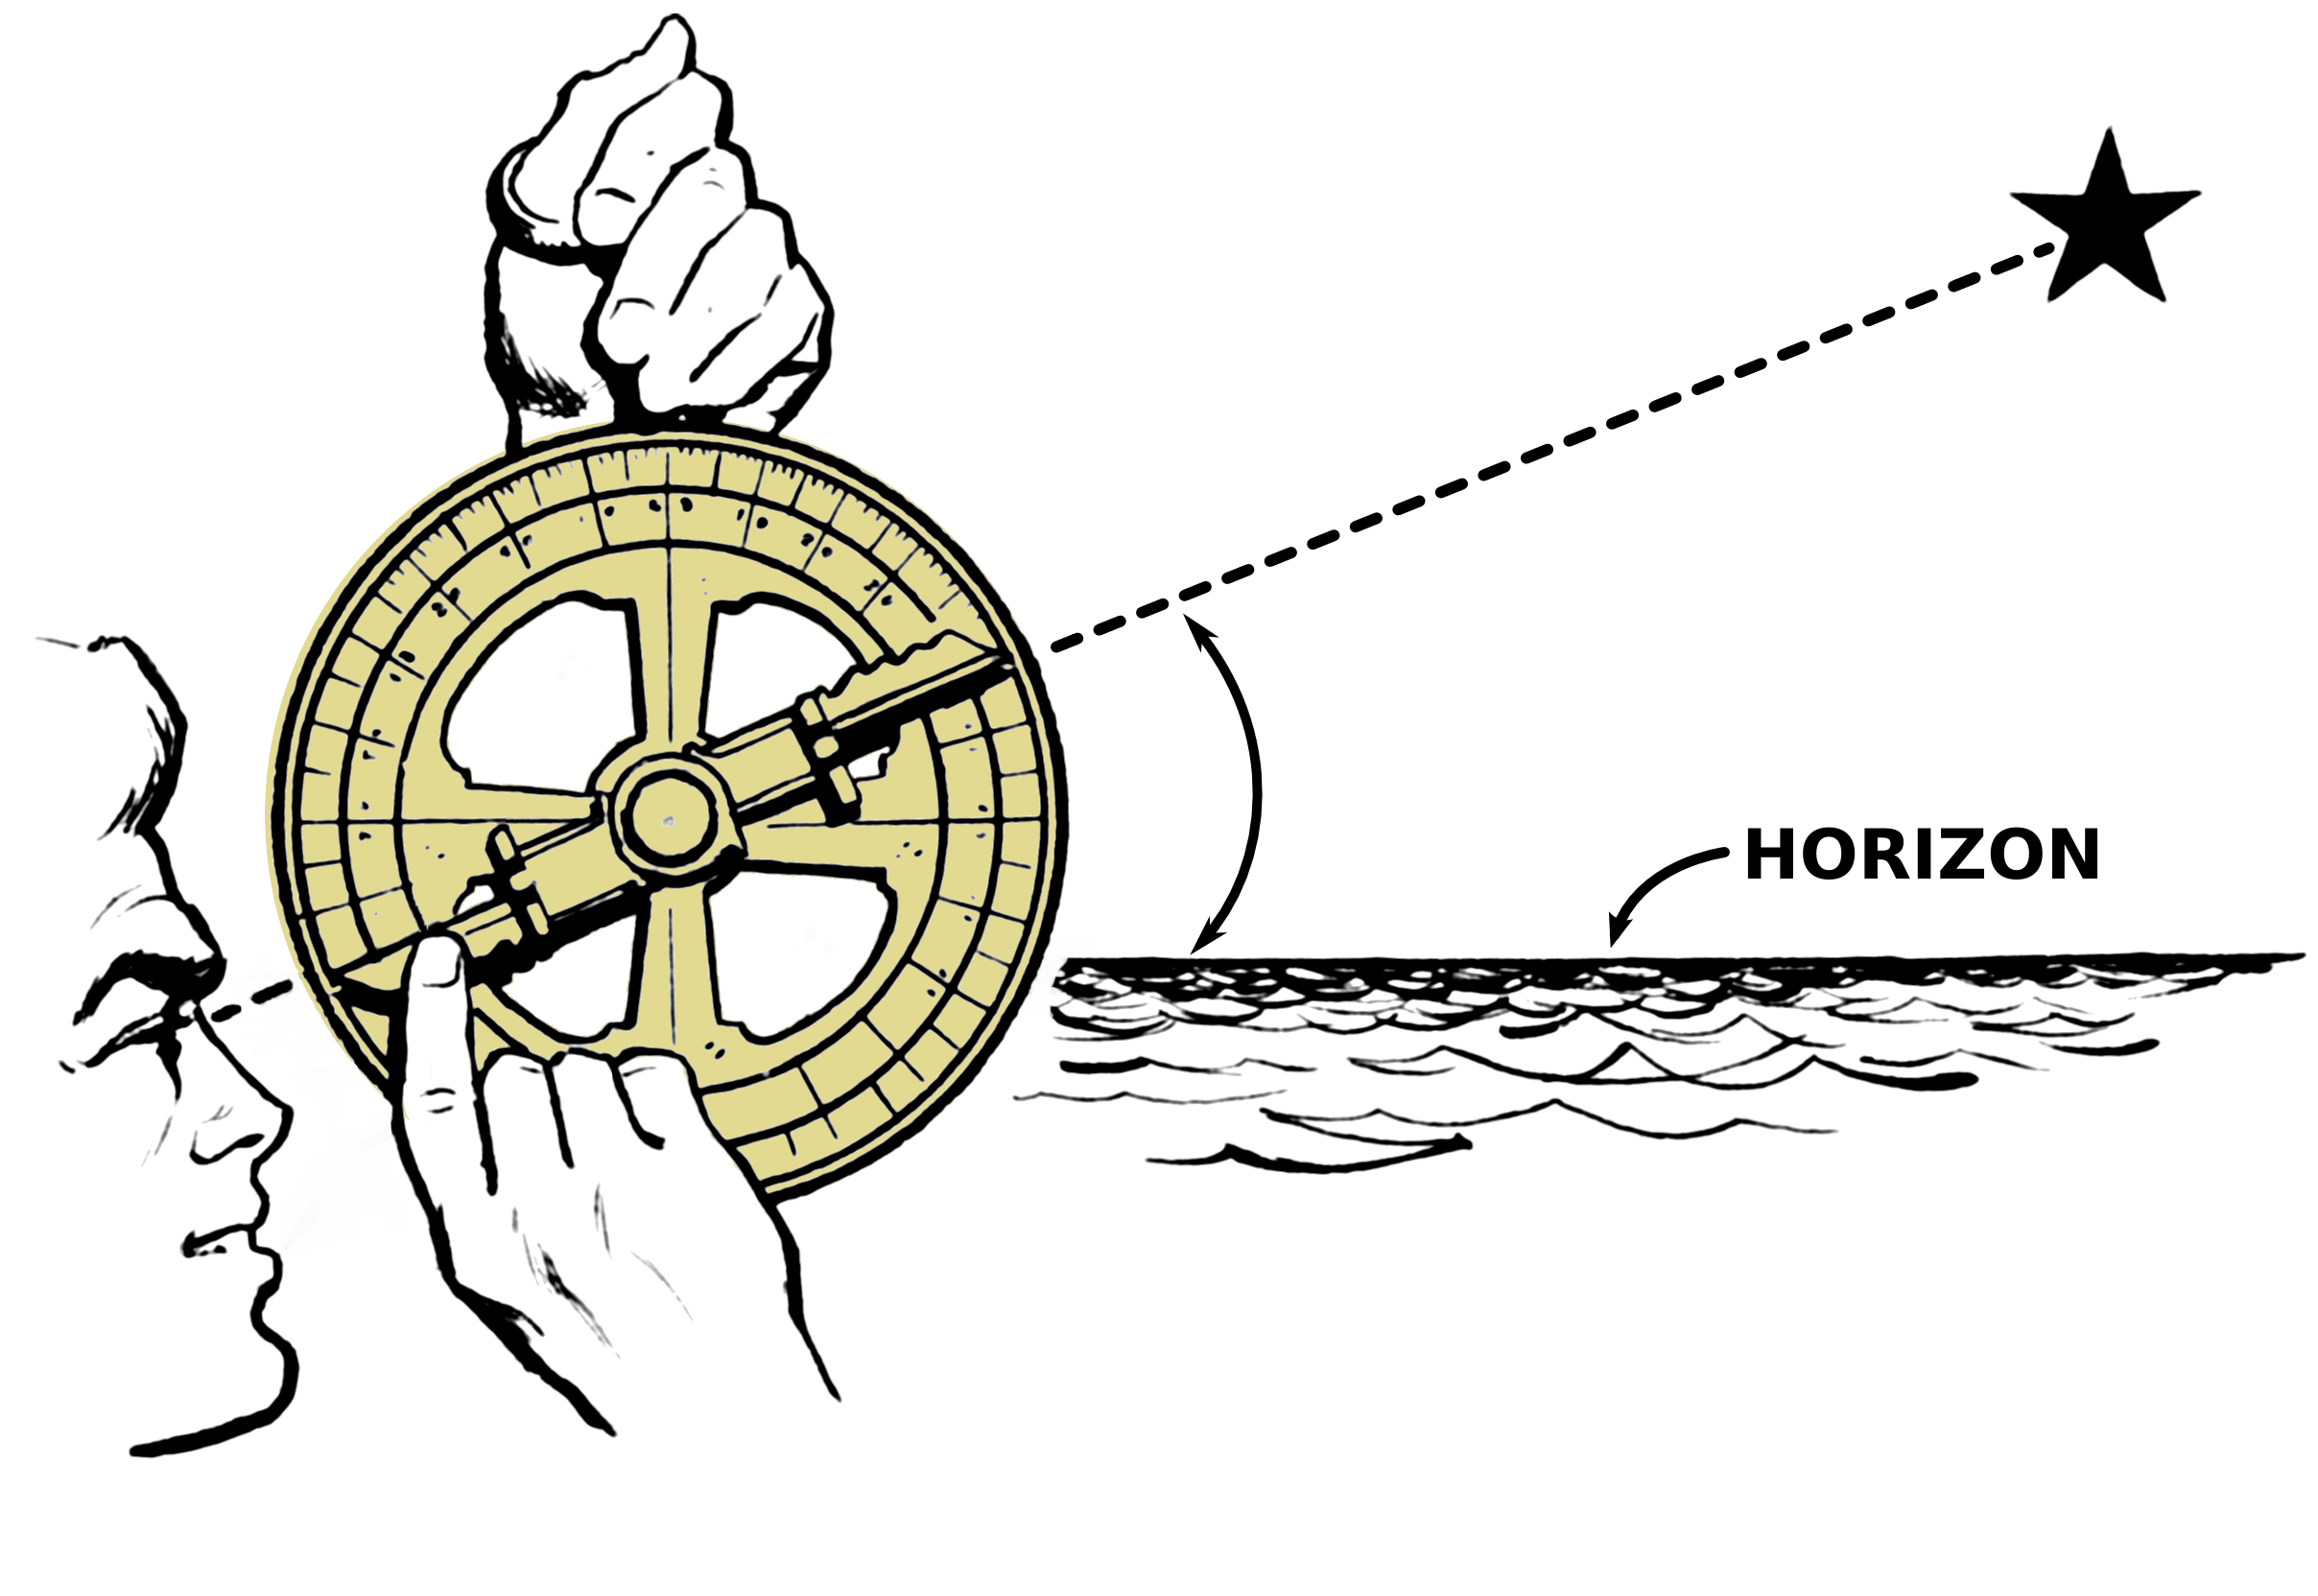
Key Concept 3.1: Regional and Trans-regional Interactions
There was a growth in the inter-regional exchange of luxury goods such as:
Silk
Cotton textiles
Spices
Porcelain
Precious metal/gems
Slaves
Exotic animals
New technologies were created that facilitated the exchange of luxury goods such as:
More sophisticated caravan organization
Compass and astrolabe
Larger ship design
New forms of credit and monetization (paper money, credit, banking houses)

Slide 4
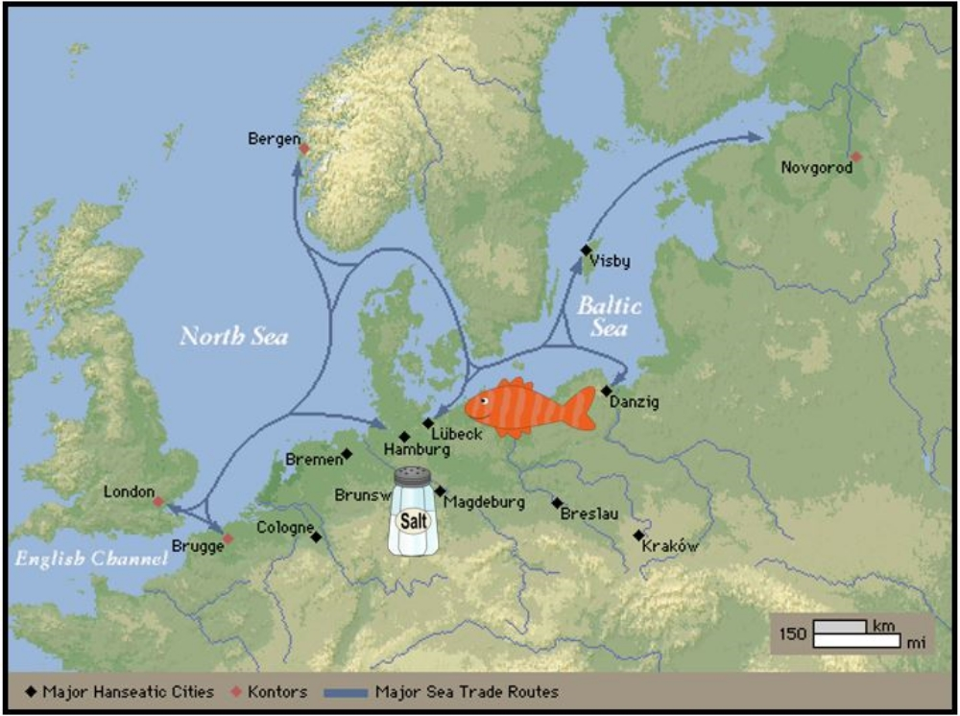
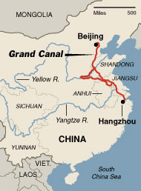
Key Concept 3.1: Regional and Trans-regional Interactions
3 factors encouraged commercial growth
1. New state practices: minting of coins and paper money
2. New trading organizations: Hanseatic League
3. New state-sponsored commercial infrastructures: Grand Canal in China

Slide 5
Key Concept 3.1: Regional and Trans-regional Interactions
Empires that existed in the Post-classical period that facilitated growth in trade
Example empires:
China: Sui, Tang, and Song Dynasties
Byzantine empire
Islamic Caliphates: Umayyads and Abbasids
Mongol Empire
How they facilitated growth in trade:
Conquest brought new people into their economies and trade networks

Slide 6
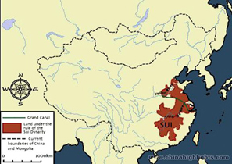
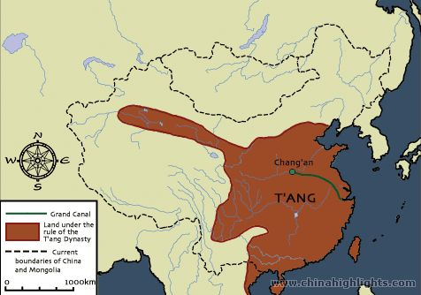
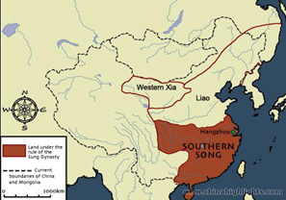
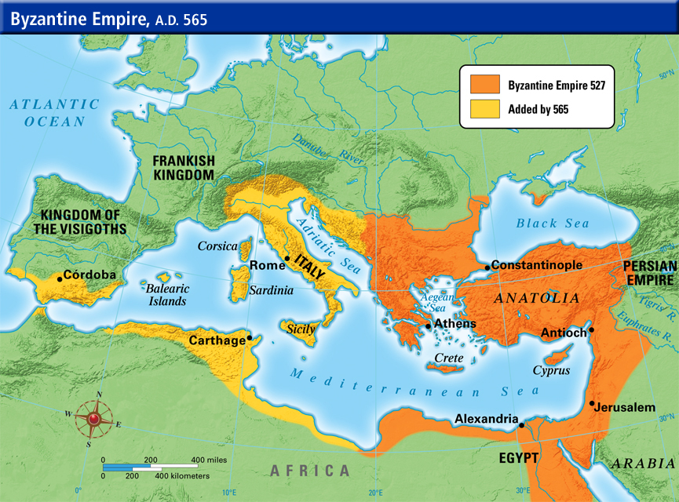
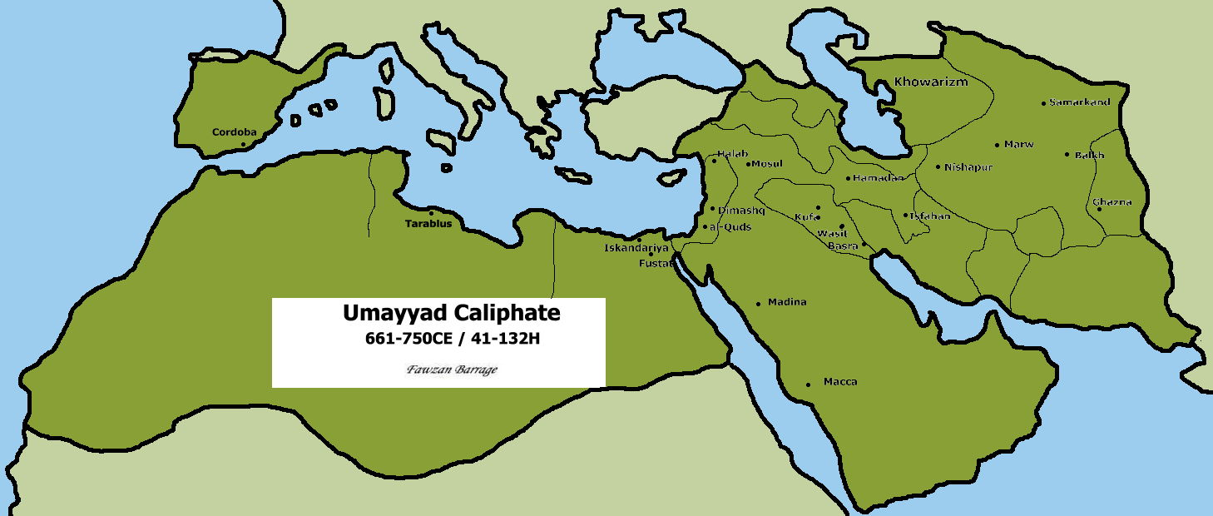
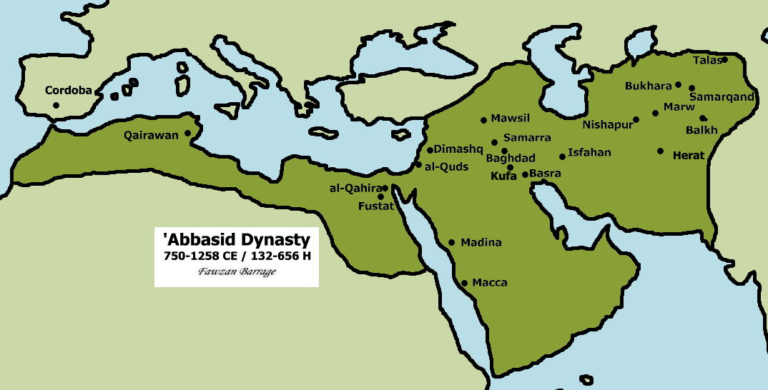

Slide 7
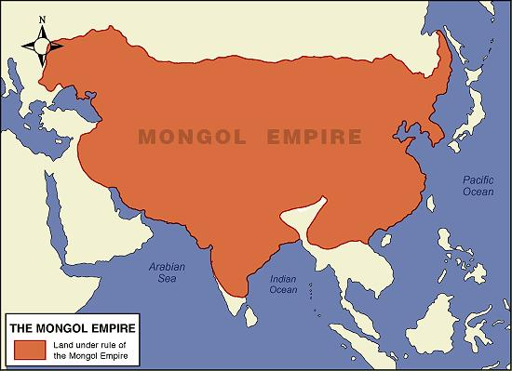
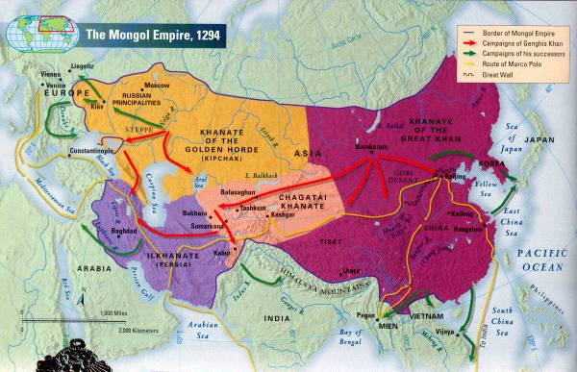

Slide 8
Key Concept 3.1: Regional and Trans-regional Interactions
The expansion of long-distance trade and migration depended on knowledge of the environment and changing adaptations to it
Examples: Vikings and their longships, Arabs/Berbers use of camels, Pastoralists use of horses
New migrations impacted the environments of newly inhabited regions
Bantus: spread iron working technology in Sub-Saharan Africa
Polynesians: transplanted food and animals into different islands in Oceania
Migrations also caused the diffusion of languages
Examples: Bantus spread Swahili, Arabs spread Arabic

Slide 9
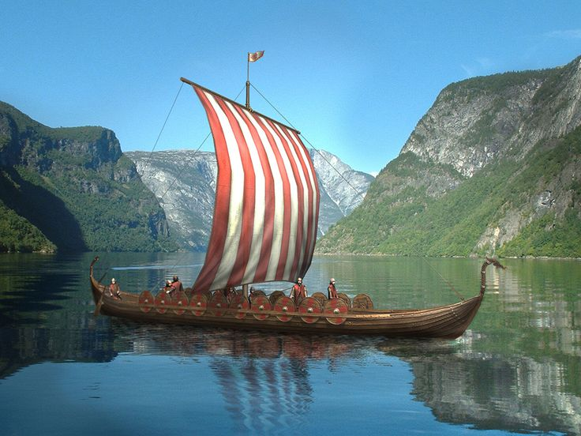
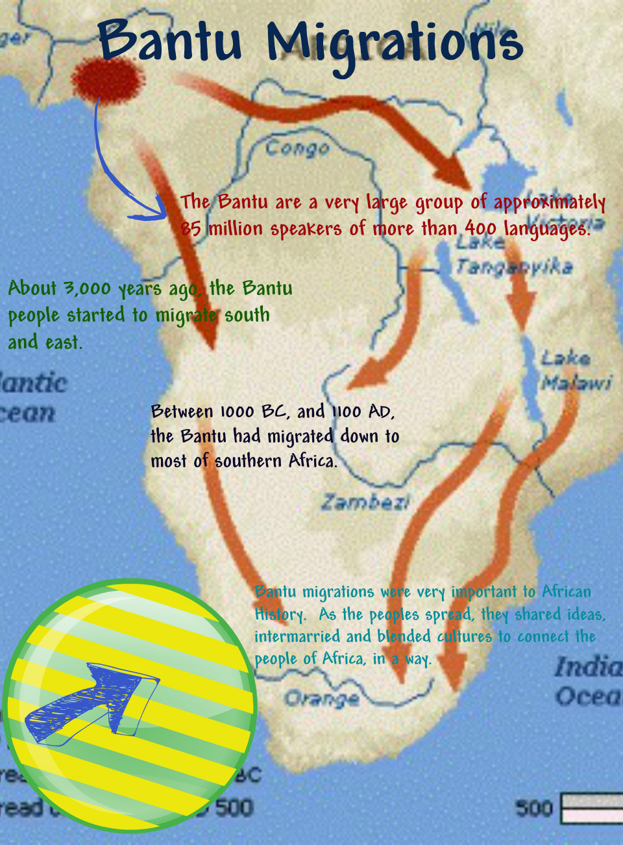
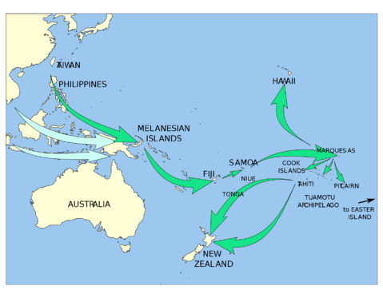

Slide 10
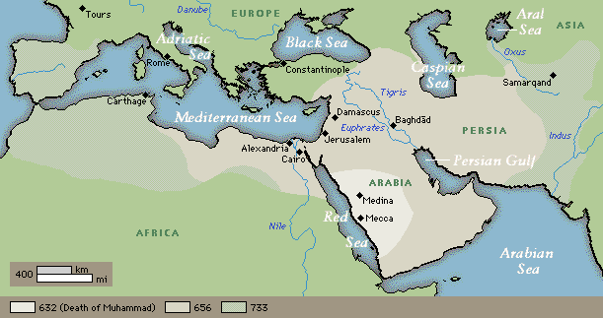
Key Concept 3.1: Regional and Trans-regional Interactions
Cross cultural interaction (cultural diffusion) increased because of trade networks
New religion of Islam spread in Mediterranean world
Origin/founder
Arabian Peninsula
Muhammad
Core teachings
Monotheism (Allah- same god as Judaism and Christianity)
5 pillars of faith
Muhammad is last prophet
Method/Location of diffusion
Mediterranean world, Middle East, South and Southeast Asia
Military conquest, merchant activity, missionaries

Slide 11
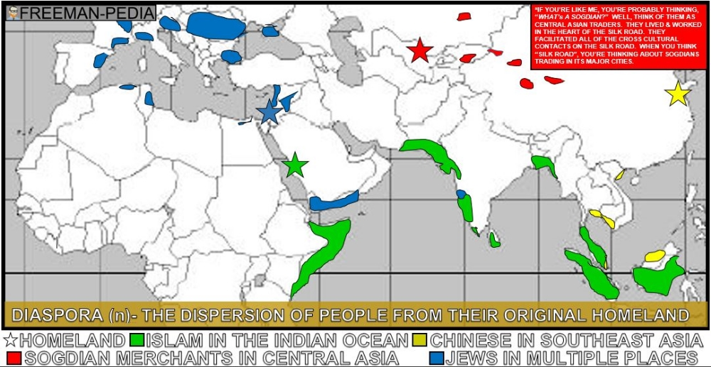
Key Concept 3.1: Regional and Trans-regional Interactions
Merchant activity created Diasporic communities in the Post-Classical period
Diasporic community: Community of peoples who have been dispersed from their ancestral homeland

Slide 12
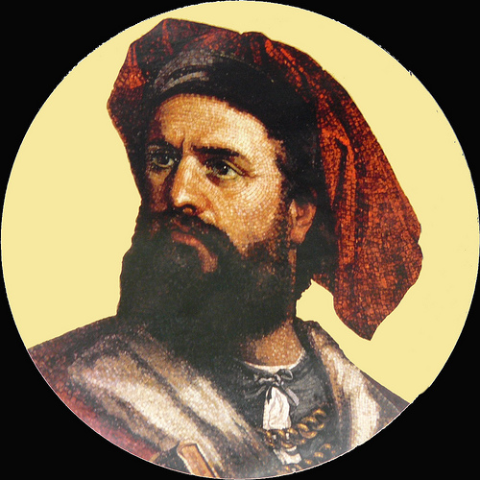
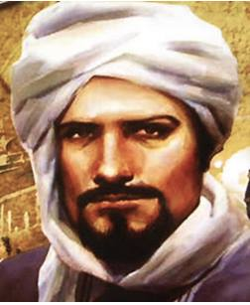
Key Concept 3.1: Regional and Trans-regional Interactions
Writings of inter-regional travelers illustrate the extent and limitations of intercultural knowledge
Marco Polo
Ibn Battuta
Literature, art and cultural traditions diffused to new regions as a result of trade relationships
Islam in Sub-Saharan Africa and South Eat Asia
Neoconfucianism in East and Southeast Asia
NeoConfucianism: literally means “New-Confucianism”, in practice was a more secular form of Confucianism that rejected “spiritual” aspects that had been accepted from Taoism
Science and technology also diffused as a result of increased trade
Greek and Indian mathematics -> Muslim scholars
Printing and gunpowder from East Asia -> Europe and Middle East
Greek philosophy from Middle East- > Western Europe

Slide 13
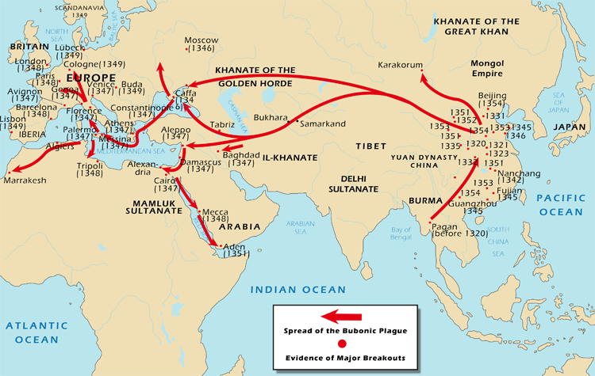
Key Concept 3.1: Regional and Trans-regional Interactions
New crops and pathogens spread to world regions as a result of increased trade and changed the biological make-up of world regions
New foods that spread:
Bananas in Africa
Champa rice in East Asia
Cotton, sugar, and citrus in Mediterranean region
Diseases that spread:
Bubonic plague (black death)

Slide 14
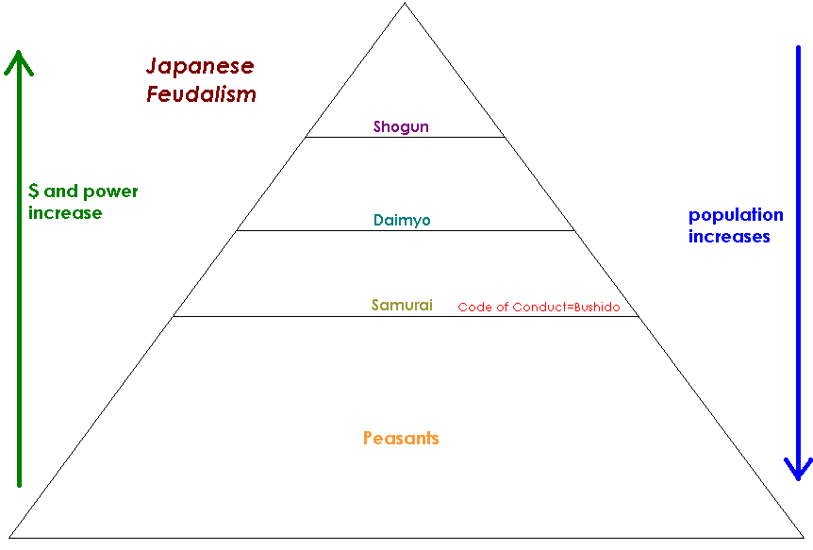
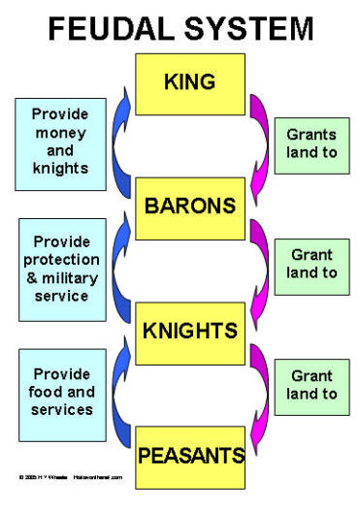
Key Concept 3.2: Continuity and innovation of state forms and their interactions
Some changes in state formation during this era included:
The rise of decentralized governments (feudalism in Japan and Western Europe)
Pastoralists created empires (Mongols)
The caliphate emerged in the Islamic world
Some new empires emerged out of the foundations laid in the classical period
Byzantine empire
Sui, Tang, and Song dynasties in China
New empires avoided the mistakes of the past by:
Combining traditional sources of authority (patriarchy, religion, and landowning elites)
With innovations (new taxation methods, tributary systems, adaptations to religious beliefs)

Slide 15
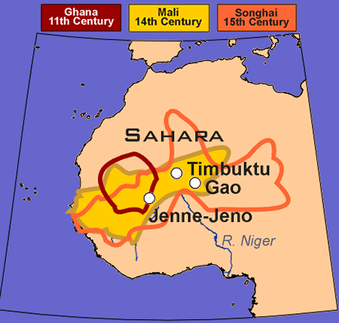
Key Concept 3.2: Continuity and innovation of state forms and their interactions
New forms of government emerged in all the following places:
Middle East: Caliphates (Islamic states)
Umayyad and Abbasid
Central Asia: Mongol Khanates
Western Europe and Japan: Feudalism
East Africa, Southeast Asia, the Americas, and the Italian peninsula: city-states
West Africa: kingdoms
Ghana, Mali, Songhai
Some states synthesized or borrowed traditions
Chinese traditions adopted in Japan

Slide 16
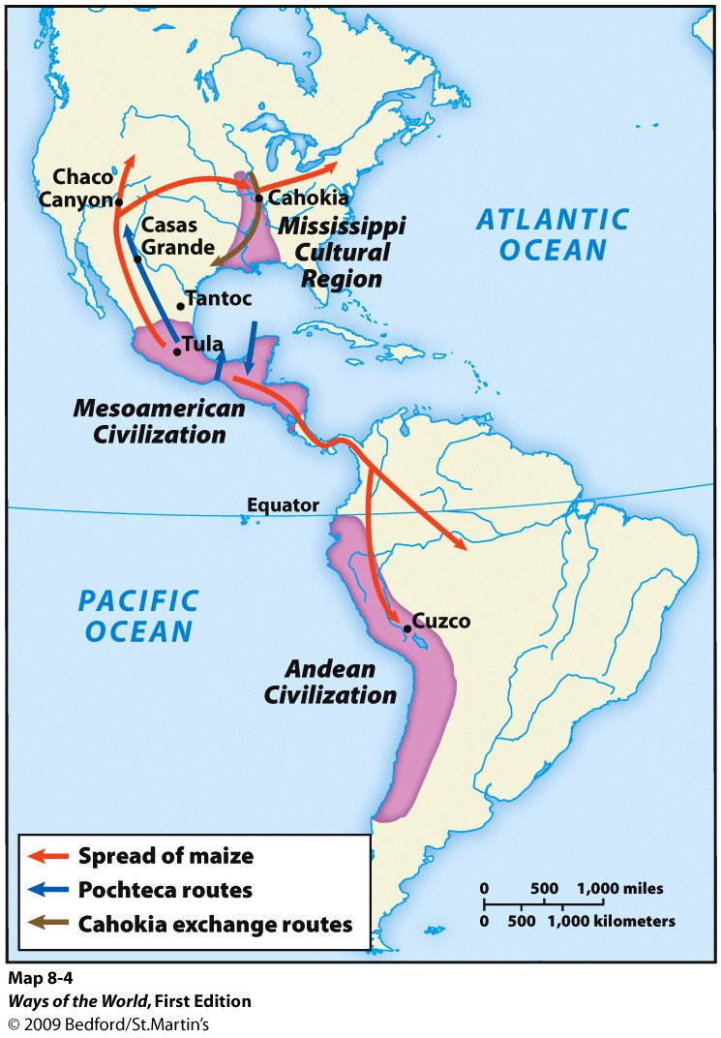
Key Concept 3.2: Continuity and innovation of state forms and their interactions
In the Americas, trade and state systems expanded in size and scope
Aztec and Inca empires formed
Inter-regional contacts and conflicts affected trade
Tang dynasty and Abbasid Caliphate:
Adoption of printing, paper, and gunpowder technology from China
Unification of Mongol empire:
Increased safety and ease of travel on Silk roads
Crusades:
Greek philosophy, Arabic numerals, and Chinese technologies (listed above) brought to Europe

