Slide 1
Unit 4.1 pt2
Early Modern
1450 CE- 1750 CE

Slide 2
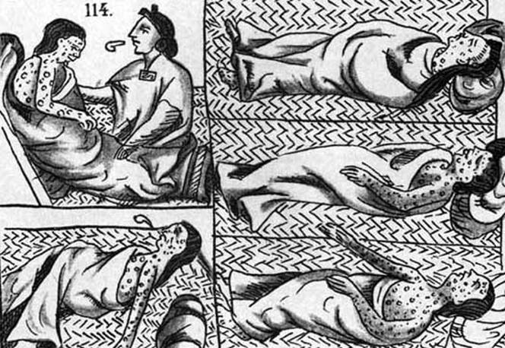
Key Concept 4.1: Globalizing networks of communication and exchange
The New connection between the East and the West became known as the Columbian Exchange
Biological effects of the exchange:
Increased spread of diseases (smallpox, measles, influenza) -> endemic to Amerindian populations
Unintentional transfer of vermin (rats and mosquitoes)

Slide 3
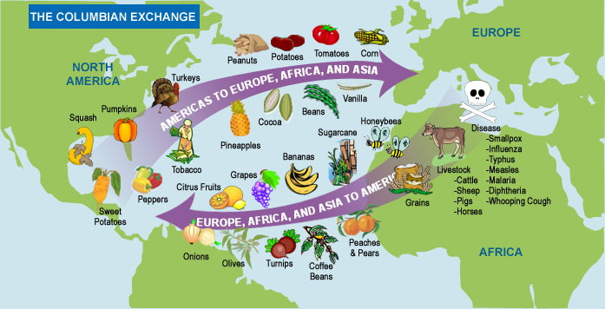
Key Concept 4.1: Globalizing networks of communication and exchange
American foods became staple crops in Europe, Asia, and Africa
Potatoes
Maize
Manioc
New cash crops were being grown in the Americas and exported abroad
Sugar
Tobacco

Slide 4
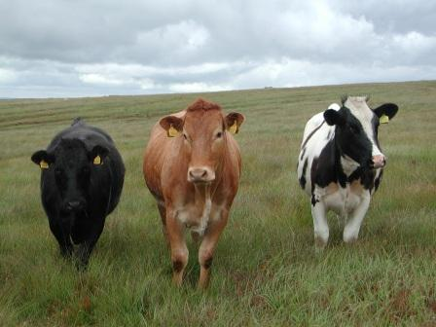
Key Concept 4.1: Globalizing networks of communication and exchange
Afro-Eurasian plants and animals were brought to the Americas
Fruit trees
Grains
Sugar
Horses
Cattle
Pigs
Foods were also brought by African slaves to the Americas
Okra
Rice

Slide 5
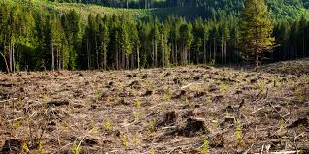
Key Concept 4.1: Globalizing networks of communication and exchange
Populations in Afro-Eurasia increased from the nutritional benefits of American crops
Sweet potato in Asia
Potato and Maize (corn) in Europe
The environment in the Americas was negatively affected by European agricultural practices
Deforestation
Soli depletion

Slide 6
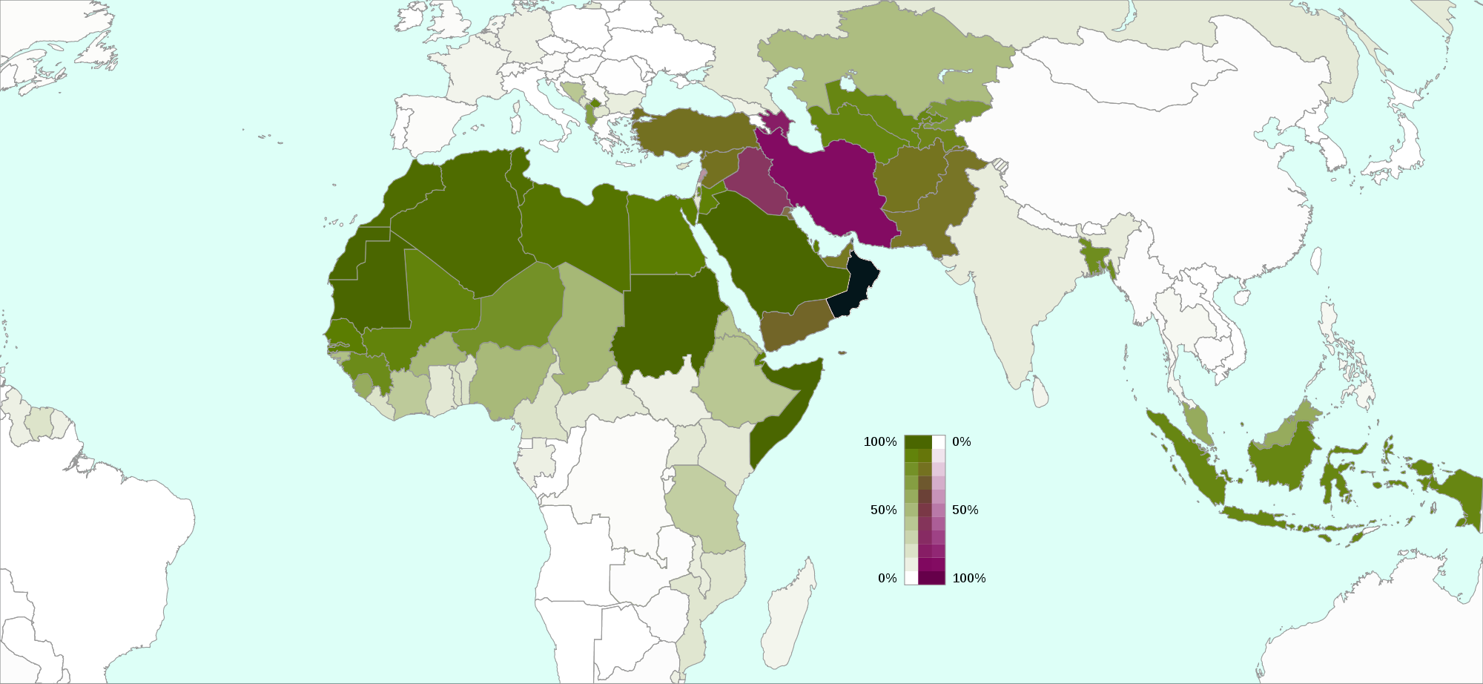
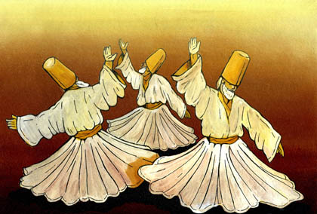
Key Concept 4.1: Globalizing networks of communication and exchange
The Columbian exchange affected the spread of religions on the following ways:
Expanded the spread of religions
Caused reforms to existing religions
Created syncretic beliefs systems
Islam spread to Afro-Eurasia
Split between Sunni and Shi’a intensified
Sufi practices became more widespread

Slide 7
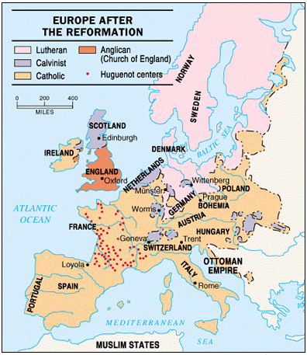
Key Concept 4.1: Globalizing networks of communication and exchange
Christianity spread to the Americas and within Africa and Asia
During this period the Protestant Reformation created a new sect of Christianity in Europe that helped encouraged competition between Catholics and protestants in converting Amerindians

Slide 8
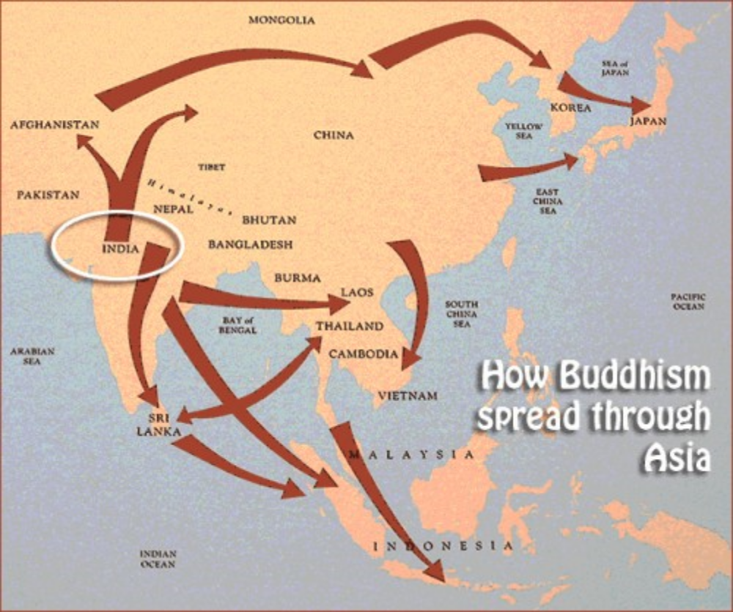
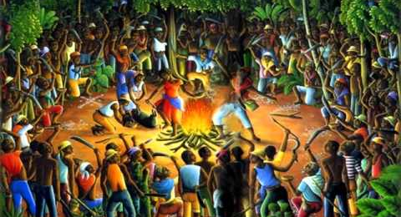
Key Concept 4.1: Globalizing networks of communication and exchange
Buddhism spread throughout Asia
Syncretic and new forms of religions were created and spread
Vodun in the Caribbean
Sikhism in South Asia

Slide 9
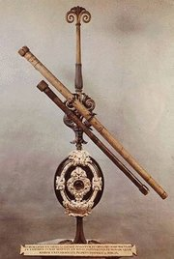
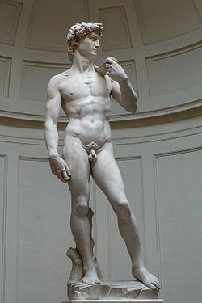
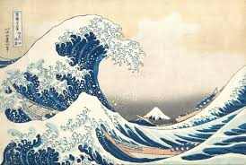
Key Concept 4.1: Globalizing networks of communication and exchange
As merchants’ profits increased and governments began collecting more taxes, funding for the arts increased
Innovations in visual and performing art took place
Renaissance in Italy
Woodblock prints and kabuki theatre in Japan
Advances in Science occurred in Europe during the Scientific Revolution
Scientific Revolution: emergence of modern science with developments in math, physics, astronomy, biology, and chemistry

Slide 10
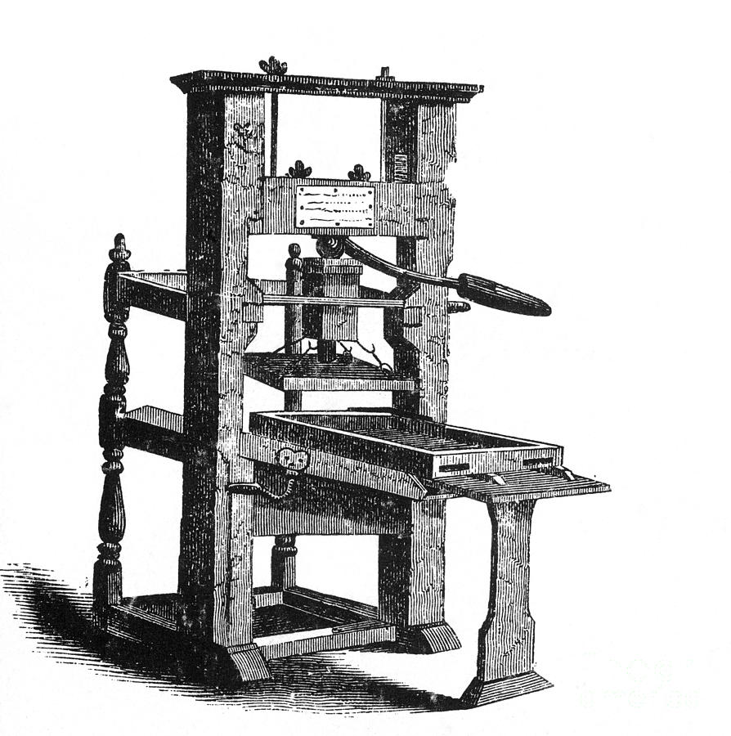
Key Concept 4.1: Globalizing networks of communication and exchange
Literacy increased and made authors more popular
Shakespeare
Cervantes (Don Quixote)
Increased literacy was aided by the spread of printing technology and the printing press
Originally developed in China
Made popular in Europe by Johannes Gutenberg

