Slide 1
AP Review: Unit 4.2 (Society and State)
Early Modern Era
1450 CE-1750 CE

Slide 2
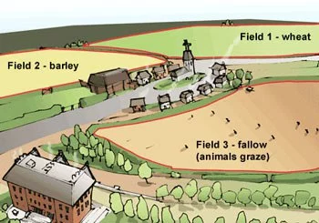
Key Concept 4.2: New forms of social organization and modes of production
There was an increase in agricultural activity in this era as a result of:
Crop rotation techniques
Introduction of new crops
Merchants status rose in most societies
Demographic growth surged in most places
Even after the initial decline in population in the Americas due to the spread of disease
There was also a rise in mixed-race people groups as a result of increased migrations
mestizos and mulattos
New forms of coerced labor developed

Slide 3
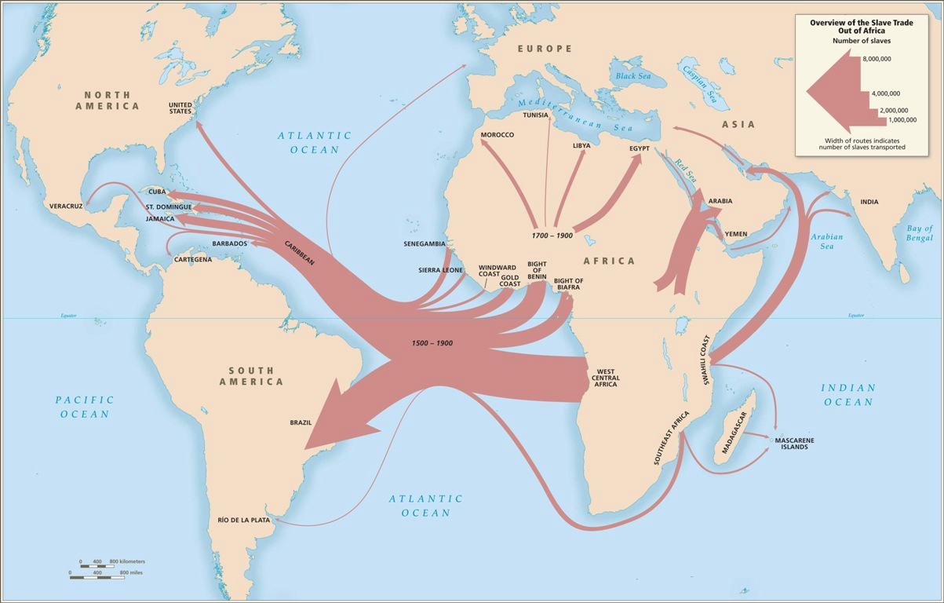
Key Concept 4.2: New forms of social organization and modes of production
Peasant labor intensified in many regions (more workers were needed)
Cotton textile production in India
Silk production in China
African slaves continued to be exported to the Mediterranean region, Middle East, and Indian Ocean basin predominantly as household servants
There was an increased demand for slaves in the Americas
Africans proliferated the slave trade by selling other Africans to Europeans as slaves in exchange for guns

Slide 4
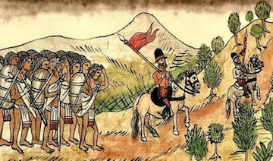
Key Concept 4.2: New forms of social organization and modes of production
As the plantation economy grew in the Americas- the demand for African slaves increased
Colonial economies depended on a range of coerced labor systems
Chattel slavery
Encomienda
Spanish adaptation of the Incan mit’a system
Indentured servitude

Slide 5
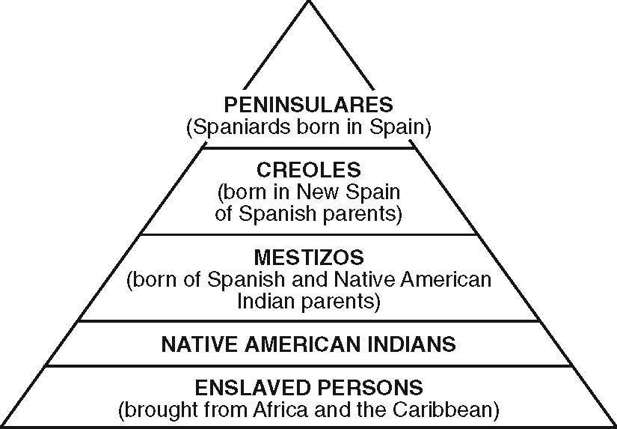
Key Concept 4.2: New forms of social organization and modes of production
The migrations of peoples caused restructuring in ethnic, racial, and gender hierarchies
New elite groups emerged:
Manchus in China
Creoles in Spanish America
The power of exiting elites fluctuated and often declined as the power of monarchs increased

Slide 6
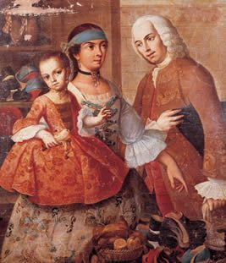
Key Concept 4.2: New forms of social organization and modes of production
Gender roles and family structures were affected by these global interactions
Southeast Asia: Women dominate trade
Europe: family sizes shrink
Africa: disproportionate number of women as men are sold into slavery
Americas: disproportionate number of European males causes intermarriage with native and slave women
New racial groups were created in the Americas:
Mestizo, mulatto, creole

