Slide 1
AP Review: Unit 5.1 (Industrialization)
Modern Era
1750 CE-1914 CE

Slide 2
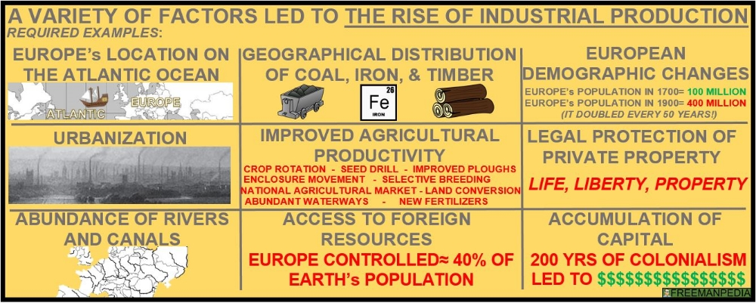
Key Concept 5.1: Industrialization and global capitalism
Industrialization fundamentally changed how goods were produced- ultimately making it easier for goods to circulate globally

Slide 3
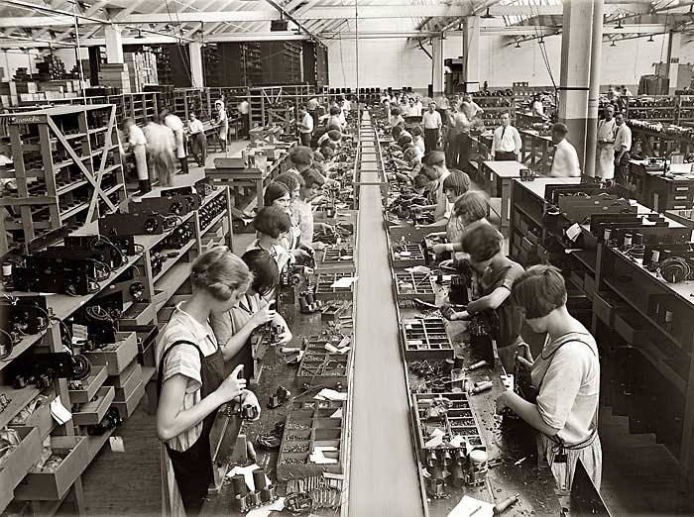
Key Concept 5.1: Industrialization and global capitalism
The industrial revolution was fueled by the development of machines that utilized the power of fossil fuels- specifically coal and oil
Steam engine
Internal combustion engine
The development of the factory system concentrated labor in a single location and led to an increasing degree of specialization of labor

Slide 4
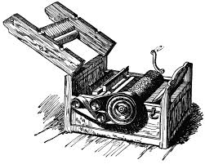
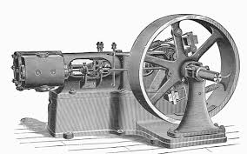
Key Concept 5.1: Industrialization and global capitalism
The industrial revolution began in great Britain and then spread elsewhere:
Other parts of Europe (Germany, France)
United States
Russia
Japan
During the second half of the 19th century, the second industrial revolution began with a focus on:
Steel
Chemicals
Electricity
Precision machinery

Slide 5
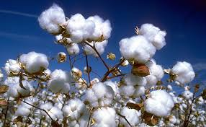
Key Concept 5.1: Industrialization and global capitalism
The global economy became further integrated leading to new patterns of global trade as industrialists sought
Raw materials
New markets for their factory produced goods
Export economies were created to specialize in the mass production of a single natural resource
Cotton
Rubber
Palm oil
Sugar
Wheat
Meat
Guano

Slide 6
Key Concept 5.1: Industrialization and global capitalism
Agricultural based economies (such as cotton textile production in India) declined in response to rising popularity of industrialization
A rapid increase in production levels caused industrial states to seek out new markets to sell finished goods
British and French open up Chinese markets
USA opens up trade with Japan
The global demand for gold, silver, and diamonds as forms of wealth increased
Caused increased mining activity

Slide 7
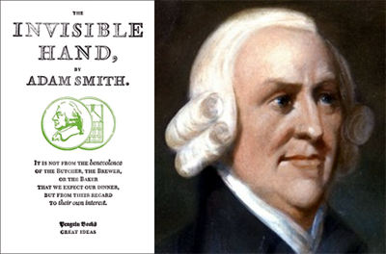
Key Concept 5.1: Industrialization and global capitalism
The global nature of trade led to the creation of trans-national businesses
New ideologies developed to legitimize industrial production
Capitalism and classical liberalism: Adam Smith and John Stuart Mill
To facilitate investments at all levels, financiers developed and expanded various financial institutions such as:
Stock markets
Insurance
Limited liability corporations
Gold standard

Slide 8
Key Concept 5.1: Industrialization and global capitalism
There were major developments in transportation and communication technology as a result of industrialization
Railroads
Steamships
Canals
Telegraphs

Slide 9
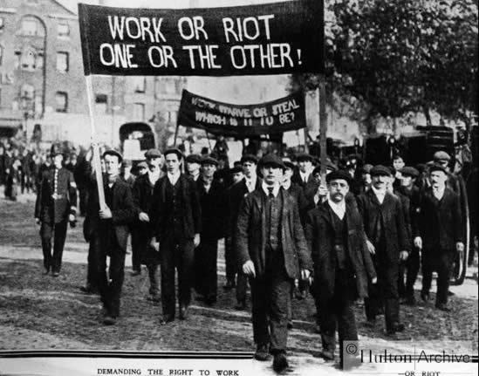
Key Concept 5.1: Industrialization and global capitalism
The development and spread of global capitalism led to a variety of responses
Response of workers:
1. Organized to demand higher wages, limit working hours, and improve conditions
2. Opposed capitalism and offered alternative visions of society (Socialism, Marxism/Communism)
*** Capitalism is a free market economy where everything is privately owned. Communism promotes collective ownership where all things are shared in common.

Slide 10
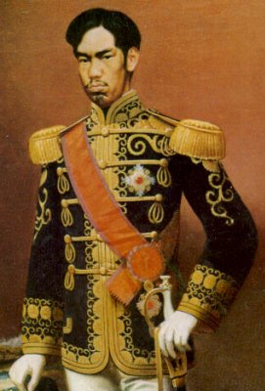
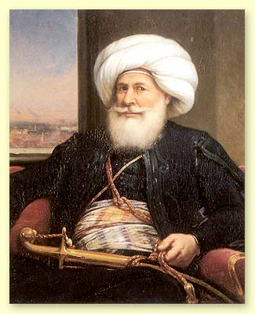
Key Concept 5.1: Industrialization and global capitalism
Response of governments: resistance
Qing China
Ottoman empire
Response of governments: state-sponsorship
Meiji Japan
Tsarist Russia
China’s self-strengthening movement
Muhammad Ali’s development of cotton textile industry in Egypt
Response of governments: make reforms
State pensions in Germany
Public education
Expansion of suffrage in Britain

Slide 11
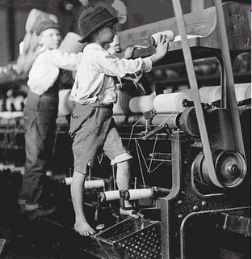
Key Concept 5.1: Industrialization and global capitalism
Industrialization caused massive changes in social organization
New classes developed in Industrial states
Middle Class
Industrial working class
Family dynamics and gender roles change
Focus on nuclear families (immediate family)
Rise of child labor -> public education
Women begin working in factories -> feminist movements for suffrage
Rapid urbanization caused problems for society
*Urbanization: the rise of cities
Unsanitary conditions, increase in crime, new forms of community

