Slide 1
AP Review: Unit 5.2 (Industrialization)
Modern Era
1750 CE-1914 CE

Slide 2
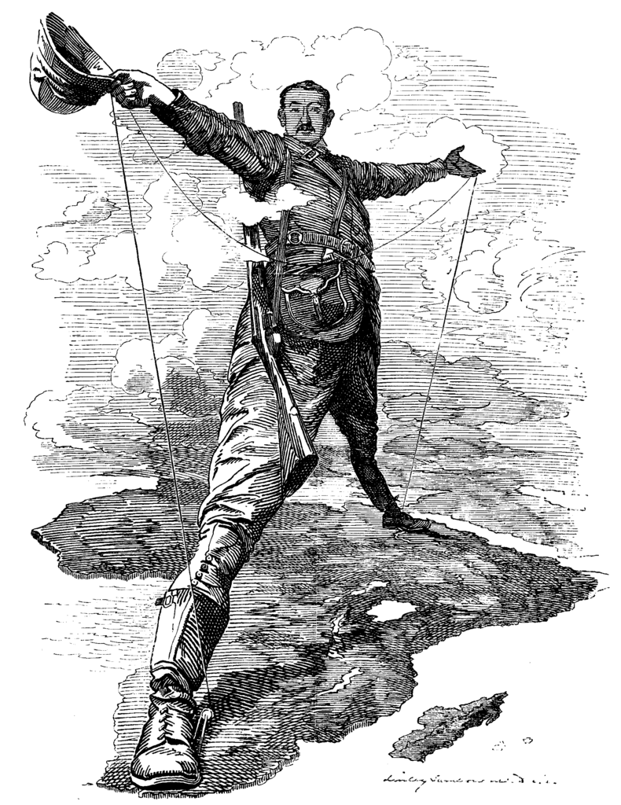
Key Concept 5.2: Imperialism and nation-state formation
Industrializing powers established trans-oceanic empires
*imperialism: the act of creating an empire
*colonialism: a country conquers and rules over regions and sends permanent settlers to live there
Some states increased their global influence
Britain
France
Netherlands
Germany
USA
Japan
Russia
While some states saw their global influence decline
Spain
Portugal

Slide 3
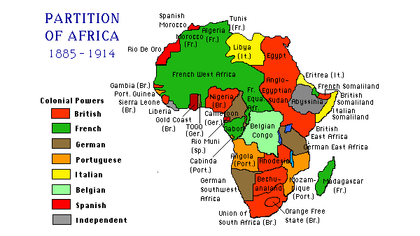
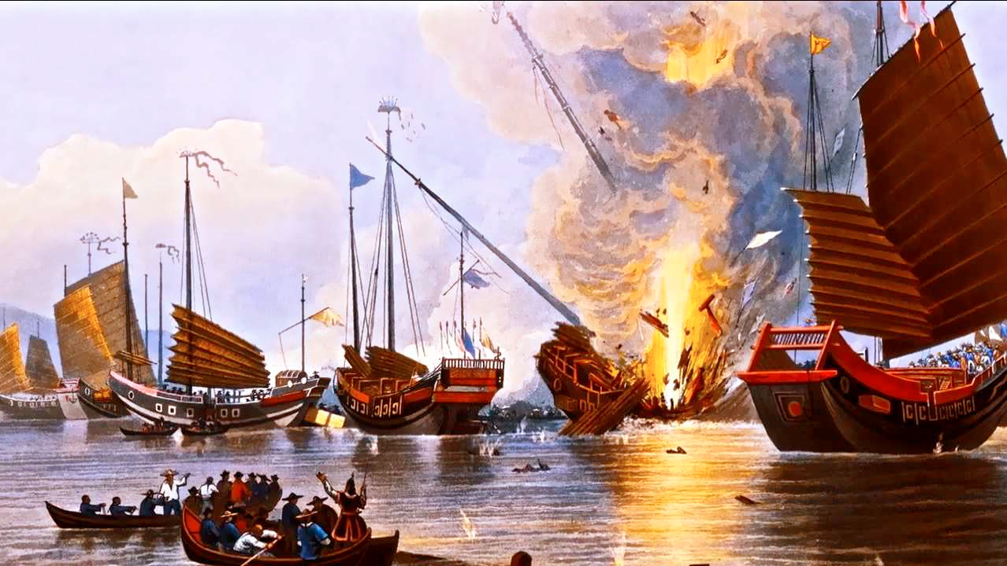
Key Concept 5.2: Imperialism and nation-state formation
European states used both warfare and diplomacy to establish empires in Africa
Berlin Conference: 1884-1885
Meeting of major European powers to divide up the continent of Africa between them
European states also established settler colonies across the globe
British in South Africa, Australia, New Zealand
French in Algeria
In other parts of the world states practiced economic imperialism
British and French in China- Opium wars
British and USA in Latin America

Slide 4
Key Concept 5.2: Imperialism and nation-state formation
Imperialism influenced state formation and contraction around the world
Japan: Meiji restoration and rise of westernization and industrialization as a result of interactions with USA
USA and Russia: emulated (copied) European imperialism and expanded their borders
Ottoman Empire: contracted as result of Anti-imperialist movements
New state creation on edge of existing empires: Siam (Thailand), Hawaii, Zulu kingdom

Slide 5
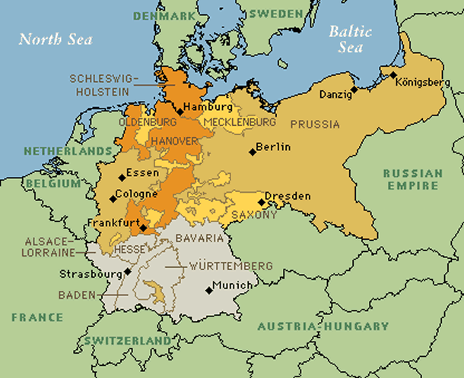
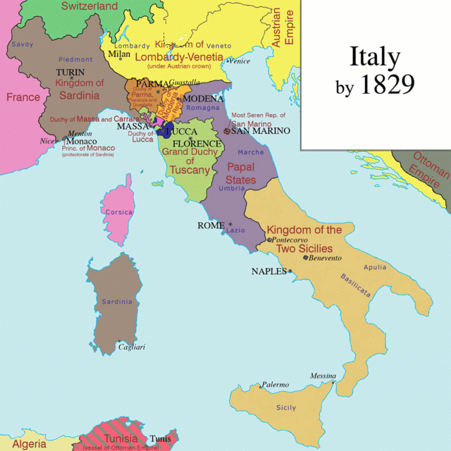
Key Concept 5.2: Imperialism and nation-state formation
Nationalism fostered the growth and contraction of empires during this era
Separation Nationalism: Ottoman empire
State-building nationalism: Britain, France, USA, Japan
Unification nationalism: Germany, Italy
Imperialists justified their actions by creating new racial ideologies such as:
Social Darwinism

