Slide 1
AP Review: Unit 5.3 pt. 1 (Industrialization)
Modern Era
1750 CE-1914 CE

Slide 2
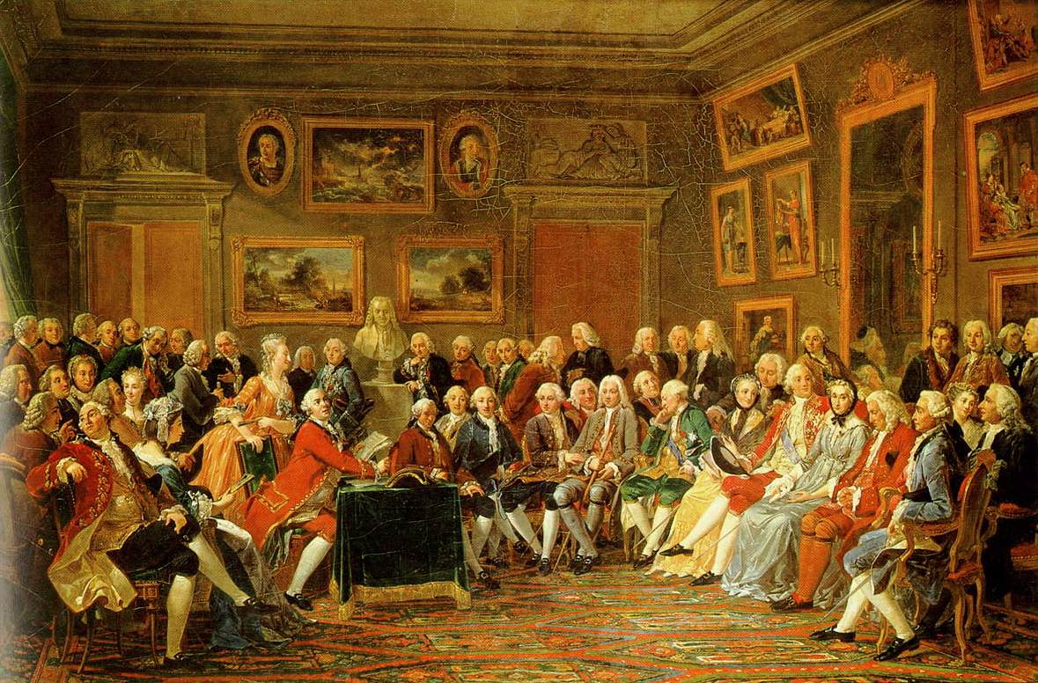
Key Concept 5.3: Nationalism, Revolution, Reform
The rise and diffusion of Enlightenment thought that questioned established traditions often preceded revolutions and rebellions against existing governments
The Enlightenment: a philosophical movement in the 17th and 18th centuries that reoriented political, scientific and philosophical thought
Enlightenment thinkers applied new ways of understanding the natural world to human relationships
Encouraged observation and inference
Enlightenment thinkers:
Hobbes, Locke, Rousseau, Voltaire, Montesquieu

Slide 3
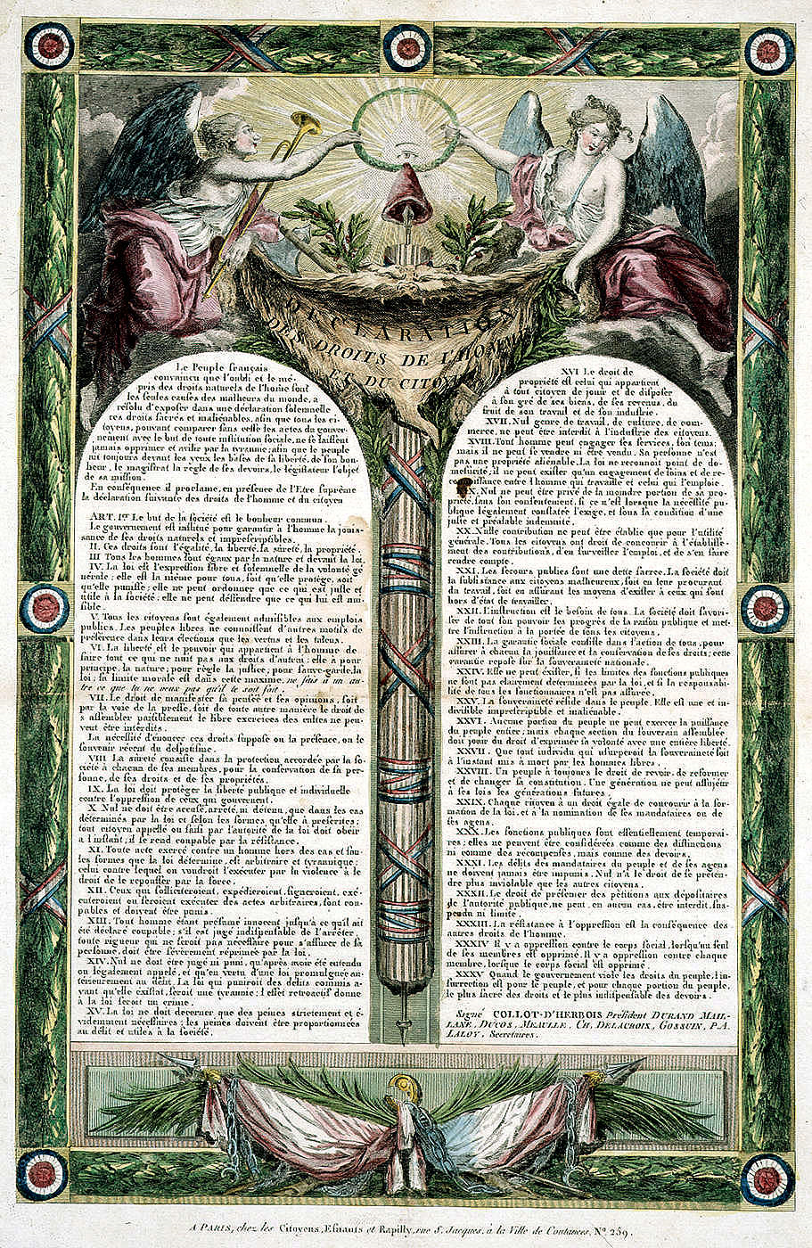
Key Concept 5.3: Nationalism, Revolution, Reform
Enlightenment thinkers often criticized the role of religion in public life
Emphasized importance of reason over revelation
The thinkers who focused on new ideas about individuals, natural rights and the social contract included:
Hobbes: Social contract
Locke: natural rights of life, liberty, and property
Montesquieu: separation of powers
Political documents were influenced by these thinkers
Declaration of Independence
Jamaica Letter
Declaration of the rights of Man and of citizen

Slide 4
Key Concept 5.3: Nationalism, Revolution, Reform
These ideas encouraged people to challenge existing social norms which led to the expansion of rights
Expanded suffrage
Abolition of slavery
End of serfdom

Slide 5
Key Concept 5.3: Nationalism, Revolution, Reform
Beginning around the 18th century peoples around the world developed a sense of nationalism:
* sense of commonality based on language, religion, social customs, and territory
Most people linked this identity with the borders of the state
Governments used this to their advantage to unite diverse populations

Slide 6
Key Concept 5.3: Nationalism, Revolution, Reform
Increasing discontent with imperial rule propelled revolutionary movements
Subjects challenge centralized imperial governments in:
America
Haiti
Latin America

