Slide 1
AP Review: Unit 5.3 pt. 2 (Industrialization)
Modern Era
1750 CE-1914 CE

Slide 2
Key Concept 5.3: Nationalism, Revolution, Reform
American Revolution
Dates: 1775-1783
Important Individuals:
George Washington
Thomas Jefferson
Causes:
Taxation without representation
stamp act, tea tax
Enlightenment
Outcomes:
Independent United States- republican democracy
Voting rights for landowning white men
Influenced later revolutions

Slide 3
Key Concept 5.3: Nationalism, Revolution, Reform
French Revolution
Dates: 1789-1802
Important Individuals:
Louis XVI
Robespierre
Napoleon
Causes:
Class divisions: 3 estates (peasants pay most in taxes)
Failing economy
Participation in American Revolution
Enlightenment
Outcomes:
Republic established and then replaced by Napoleon as dictator
Causes rebellion in Haitian colony
Huge death toll from guillotine

Slide 4
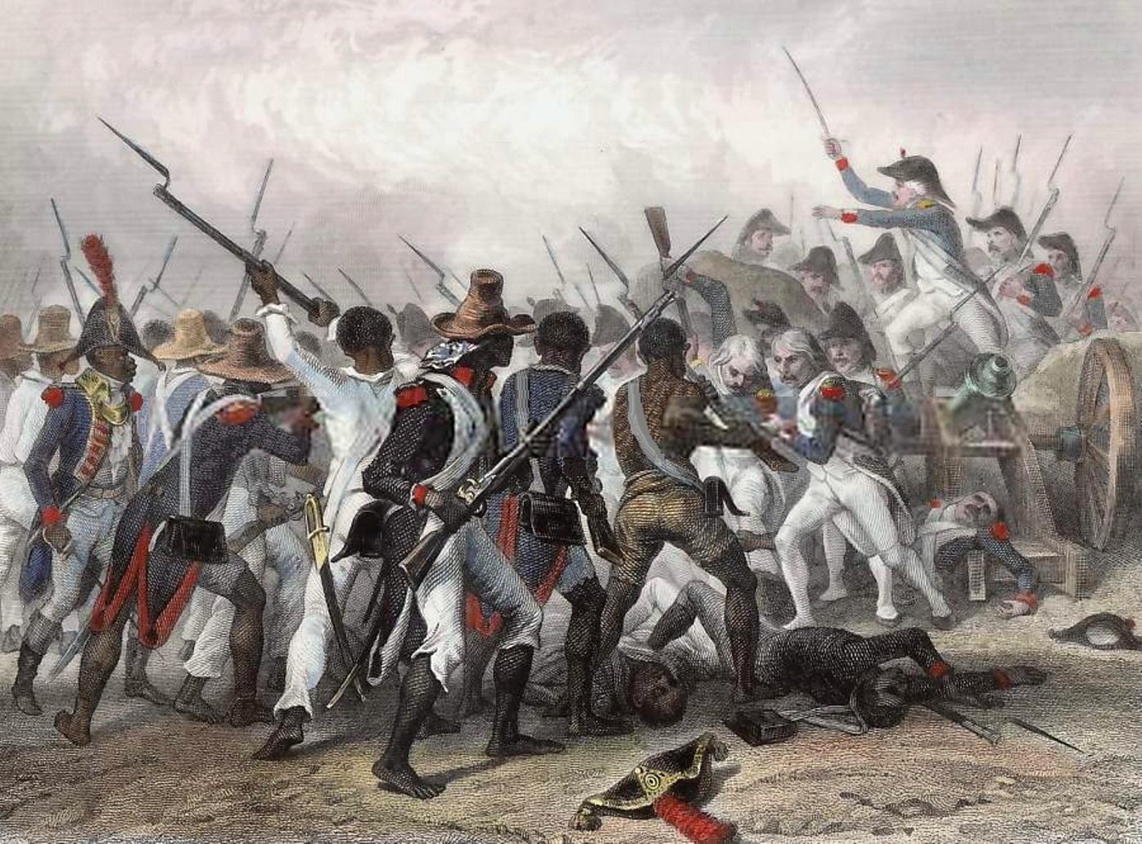
Key Concept 5.3: Nationalism, Revolution, Reform
Haitian Revolution
Dates: 1791-1804
Important Individuals:
Toussaint L’Ouverture
Napoleon
Causes:
French Revolution
Enlightenment
Slaves desire for freedom
Outcomes:
Haiti becomes first independent slave nation
Haitian economy is destroyed

Slide 5
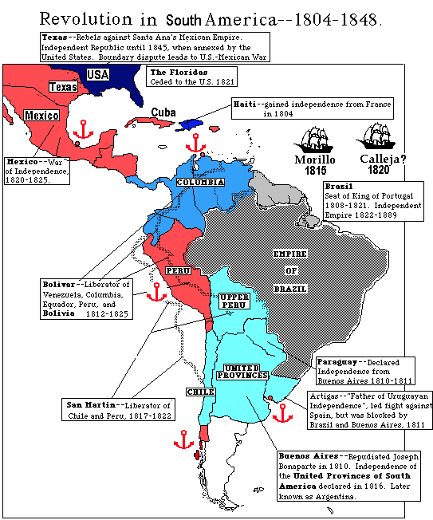
Key Concept 5.3: Nationalism, Revolution, Reform
Latin American Revolution
Dates: 1800-1830
Important Individuals:
Simon Bolivar
Jose de San Martin
Causes:
Enlightenment
Haitian revolution
Unequal social hierarchy and frustration of Creole elites
Outcomes:
Independent nation-states formed in South and central America

Slide 6
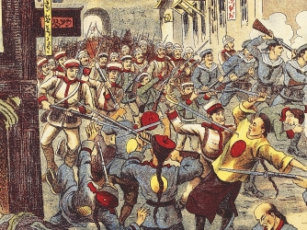
Key Concept 5.3: Nationalism, Revolution, Reform
Slaves resisted existing authorities through the establishment of maroon societies
Anti-colonial movements arose in Asia as well, although they didn’t result in full scale revolution
Indian revolt of 1857
Boxer rebellion (China)
Some rebellions that arose were influenced by religious beliefs
Taiping rebellion

Slide 7
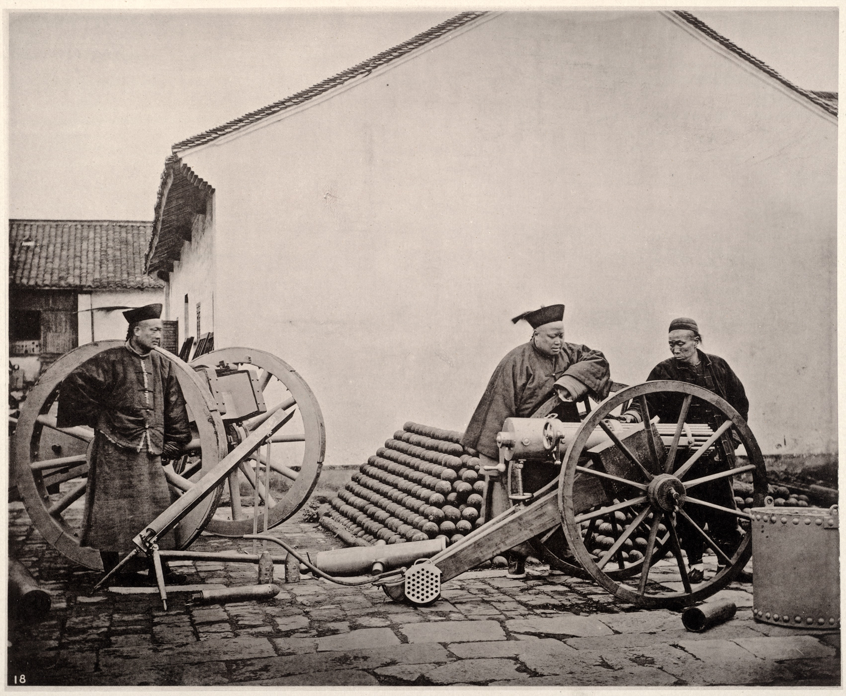
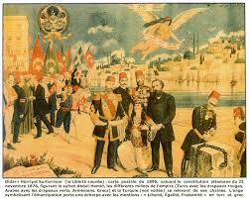
Key Concept 5.3: Nationalism, Revolution, Reform
Governments sometime responded to these rebellions by making reforms:
Ottoman empire: Tanzimat reforms
Qing dynasty: Self-strengthening movement
Discontent with monarchy or imperialist rule led to the development and increased popularity of
Liberalism
Socialism
Communism

Slide 8
Key Concept 5.3: Nationalism, Revolution, Reform
Despite Enlightenment thinkers challenging existing political and social constructions, women’s rights were largely ignored in Enlightenment discourse
Women still pursued feminist movements and suffrage
Mary Wollstonecraft
Olympia de Gouges

