Slide 1
AP Review: Unit 5.4 (Industrialization)
Modern Era
1750 CE-1914 CE

Slide 2
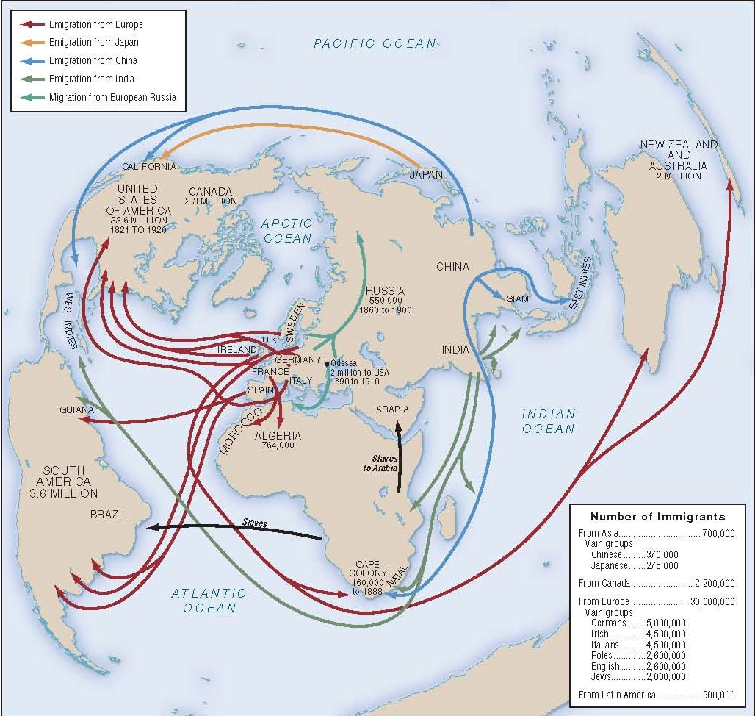
Key Concept 5.4: Global Migration
Global migrations increased as compared to previous eras
The global population increased as a result of:
Changes in food production
Improved medical conditions
New modes of transportation led to an influx of migrations to cities (urbanization)

Slide 3
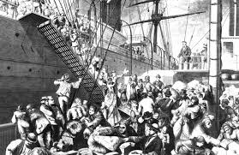
Key Concept 5.4: Global Migration
Migrants relocate for a variety of economic reasons
In search of work
Forced to move (coerced laborers)
1. Slavery
2. Chinese/Indian indentured servitude
3. Convict labor
While most migrants relocate permanently, some returned home seasonally
Italians in Argentina
Lebanese workers in the Americas

Slide 4
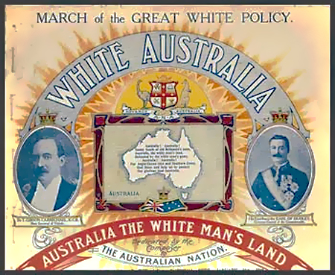
Key Concept 5.4: Global Migration
Most migrants from Asia and Africa were relocating to the Americas
However, Europeans were both relocating to the Americas and to their colonial territories in Africa and Asia
These migrations caused a variety of social and cultural consequences
Gender roles: most migrants were men, left women to care for families and do jobs formerly belonging to men
Transplanting new culture: migrants created ethnic enclaves
Receiving societies response: receiving societies often rejected immigrants and tried to regulate the number of people entering their country
Chinese exclusion act
White Australia policy

