Slide 1
AP Review: Unit 6.1
Contemporary Era
1900 CE - Present

Slide 2
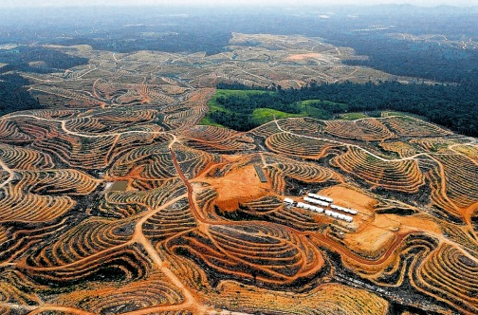
Key Concept 6.1 – Science and the Environment
Advances in Science led to rapid population growth, which in turn led to changes in the environment
Global warming/climate change
Deforestation
New modes of transportation/communication helped eliminate the problem of geographical distance (internet, cell phones, airplanes)
Made the world “much smaller”

Slide 3
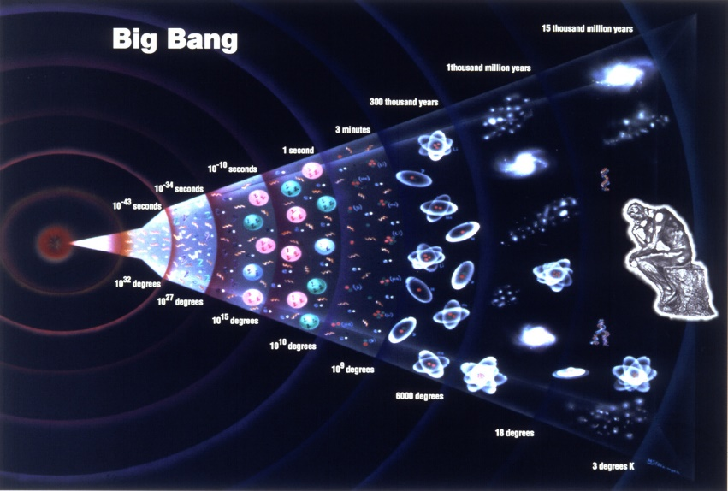
Key Concept 6.1 – Science and the Environment
New scientific theories helped humans understand the world better
Einstein’s Theory of Relativity
Big Bang Theory
Quantum Mechanics
Psychology

Slide 4
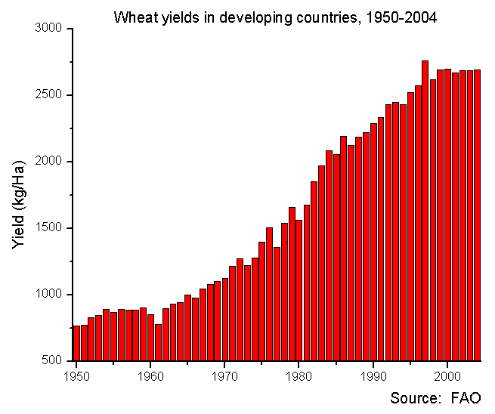
Key Concept 6.1 – Science and the Environment
Agricultural innovations
Medical Innovations
The Green Revolution helped to increase crop production
chemically and genetically enhanced forms of agriculture
GMO’s
Innovations in the medical field helped increase human ability to survive
Polio Vaccine
Antibiotics
Artificial heart

Slide 5
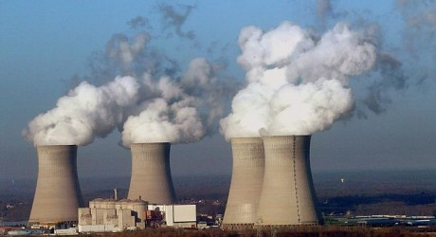
Key Concept 6.1 – Science and the Environment
Innovations in Energy
Effects on the Environment
New types of energy used in 20th century
Oil
Nuclear power
Increased population and competition led to negative effects on Environment
Negative consequences
Greenhouse gases/pollution leading to global warming
Deforestation/desertification
Endangered species of animals

Slide 6
Key Concept 6.1 – Science and the Environment
Causes of demographic changes in 20th century
Diseases associated with poverty
Malaria
Cholera
Tuberculosis
Epidemic diseases
HIV/AIDS
Ebola
Diseases associated with longer-living
Diabetes, Heart disease, Alzheimer's
Diseases
Scientific innovations
Birth control – gives women greater control over preganancy
Conflicts (wars)
New tactics and technologies causing greater casualty rate
Trench warfare, napalm strikes
Tanks, fighter planes, atomic bomb

