Slide 1
AP Review: Unit 6.2
Contemporary Era
1900 CE - Present

Slide 2
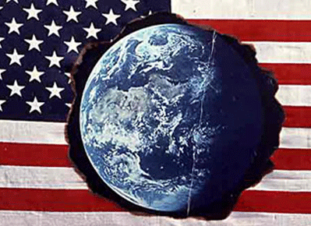
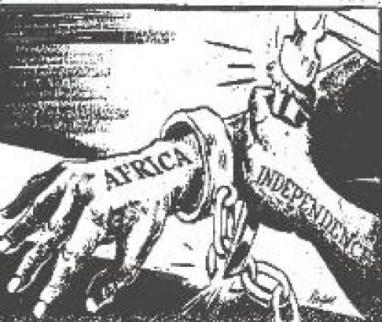
Key Concept 6.2: Global conflicts and their consequences
Western Europe had dominated the world political order at the beginning of the 20th century and was soon joined by The U.S., Russia, and Japan
Over time, people and states around the world challenged this order in effort to achieve recognition
Anti-Imperialist/Nationalist movements
Decolonization
Ethnic and religious conflicts

Slide 3
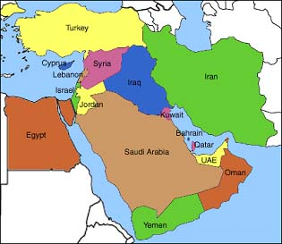
Key Concept 6.2: Global conflicts and their consequences
Land based Empires such as the (Ottomans and Qing Empires) collapsed due to a combination of internal and external factors Economic hardship
political and social discontent
technological stagnation
military defeat
On the other hand, Imperial Colonies held by maritime empires achieved independence either by negotiation or violence
British India, Ghana – non-violent negotiations
French Indochina, Algeria – armed struggles

Slide 4
Key Concept 6.2: Global conflicts and their consequences
New nationalist movements challenged Imperialism
Mohandas Gandhi – India
Ho Chi Minh – Vietnam
Kwame Nkrumah – Ghana
Regional ethic religious movements
Mohammed Ali Jinnah – Pakistan
Quebecois separatist movement – Canada
Transnational movements
Communism
Pan-Africanism & Pan-Arabism
Land redistribution movements
Land redistributed to peasants in China during communist regime

Slide 5
Key Concept 6.2: Global conflicts and their consequences
The migration of former colonial subjects to their former imperial motherlands helped maintain cultural and economic ties even after decolonization

Slide 6
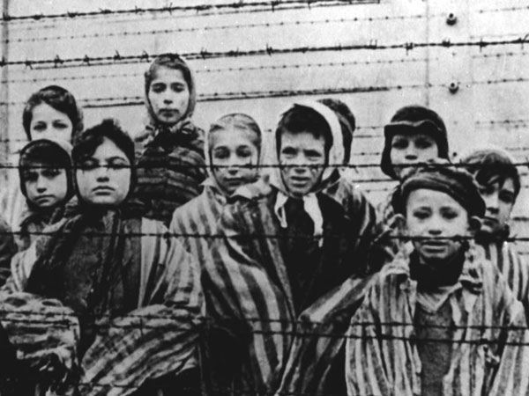
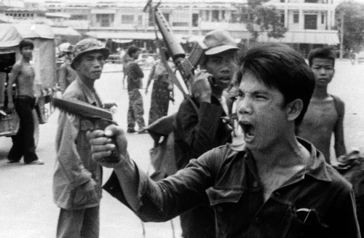
Key Concept 6.2: Global conflicts and their consequences
International conflicts and Decolonization led to an increase in:
ethnic violence
Armenian genocide
The Holocaust
Rwanda (Hutu vs. Tutsi)
Cambodia (Khmer Rouge)
displacement of peoples resulting in refugee populations
Palestinians
Darfurians

Slide 7
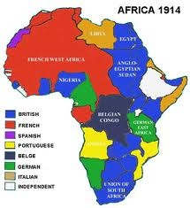
Key Concept 6.2: Global conflicts and their consequences
Causes of global conflicts
Imperialist expansion by European powers and Japan
Competition for resources
Ethnic conflict
Great power rivalries between Great Britain and Germany
Nationalist ideologies
The economic crisis caused by the Great Depression.

Slide 8
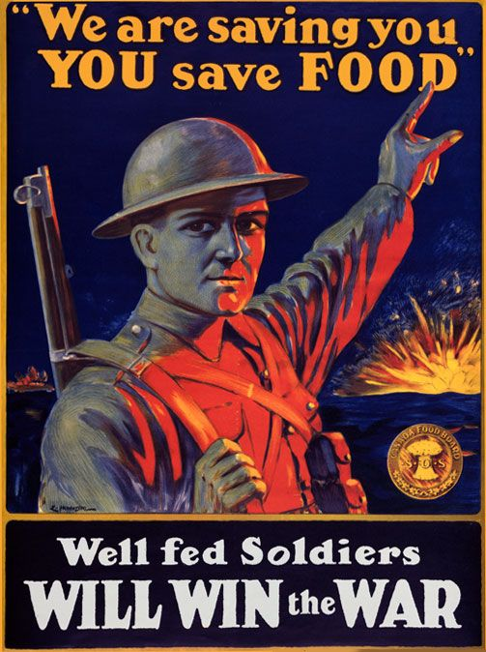
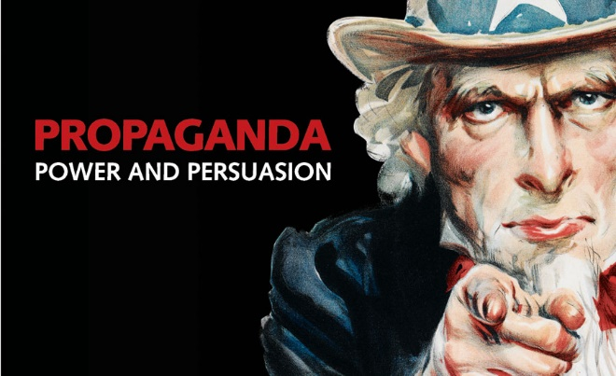
Key Concept 6.2: Global conflicts and their consequences
World War I and World war II were known as “Total Wars”
When countries use all of their state’s resources including peoples (both in the home countries and the colonies or former colonies) to help in the war effort.
Governments also used a variety of strategies, including political speeches, art/media propaganda, and intensified forms of nationalism, to mobilize these populations.

Slide 9
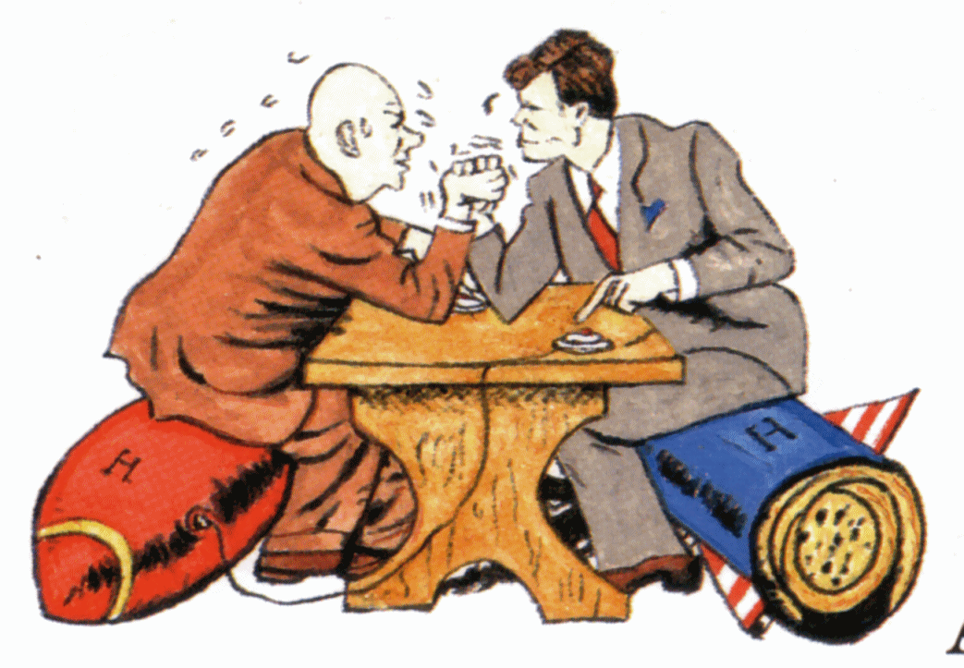
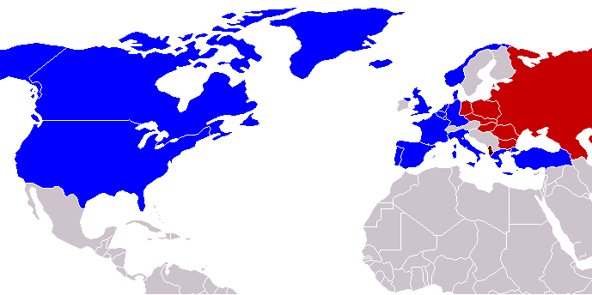
Key Concept 6.2: Global conflicts and their consequences
COLD WAR
The global balance of economic and political power shifted after end of World War II and rapidly evolved into the Cold War.
The United States and the Soviet Union emerged as superpowers
Led to struggle between Capitalism and Communism
Military consequences
new military alliances, including NATO and the Warsaw Pact
proxy wars in Latin America, Africa, and Asia
The dissolution of the Soviet Union effectively ended the Cold War.

Slide 10
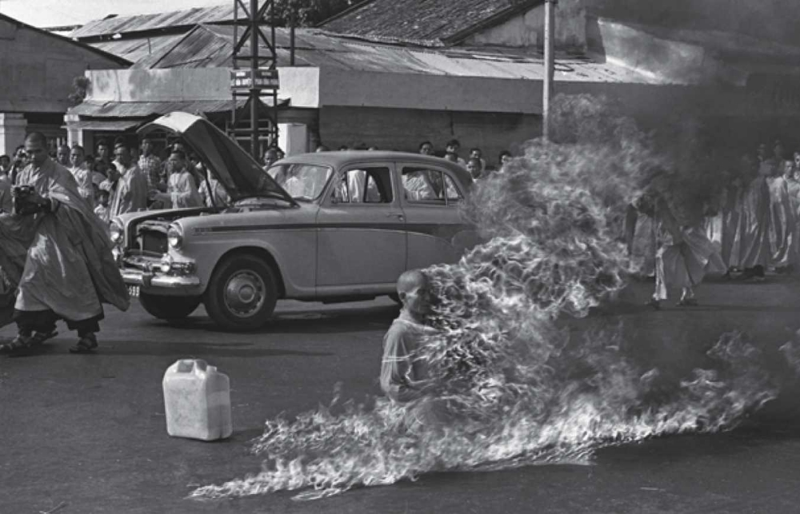
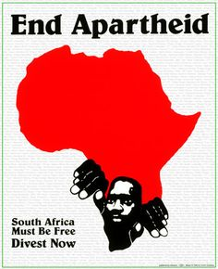
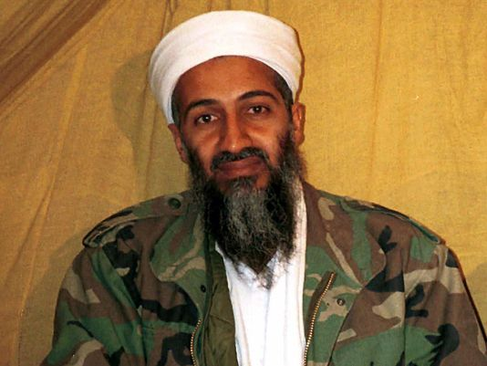
Key Concept 6.2: Global conflicts and their consequences
Reactions to these increased conflicts around the globe
Groups/Individuals promoting anti-war or anti-violence movements:
Pablo Picasso using art
Thich Quang Duc lighting himself on fire
Groups promoting alternatives to existing political, economic, and social orders:
South African Anti-Apartheid movement
Tiananmen Square protesters
Nations/Militaries intensifying conflicts around the globe:
USA building up military industrial complex during Cold War
Groups promoting violence against civilians (terrorism) to intensify global conflict:
Al-Qaeda (Afghanistan)
IRA (Ireland)

Slide 11
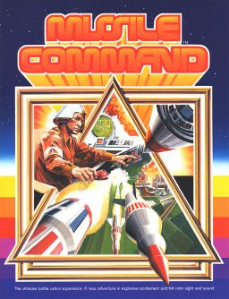
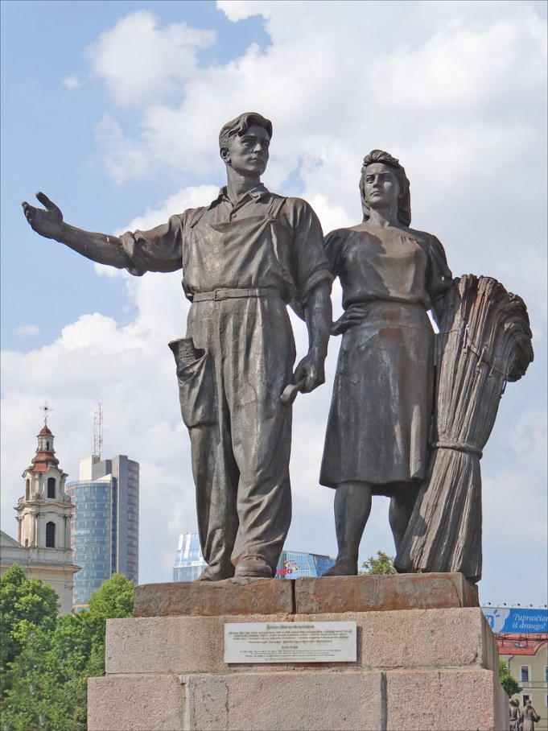
Key Concept 6.2: Global conflicts and their consequences
Global conflicts had a profound influence on popular culture (pop culture)
Socialist realism (art)
Spy novels/movies
Video Games

