Slide 1
AP Review: Unit 6.3
Contemporary Era
1900 CE - Present

Slide 2
Key Concept 6.3: New conceptualizations of global economy, society, and culture
States (governments) responded to these global conflicts and their economic effects in various ways.
Communist governments controlled their national economies
Five Year Plans - Soviet Union’s Joseph Stalin
Great Leap Forward – China’s Mao Zedong.
United States and Western Europe (after the Great Depression) governments began to take a more active role in economic life.
Roosevelt’s New Deal
The Fascist Corporatist Economy
Newly independent states in Asia and Africa governments often took on a strong role in guiding economic life to promote development
Increased exports in Southeast Asia
Economic development in Egypt

Slide 3
Key Concept 6.3: New conceptualizations of global economy, society, and culture
At the end of the twentieth century, many governments encouraged free market economic policies and promoted economic liberalization
United States under Reagan, China under Deng Xiaoping, Chile under Pinochet.
New international organizations formed to maintain world peace
The League of Nations
The United Nations
New economic institutions sought to spread free market economics throughout the world.
International Monetary Fund (IMF)
World Bank
World Trade Organization (WTO)

Slide 4
Key Concept 6.3: New conceptualizations of global economy, society, and culture
Humanitarian organizations developed to respond to humanitarian crises throughout the world.
Red Cross
Doctor's without Borders
World Health Organization
Regional trade agreements created regional trading blocs designed to promote the movement of capital and goods across national borders.
European Union
NAFTA

Slide 5
Key Concept 6.3: New conceptualizations of global economy, society, and culture
Rise in Multinational Corporations trended upward and challenged government power
Shell
Coca-Cola
Sony
Environmental movements rose throughout the world
Greenpeace
Earth Day

Slide 6
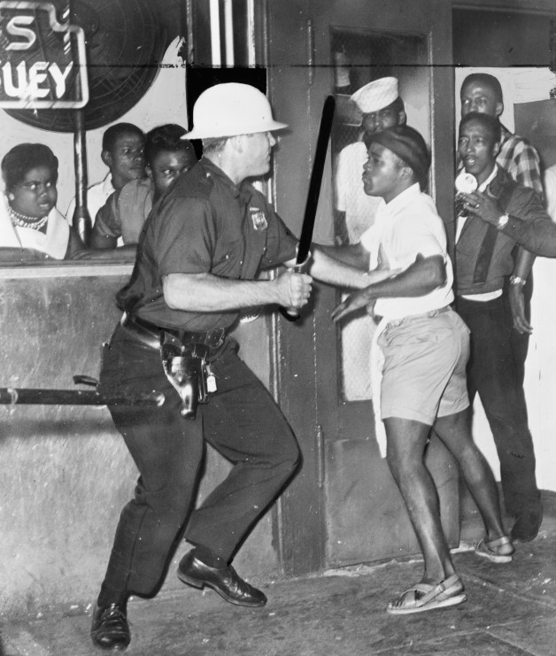
Key Concept 6.3: New conceptualizations of global economy, society, and culture
social changes that took place in the 20th century
Positive:
notion of human rights gained traction throughout the world
UN Declaration of Human Rights
Women's rights
Negative
Increased interactions among diverse peoples sometimes led to the formation of new cultural identities exclusionary reactions
Xenophobia – fear of foreigners
Race riots
Citizenship restrictions.

Slide 7
Key Concept 6.3: New conceptualizations of global economy, society, and culture
Cultural changes that took place in the 20th century
Religion
Believers developed new forms of spirituality
New Age Religions
Hare Krishna
Falun Gong
Consumer Culture changed with greater interaction between nations
Popularity in sports rose to new heights
Olympics, World Cup Soccer
Diffusion of music and film
Reggae music
Bollywood films

