Slide 1
Empires
Macedonia Persia Rome Mongolia Britain

Slide 2
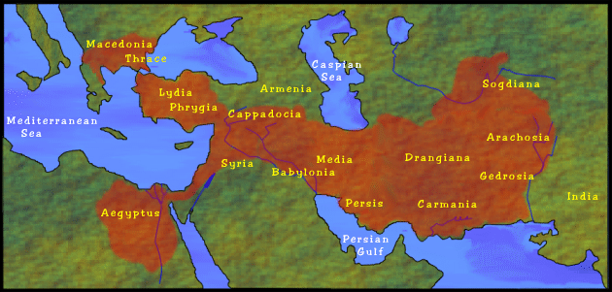
What is an Empire?
Empire: an extensive group of states or countries under the control of a single supreme authority.

Slide 3
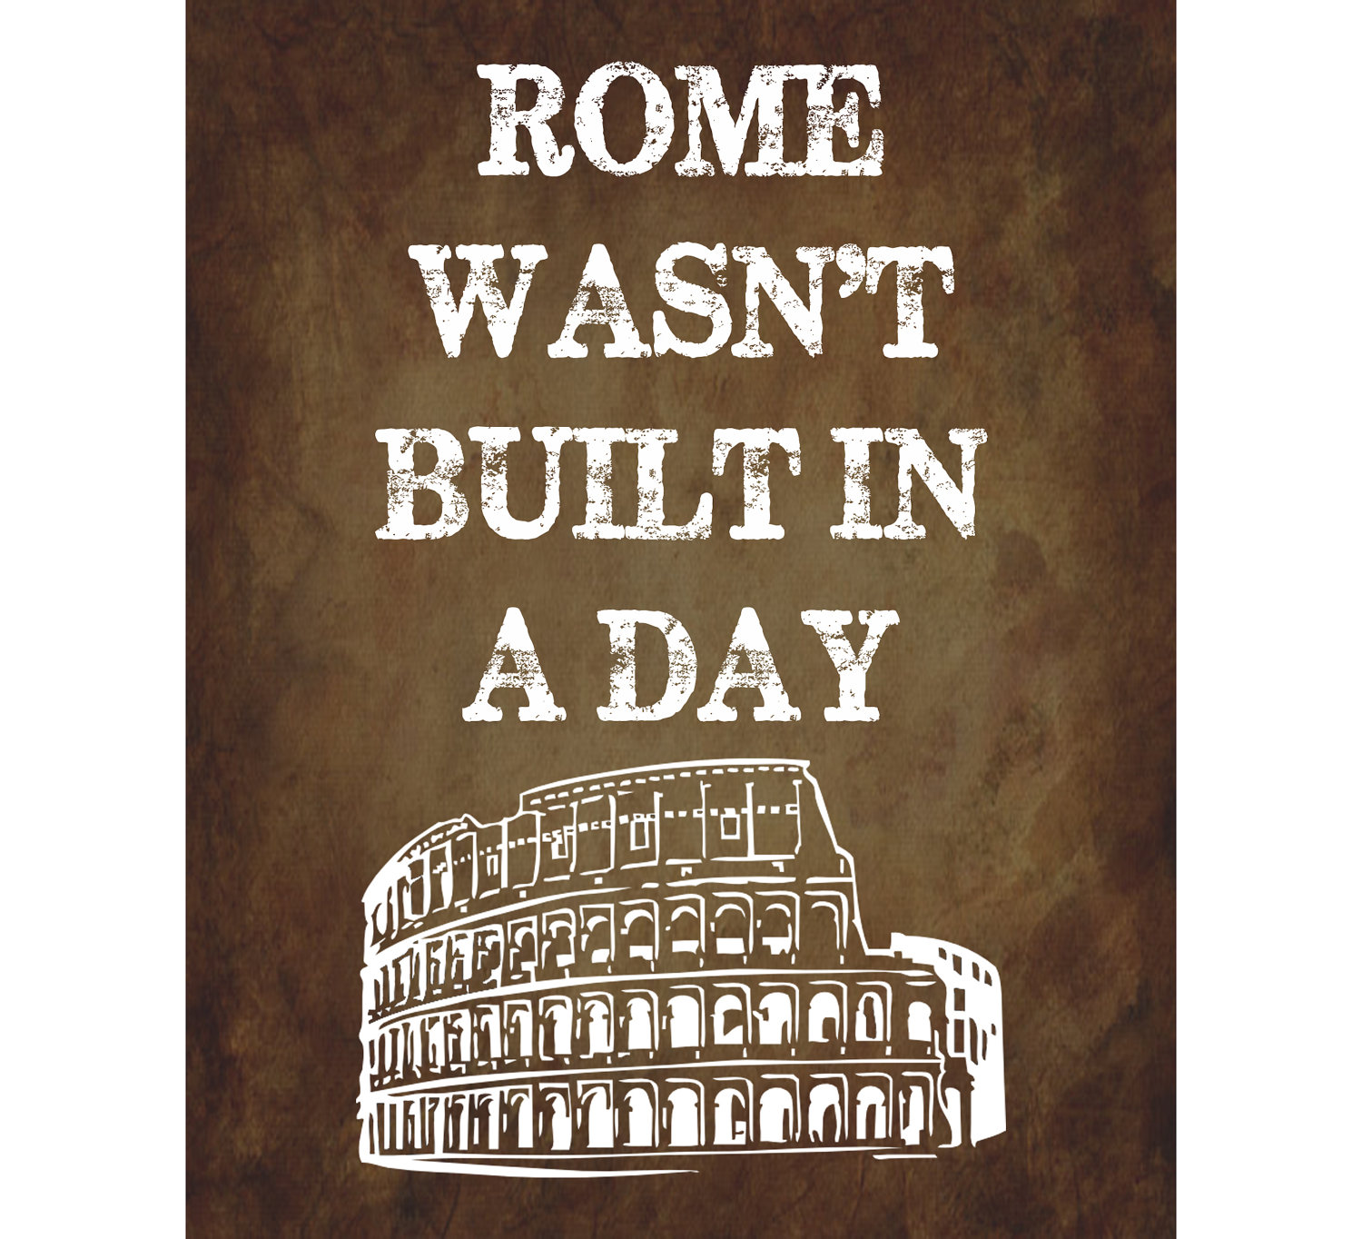
How to build an Empire:
Strong leader
War strategy
Military strength
Organized plan of control
Respect (or fear) of controlled peoples

Slide 4
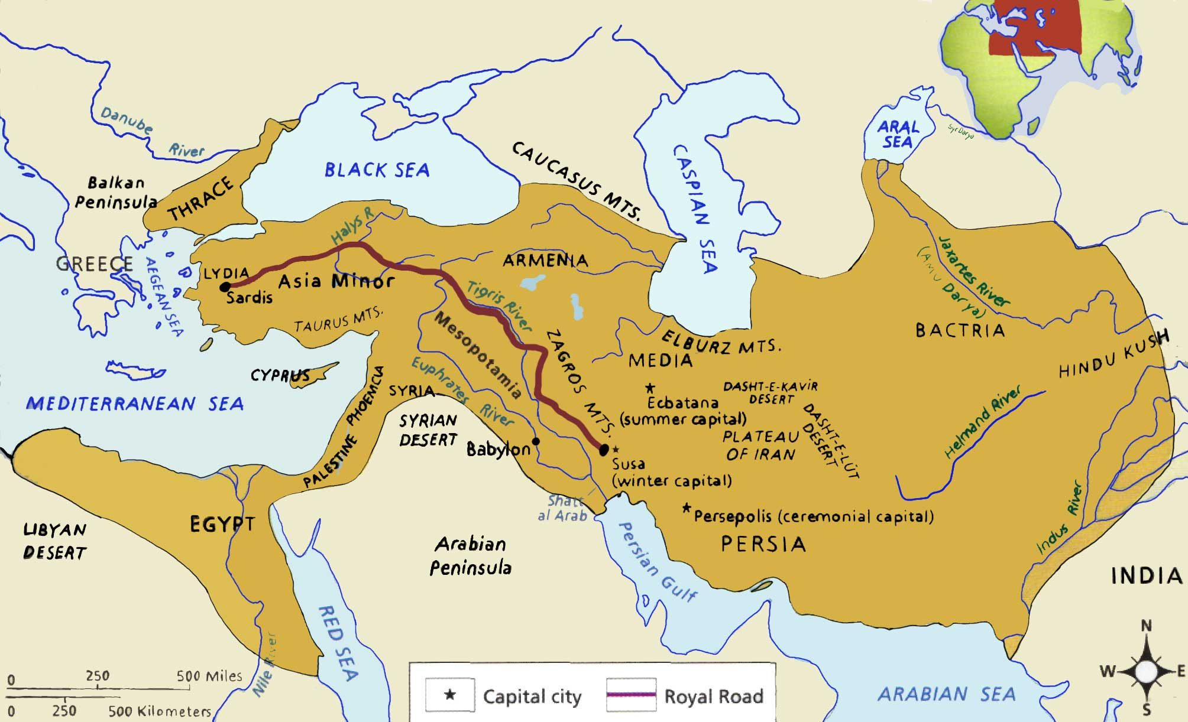
The worlds greatest empires
The Persian Empire
Cyrus the Great, Darius I, Xerxes the Great
Controlled all of the Middle East
Allowed people religious and cultural freedom in return for obeying emperor
Empire conquered by Alexander the Great

Slide 5
The worlds greatest empires
The Macedonian Empire
Alexander the Great
Controlled Greece, Egypt, and most of the Middle East
Alexander brought Greek culture to the Middle East
The mixed cultured became known as “Hellenistic culture”
Empire fell apart after Alexander’s death

Slide 6
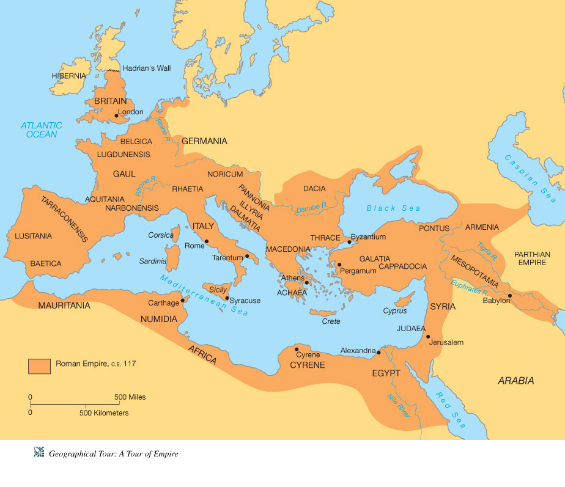
The worlds greatest empires
The Roman Empire
Augustus Caesar (Gaius Octavian)
Controlled most of Europe, North Africa, and parts of the Middle East
Built roads to connect territory and used a large army to control people throughout land
Divided when Roman capital was invaded by Germanic tribes

Slide 7
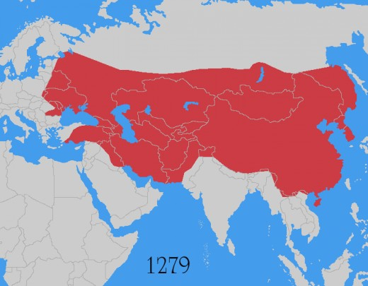
The worlds greatest empires
The Mongolian Empire
Genghis Khan, Kublai Khan
Controlled most of Asia and the Middle East
Only ~100,000 Mongolians
excellent warriors and strategists
Dissolved after the death of Genghis Khan, sons fought for control

Slide 8
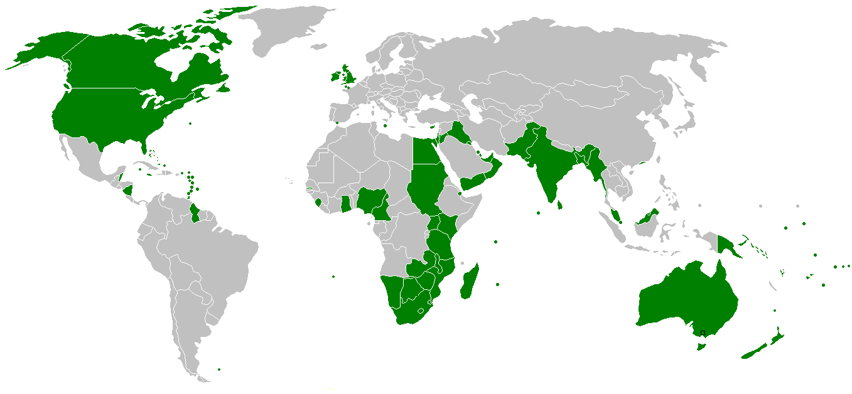
The worlds greatest empires
The British Empire
Many Kings and Prime Ministers played a role
Controlled parts of Europe, North America, Africa, Asia, and Australia (6 continents!)
Wanted raw materials for factories in homeland, signed treaties with foreign lands
Individual countries fought for independence

