Slide 1
Enlightenment and Revolutions
Europe and beyond

Slide 2
Fast forward through time…
The “Dark Ages” are over
The bubonic plague is less prevalent, population growing
The Crusades led to newfound interest in trade and learning
The Renaissance has started
Pope loses power after failure of crusades
People place their trust in Kings

Slide 3
The Power of Kings
Like the Pope, Kings were thought to have been chosen by God
Divine right of rule = King is God’s chosen leader, so nobody can question his ruling
People must listen and obey or suffer the consequences

Slide 4
Questioning Authority
What are some reasons that cause you to question or argue with authority?
What are some reasons that cause you to NOT to question or argue with authority?

Slide 5
The Enlightenment
To be “enlightened” - having or showing a rational, modern, and well-informed outlook.
Traits of the Enlightenment
Use of reason or common sense
Questioning previously accepted beliefs
Taking “God wills it!” out of the equation

Slide 6
Roots of the Enlightenment
Sprung out of the Scientific Revolution
Used reason to explain the laws governing nature

Slide 7
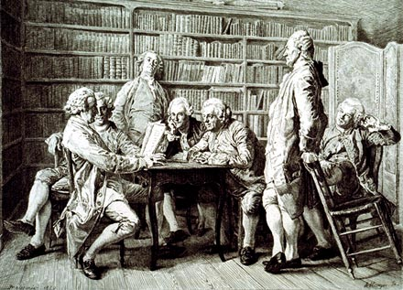
The Age of Reason
Soon philosophers started to apply reason and the scientific method to other aspects of life:
Government
Religion
Economics
Education
By mid 1700’s, the Enlightenment had reached its height.

Slide 8
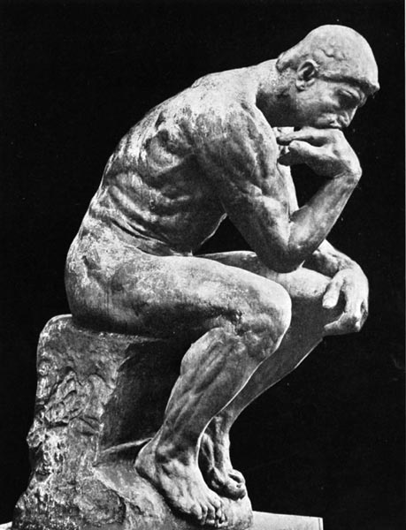
Core of the philosophy
Reason – truth could be discovered through logical thinking
Nature – believed that there were natural laws that governed aspects of life such as economics and politics
Happiness – people are rightfully happy, not doomed
Progress – believed society could be perfected
Liberty – freedom of speech, religion, trade, travel

Slide 9
Idea’s spreading
Paris was the cultural and intellectual capital of the world
Philosophers would gather regularly at salons to discuss ideas
Also read books, magazine articles, and sent letters to each other
Art and music began to reflect enlightenment ideals and new styles spread rapidly across Europe

Slide 10
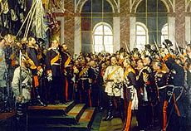
Changing Monarchs
Philosophes encouraged absolute monarchs to rule justly.
Wanted all monarchs to be modeled after England (William and Mary)
Some embraced the ideas and made reforms
Called: Enlightened Despots
Still had absolute power, but could make their countries stronger and their rule more effective

Slide 11
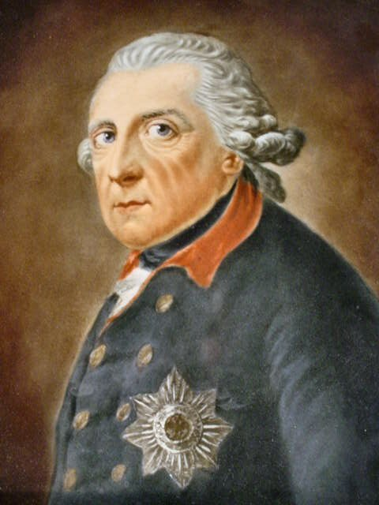
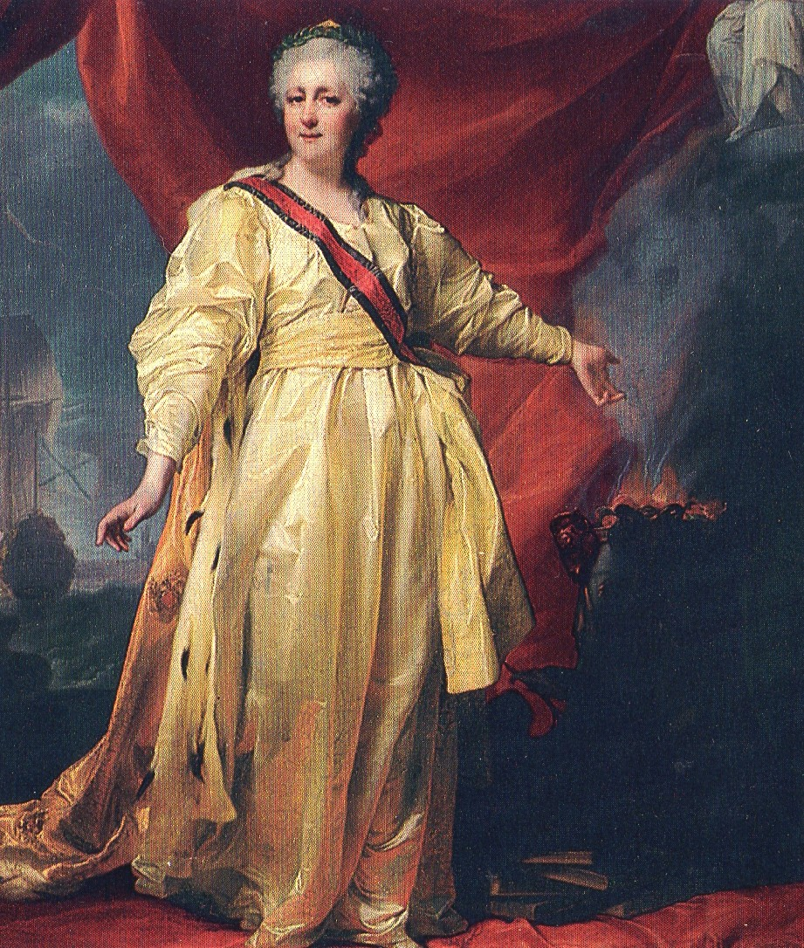
Enlightened Despots
Fredrick the Great – Prussia (1740-1786)
Reformed education, granted religious freedoms, reduced censorship
Did not agree with serfdom, but did nothing to end it – nobles had absolute power over serfs
Catherine the Great – Russia (1762-1796)
Formed a commission to review Russian laws, religious toleration, abolished torture
Expanded Russia’s territory
Peasants were ignored – crushed massive serf uprising

Slide 12
Across the “pond”
English monarchs have had limited power over the people because of written laws
England also has territorial claims overseas in North America – laws limiting King’s power don’t apply…

Slide 13
‘Merica
King George II would pass preposterous laws over in his colonies in order to pay off his massive war debts
Raised taxes without people’s consent
“No taxation without representation”

Slide 14
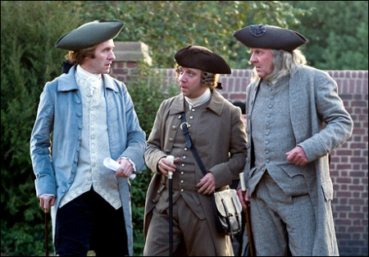
American Revolution
Enlightened philosophers ideas spread to the colonies, who began to cry out for the same freedoms as their English relatives
Ideas evident in the Declaration of Independence
List of grievances to King George II
American people openly rebelled to fight for independence

Slide 15
French Revolution
13 years later, the French people decide to rebel against their own government in hope of changes similar to those in America
Enlightenment ideals are present, but not necessarily the immediate cause of the French revolution
The actual cause: grain shortage
People spending 80% of income on bread

Slide 16
Latin American Revolutions
Social class division
Pure blood Spanish people born on American soil (Creoloes) automatically lower than native Spaniards on social pyramid
Racism
Spanish who mated with Native Americans (mestizos) or with African slaves (mulattos) were seen as lesser human beings
Nationalism
Wanted self rule and free trade

Slide 17
Impact of the Enlightenment
Human Reason could solve social problems, much like it did scientific problems
Questioning Authority – placing a new focus on the individual, rather than the church or royalty.

