Slide 1
Warm up – Monday 2/13
Words of the day: Textile, Commodity
Define these words
Textile: Type of fabric, any cloth or goods produced by weaving ex: wool
Commodity: A raw material or agricultural product that can be bought or sold
Come up with two synonyms or examples for each word
Textile: Fabric, clothes/cloth
Commodity: Coffee, cash/staple crops, tobacco, metals

Slide 2
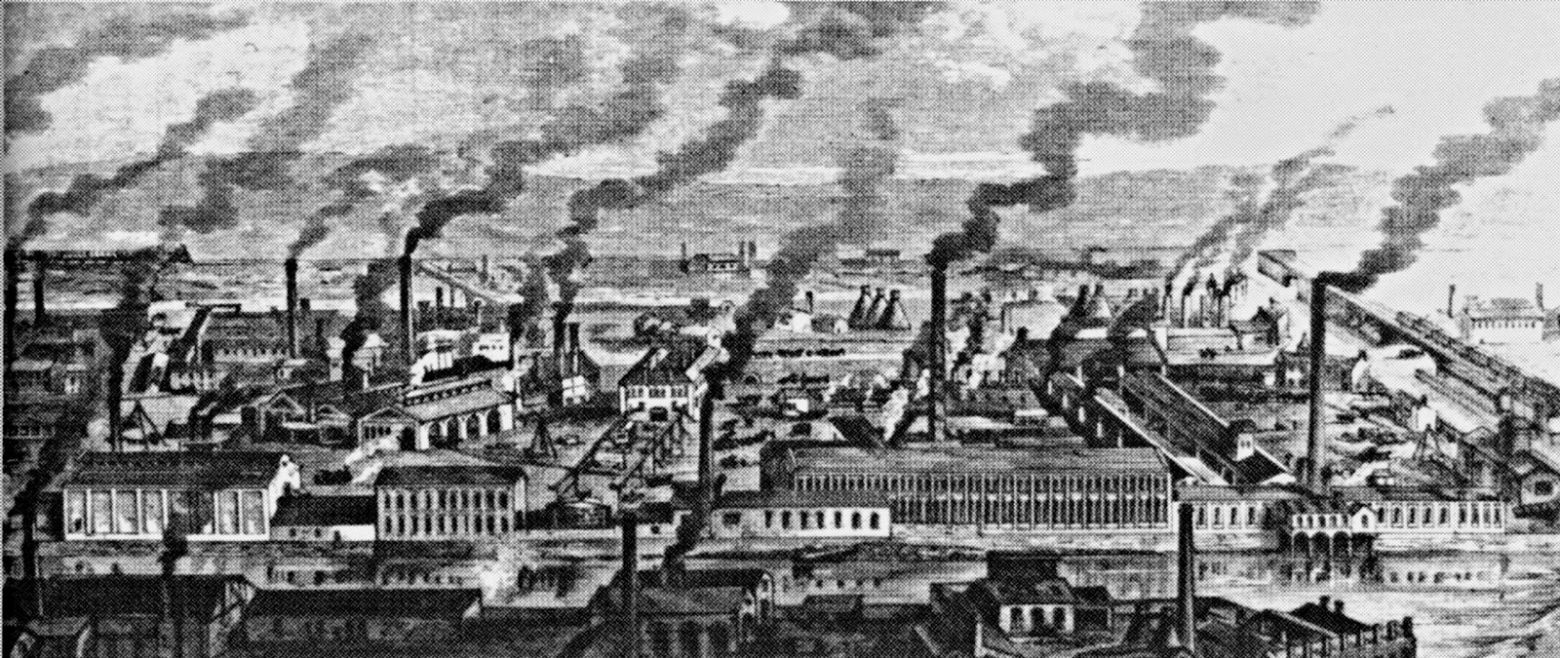
Industrial Revolution around the world 1750-1900

Slide 3
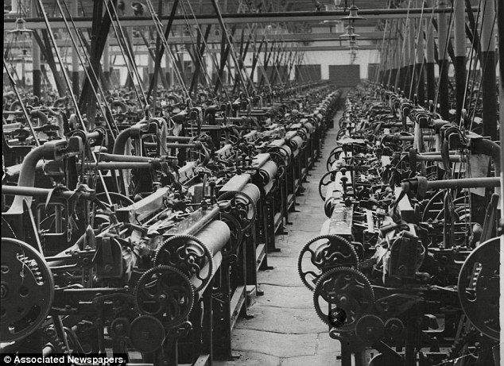
Industrialization – what is it?
Industrialization
the process by which an economy is transformed from primarily agricultural to one based on the manufacturing of goods.
Individual manual labor is often replaced by mechanized mass production, and craftsmen are replaced by assembly lines.

Slide 4
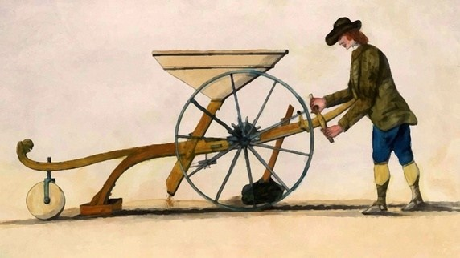
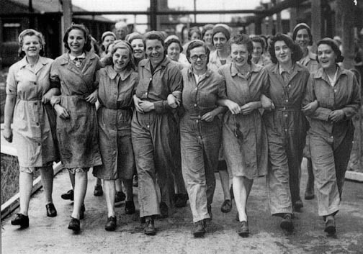
Industrial Revolution - Europe
Begins in England - late18th century
Underlying causes
Agricultural revolution leads to population boom
Abundance of natural resources – coal, iron ore
Colonies abroad with abundant raw materials
Rise in factory and mining industries
Creation of a middle class
Women and children workers
Women’s suffrage – right to vote
Labor unions

Slide 5
Industrialism in Europe by 1850

Slide 6
Manufacturing output 1750-1900

Slide 7
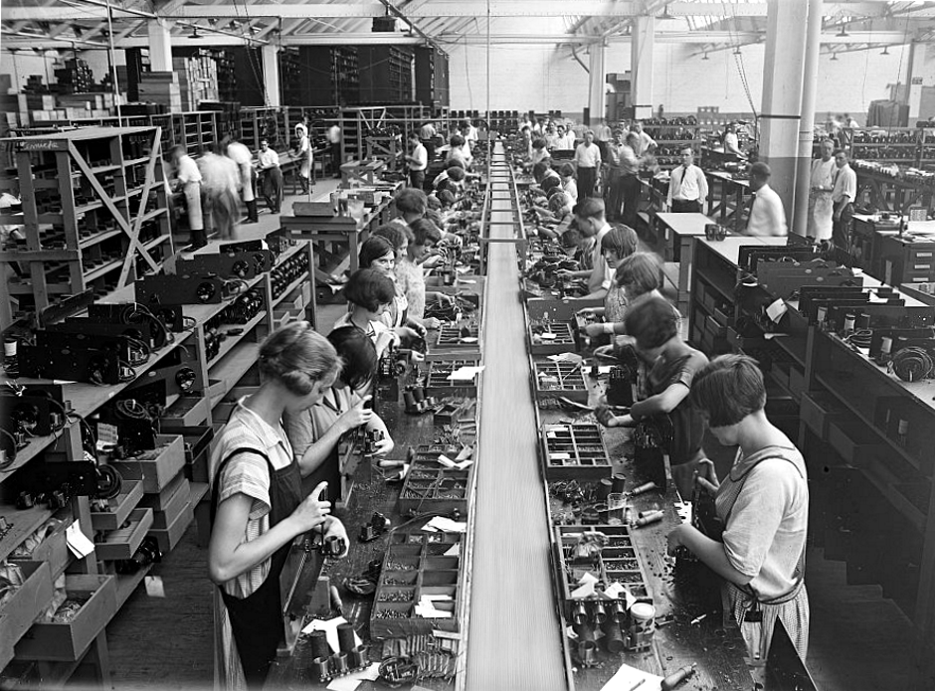
Industrial Revolution - United States
Spread to United States – mid 19th century
Factory system
Assembly line, unskilled labor, cheap
Steel – Bessemer process
Railroads, sky scrapers
Cotton production
Cotton Gin
Rejuvenated Slavery
Increase in world market share of finished products

Slide 8
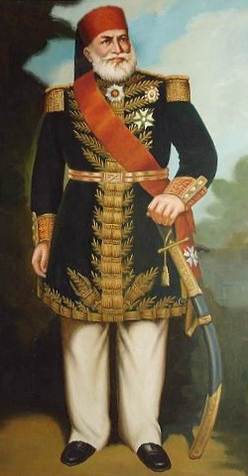
Industrial Revolution – Middle East
Many Middle Eastern governments resisted economic and social change
Ottoman Empire - Tanzimat reforms
Introduction of paper money, standardized school system, abolition of slavery
Egypt - Muhammad Ali
Improvements in infrastructure – railroads, canals, irrigation systems
Textile manufacturing, Cash crops – Cotton, tobacco
Still cannot compete with level of European industrialization

Slide 9
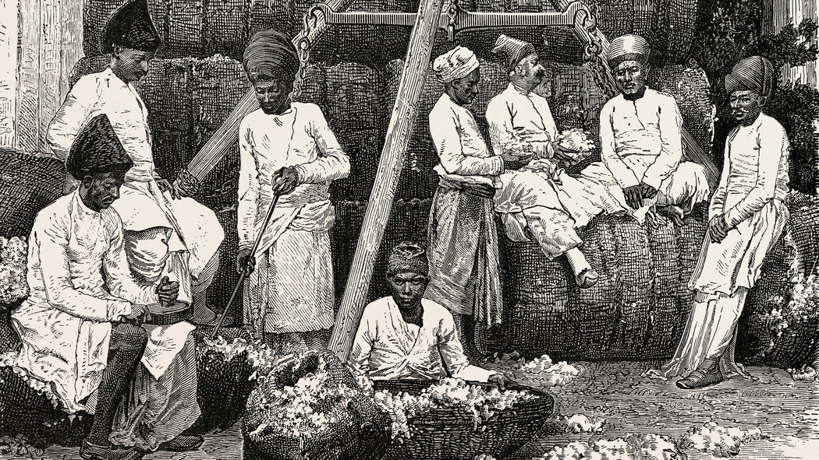
Industrial Revolution – India
Like the Middle East, India’s share in the global market begins to decrease
Continue to produce but take a significant hit due to Europeans self producing
ship building
iron working
textile industries
A weakened India will fall victim to British Imperialism in mid 1800’s

Slide 10
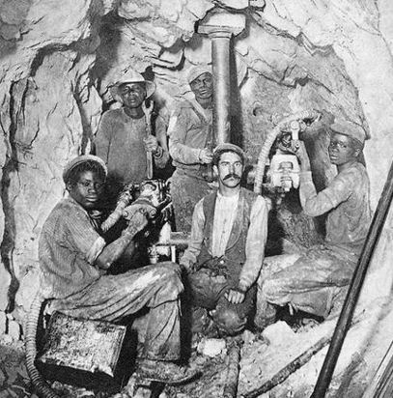
Industrial Revolution – South Africa
Discovery of diamonds and gold in South Africa – late 19th century
British Imperialism
Conquered the independent states of South Africa in 1880’s
Limited rights of black South Africans
Forced taxation
Migrant workers - forced to live in mining compounds until contract was up.

Slide 11
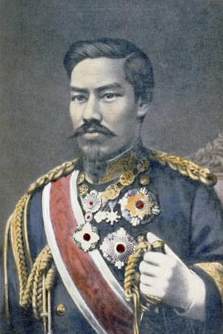
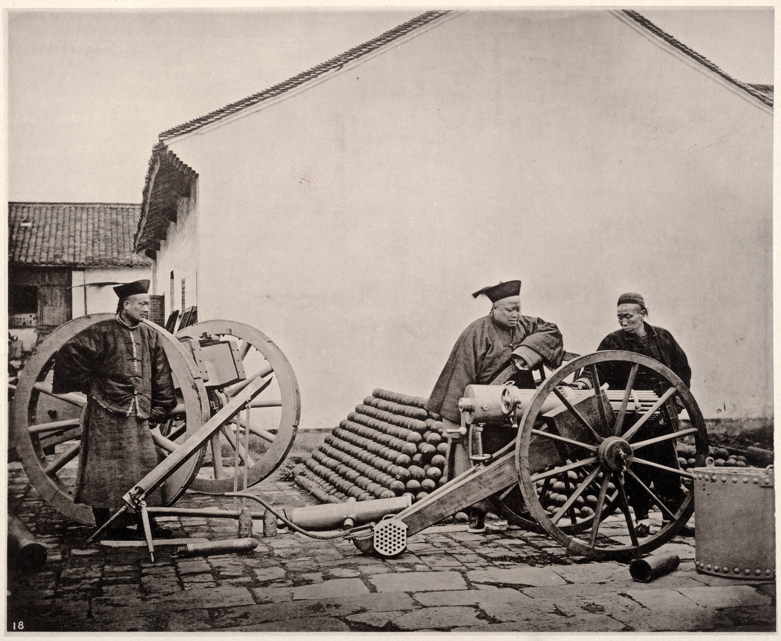
Industrial Revolution – East Asia
Meiji reforms Japan - 1868
Meiji Restoration – Emperor restored to supreme ruler, end of feudal Japan
Trade treaties with European nations and U.S.
Westernization – modeled government, economy, and societies after western powers
Self strengthening Qing China – 19th century
China not benefiting from foreign trade – limit port openings
Opium From British harmful to Chinese
Westernize industrially and militarily to self-sustain

Slide 12
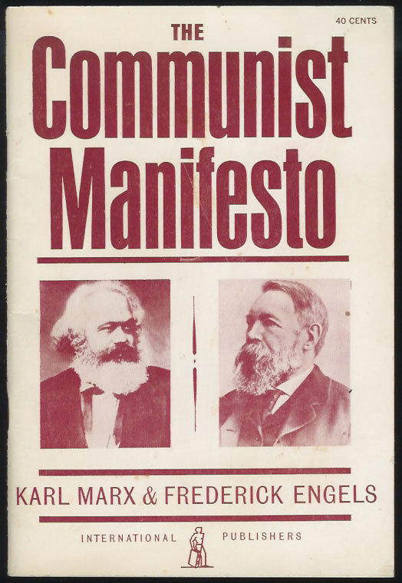
Outcomes of the Industrial Revolution around the world
The need for raw materials leads to increased global interactions, trade, colonization, and exploitation of workers
Western Europe and the United States become leaders in industrialization
Asia’s market shares decline
Economic Theories
Capitalism vs. Utopian Socialism
Beginnings of transnational businesses, stock markets, the gold standard, and insurance
United Fruit Company – U.S. company operating in Central America

