Slide 1
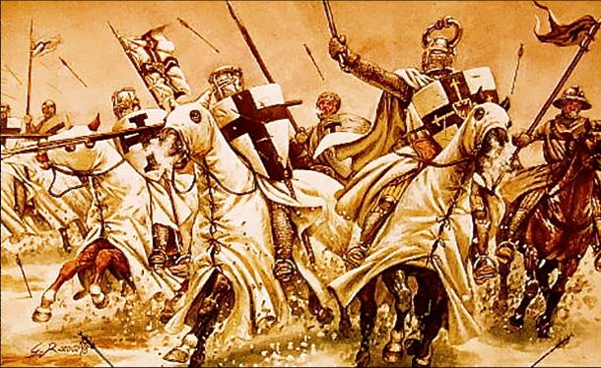
Invaders and aftermath

Slide 2
What causes wars to happen?
The need for resources
Conflicts of interest
Nationalism and political agendas
Boundary disputes

Slide 3
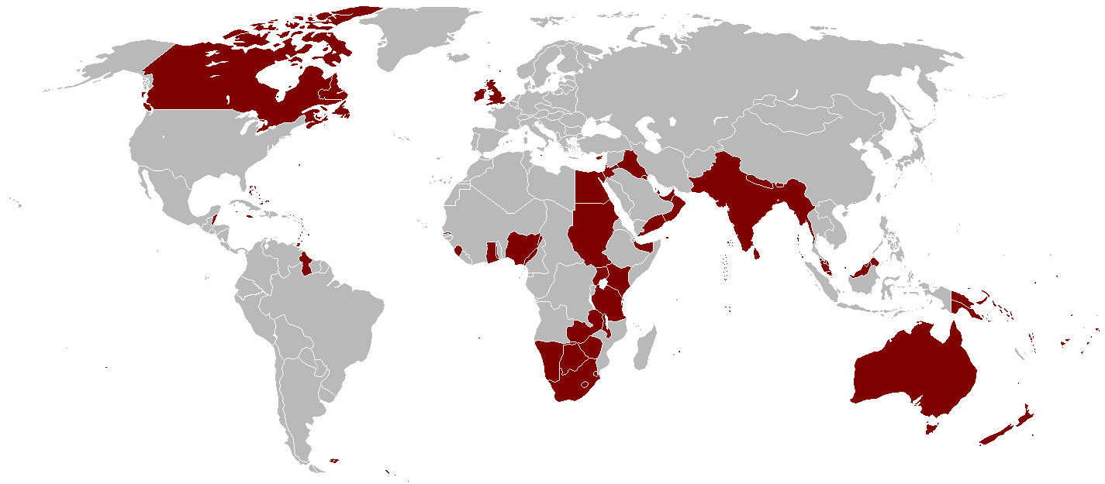
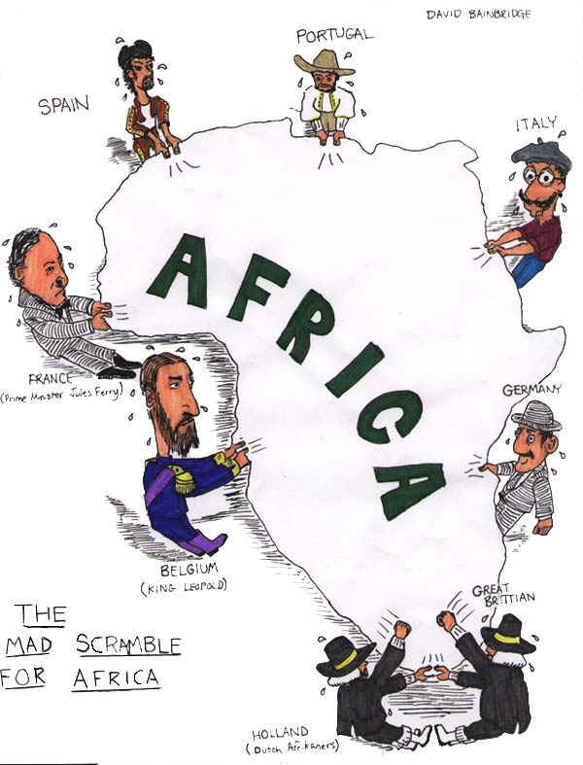
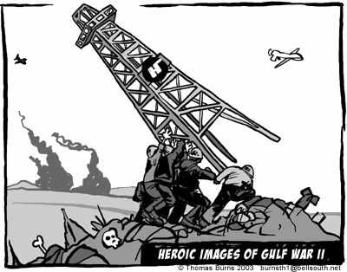
Need for Resources
Need for more land
Overpopulated
Ex: Great Britain during the Industrial Era
Natural resources
Oil
Aspects of Cold War
Persian Gulf War
Precious metals
Scramble for Africa (late 1800’s)

Slide 4
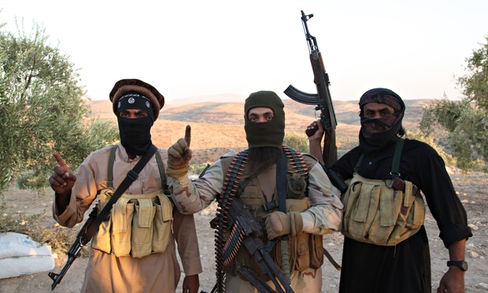
Conflicts of interest and Political agendas
Lands with special meaning to group
The Crusades
Cultural differences posing threats to neighboring territories
Germanic Invasions of Roman Empire
Ottoman Turks
Nations with ideas to make surrounding territories change their ways
Islamic Empire – Jihadist movement
1939 Germany
Vietnam War
ISIS today

Slide 5
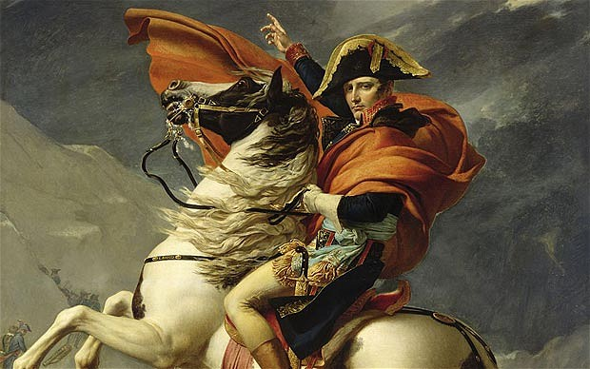
Nationalism
Nationalism:
an extreme form of this, especially marked by a feeling of superiority over other countries.
advocacy of political independence for a particular country.
Strong Nations wanting to become world powers
Macedonian Empire
Napoleonic France
Weak Nations wanting independence
American Revolution
Latin American Revolutions
WWI (Assassination of Franz Ferdinand)

Slide 6
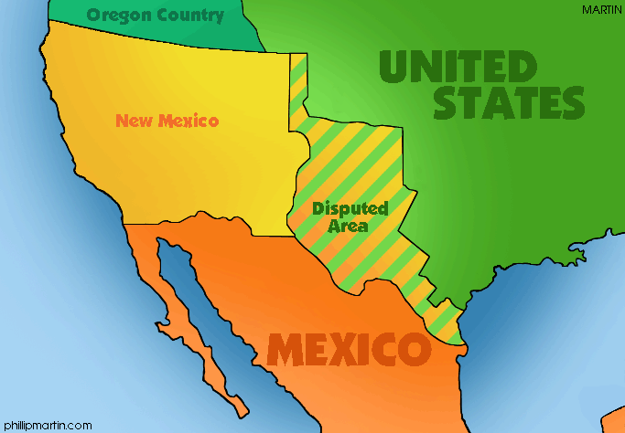
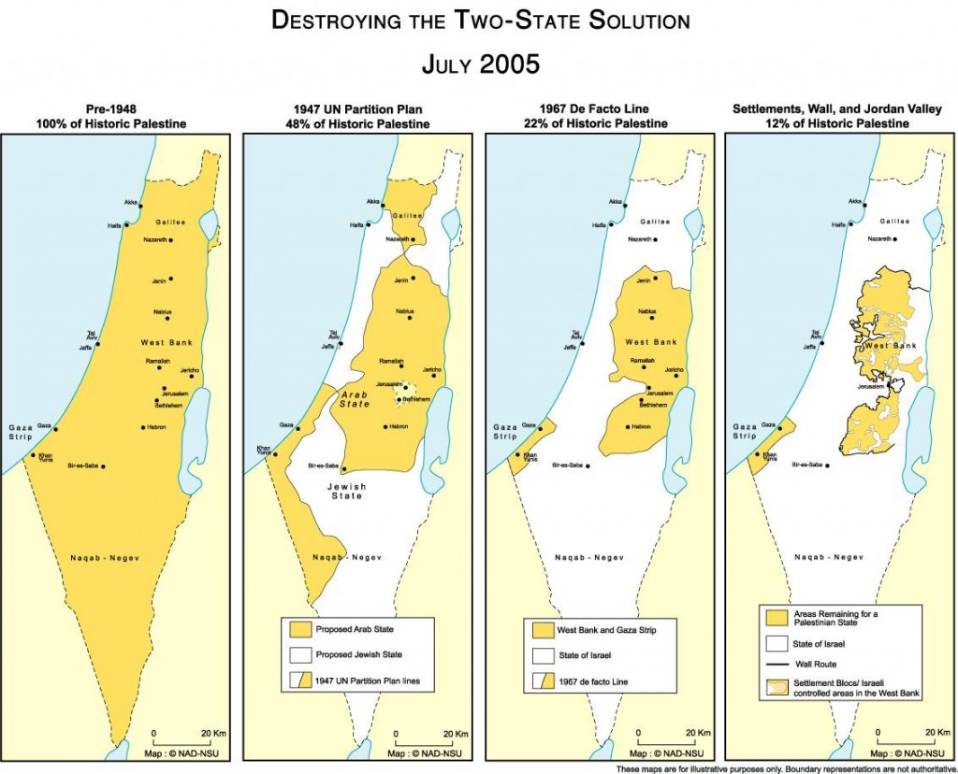
Boundary and territorial Disputes
Two or more groups disputing land claims
Mexican-American War
Korean War
Land can be meaningful not just in terms of resources
Crusades
Arab Israeli war
Special cases
Civil war (slavery dispute)

Slide 7
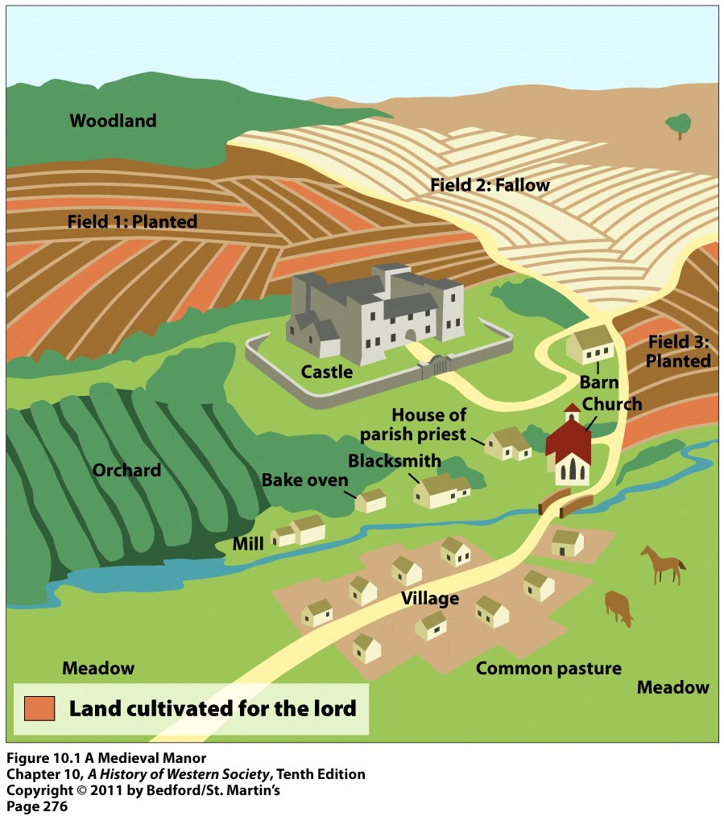
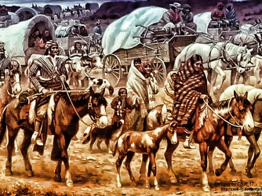
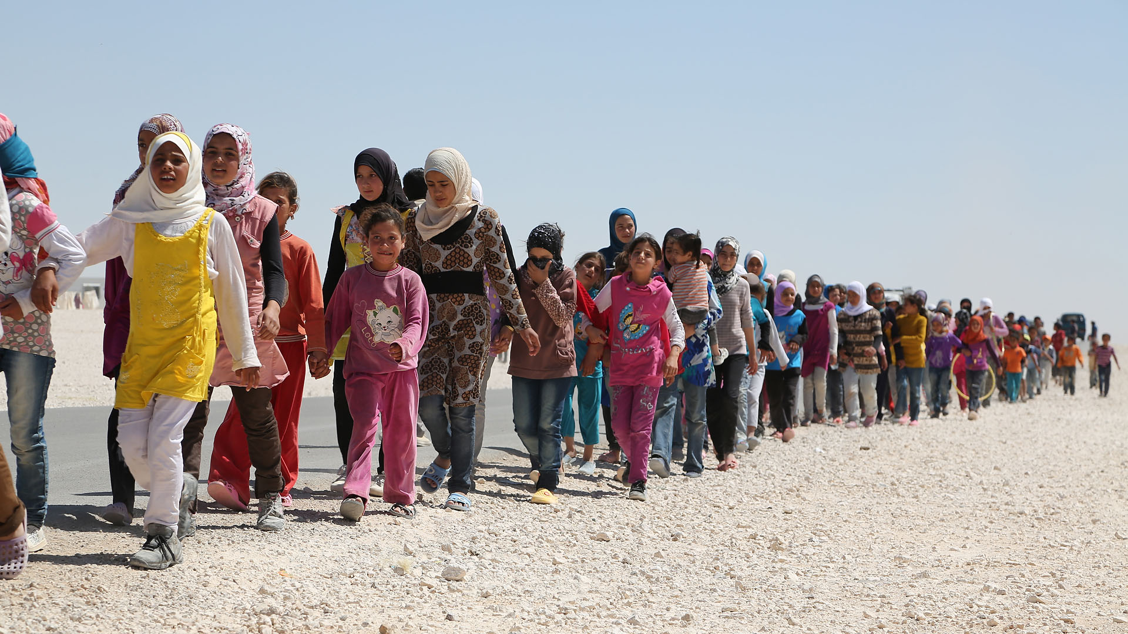
Aftermath of Classical and Post-Classical Warfare
Warfare from 600-1450 BCE left more problems than solutions
Cities destroyed
People scattered
Trade nonexistent
Civilization basically starts from scratch
Feudal Europe
Native American reservations
Syrian Refugees

