Slide 1
Rome and Han China
A comparison

Slide 2
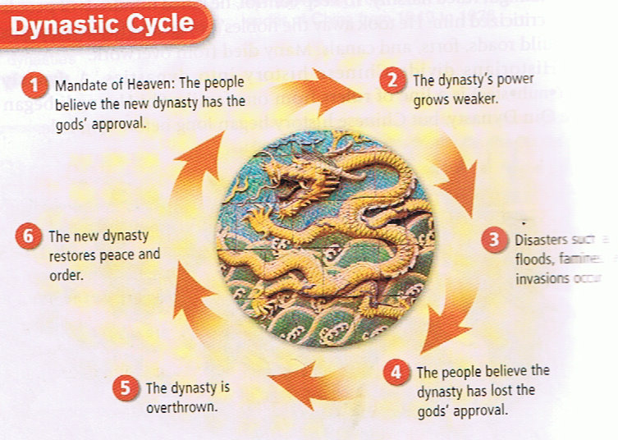
First… what is a “dynasty”
For much of China’s history, they used a political system to choosing emperors called the “ Dynasty System”
One family would rule, passing it on for generations
The first dynasty – Xia
actually made up by the Shang to legitimize their reason to rule
Dynasty’s could be overthrown by others
Mandate of Heaven – God no longer thinks family should rule
The Dynastic Cycle

Slide 3
Dynastic cycle

Slide 4
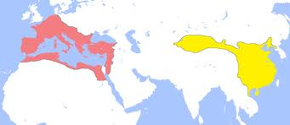
A brief history
Both Rome and Han China had started as smaller territorial holdings
Rome started as a city state
Han China expanded its control further than the Zhou and Qin dynasties
Both dynasties had proud engineering accomplishments
China: Roads, Canals, The Great Wall
Rome: roads, aqueducts, sewage systems

Slide 5
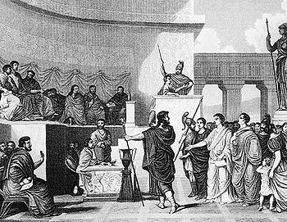
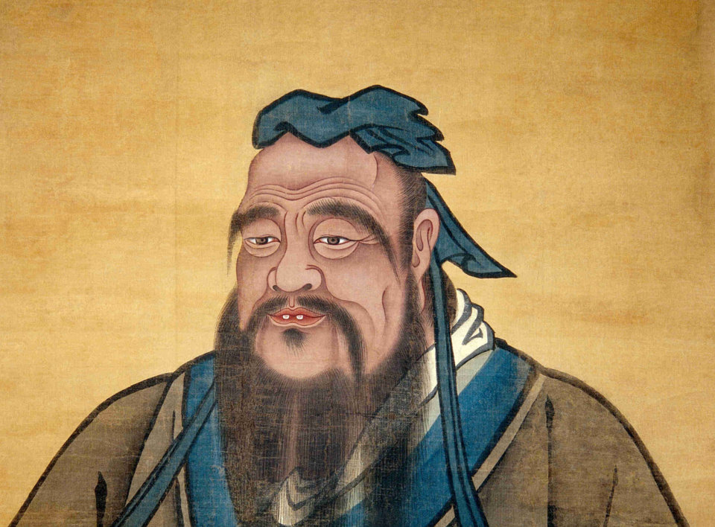
Government
Both had well organized bureaucracies
Rome used well made laws
Used ever-expanding military to grow and control new territory
local governors were given control
China used well trained men
Based on Confucian teaching of filial piety
Local government officials trained to rule over the provinces

Slide 6
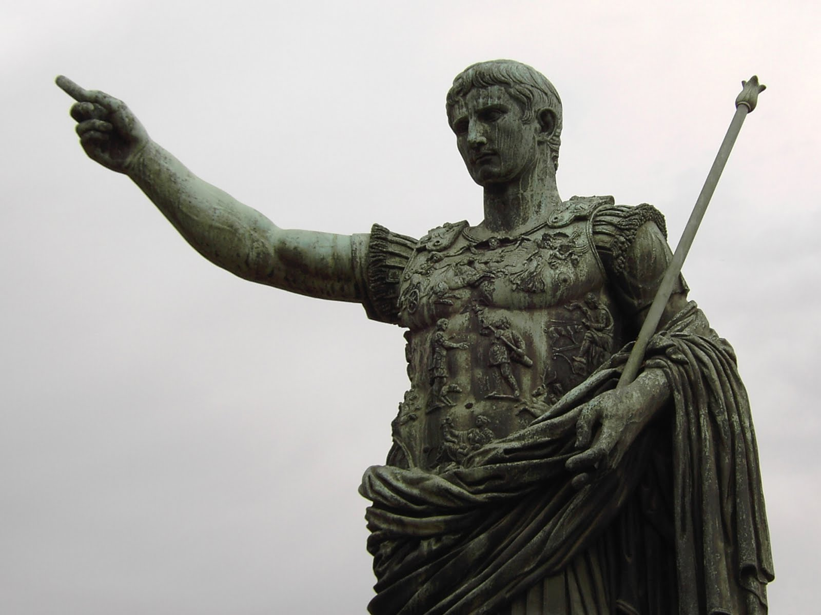
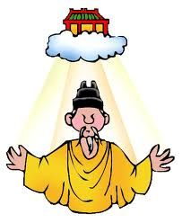
Religion
Both saw emperors as “divine” in some way
Rome: emperors had cult followings after death
China: emperors we’re seen as directly linked to heaven
Mandate of Heaven
Both saw an outside religion come in and take root
Rome: Christianity from the Middle East
China: Buddhism and Hinduism came in from India

Slide 7
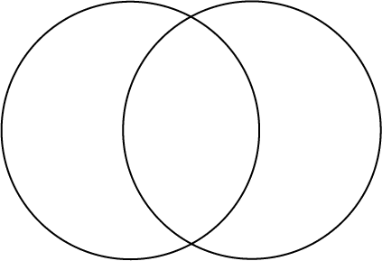
Decline
Although both empires were two of the most accomplished this world has scene, they eventual found themselves in decline
Activity: Using the document handouts, find the similarities and differences between the fall of Rome and Han China
Hint: do the 2 outside bubbles first, then move all of the similar reasons to the middle bubble
Rome Both Han China

