Slide 1
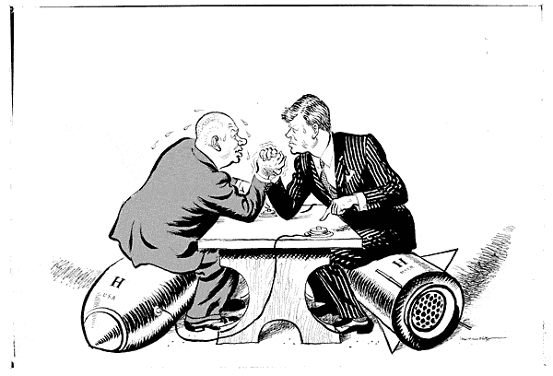
The Cold War problems already?

Slide 2
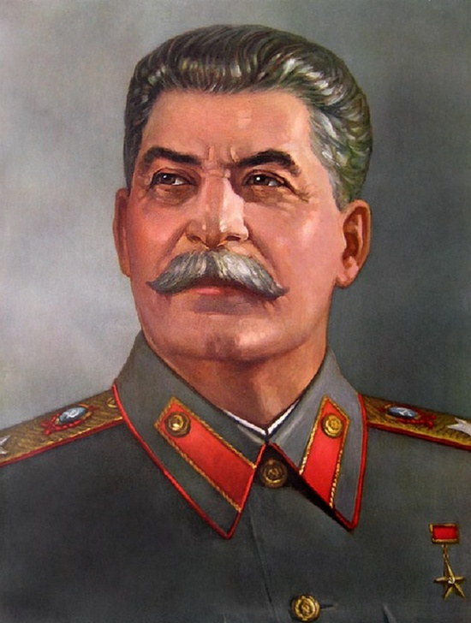
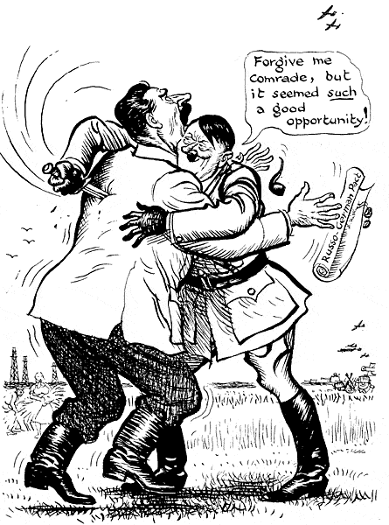
Pre-Cold War tensions
Joseph Stalin
Soviet Union communist dictator

Slide 3
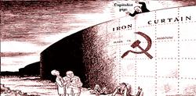
Russia’s post-WWII plan
Russia was virtually destroyed in WWII
Cities demolished (again)
Millions dead or wounded (again)
Economy non-existent (again)
Stalin wanted to make sure Russia was well protected in the future

Slide 4
The Iron-curtain
In order to protect Russia, Stalin wants “free” elections in Eastern European countries
These countries are currently occupied by Russian troops
These satellite states turn to communism
Become Russia’s “Iron Curtain”
Iron Curtain – the imaginary line between communist nations and democratic nations

Slide 5
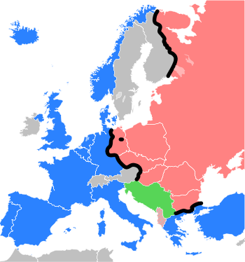
The Iron Curtain
Berlin

Slide 6
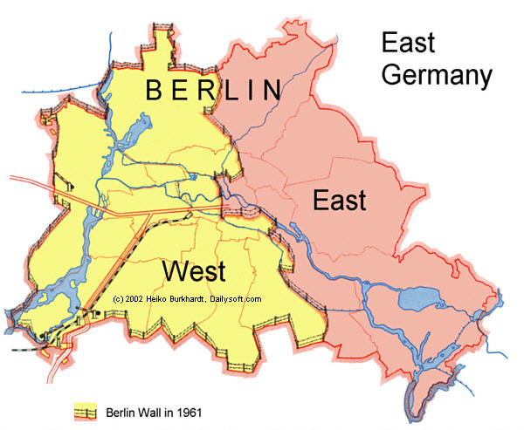
The Berlin Wall

Slide 7
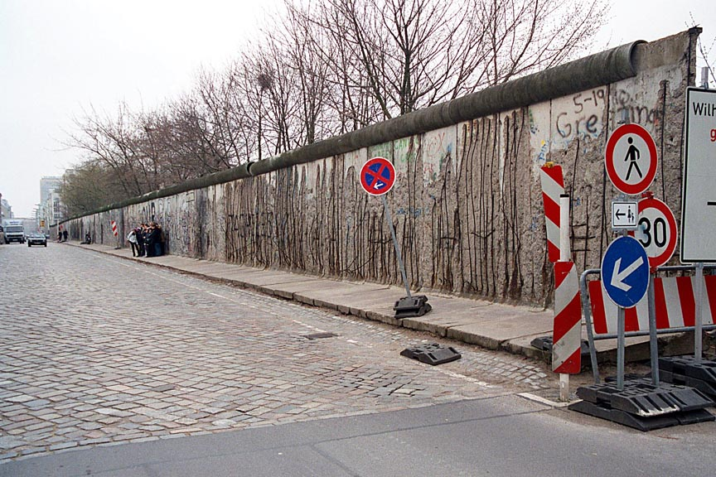
The Berlin Wall
The Soviet Union built a wall to divide the Capital of Berlin into two sections
West Berlin – Democratic
East Berlin – Communist

Slide 8
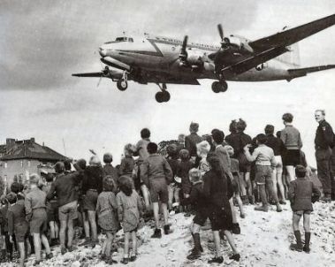
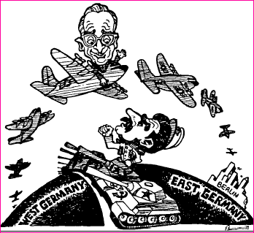
The Berlin Airlift
Russians want all of Berlin under communist control
People in West Berlin (democratic) are trapped.
For 11 months - sent planes with food, medicine and coal

Slide 9
Stopping Communism
Two plans were put in place to help stop the spread of communism to weaker nations
The Truman Doctrine – speech asking congress to provide foreign aid for Turkey and Greece
The Marshall Plan – proposal to congress asking U.S. to provide European countries with food, machines, and other materials needed

Slide 10
New Alliances
N.A.T.O.
North Atlantic Trade Organization
Western Europe, U.S., Canada
If any of these nations were attacked, others would have to fight
The Warsaw Pact
Warsaw Treaty Organization of Friendship, Cooperation, and Mutual Assistance
Russia, Poland, East Germany, Hungary, Czechoslovakia, Bulgaria, Albania

Slide 11
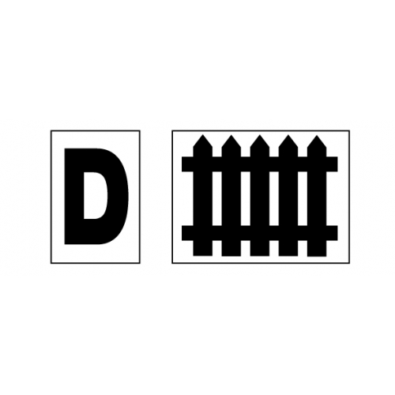
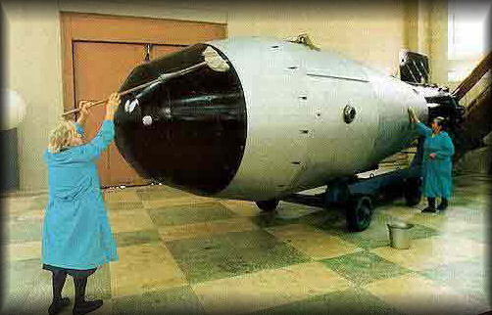
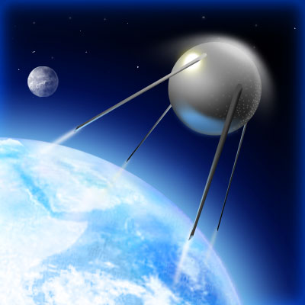
As tensions increased, defense was on the rise
U.S. and Russia begin to put more money towards scientific defense research

Slide 12
The Race to superiority
U.S. develops the Hydrogen Bomb
“H-bomb”
Russia develops H-bomb soon after
The Space Race
Russia sends first satellite into space
Sputnik
U.S. does the same soon after

