Slide 1
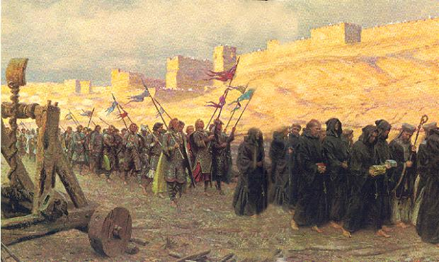
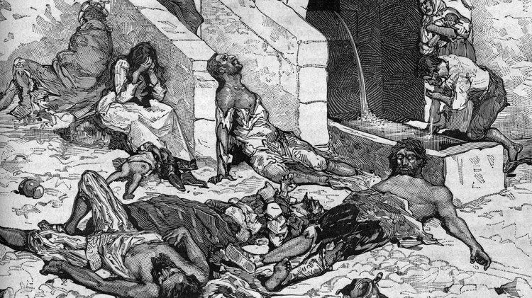
The Dark Ages

Slide 2
Feudal society
King
Nobles/Clergy
Knights
Feudalism – a economic system in which land is given in exchange for a service
Land given as payment called a “fief”
The only one more powerful than the king was God
Peasants

Slide 3
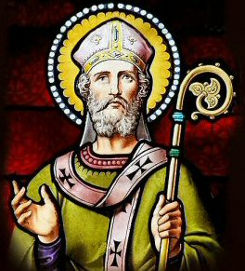
The Pope and the Church
Religion was a very important part of feudal life
The church had the ability to cleanse people of their “sins” (bad deeds)
Clergy (church officials) were considered to be in the same social class as wealthy nobles
The Pope was seen as the only person more important then the King

Slide 4
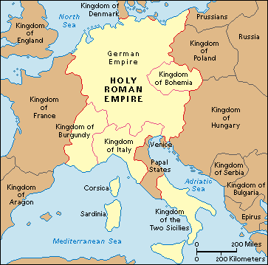
The importance of the Catholic Church
The Catholic church was the only thing that could bring order and stability to the divided kingdoms

Slide 5
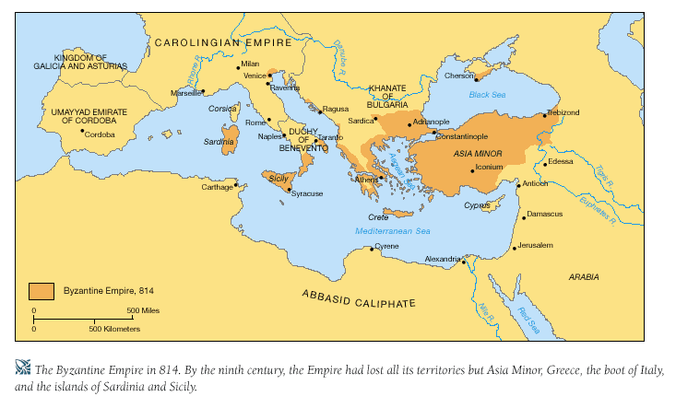
Trouble for Christian Europe
Holy Roman Empire
Byzantine Empire
Ottoman Empire

Slide 6
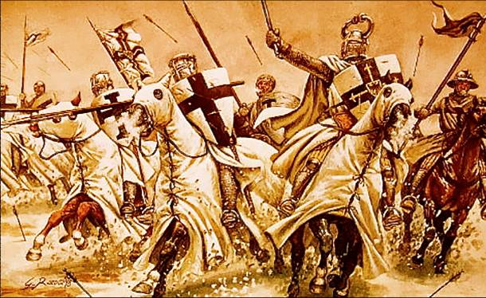
The Crusades
The Crusades – a series of “holy wars” that lasted hundreds of years
The Muslim Turks had taken control of Jerusalem (a holy place for Christians)
Pope Urban II calls upon all Christians in Europe to take back the holy land from the Muslims
Pope declares that all who join will be forgiven of their sins
Rulers and nobles from all different kingdoms come together to fight for a common cause

Slide 7
Effects of the Crusades
Although the Christians did regain temporary control of Jerusalem, The Turks proved to be too much for the European crusaders
However, there were other effects:
Effects of the Crusades
Spread of new ideas and technology
Increased trade:
And a new Middle Class of Merchants
Bad blood between Christians, Jews, and Muslims

Slide 8
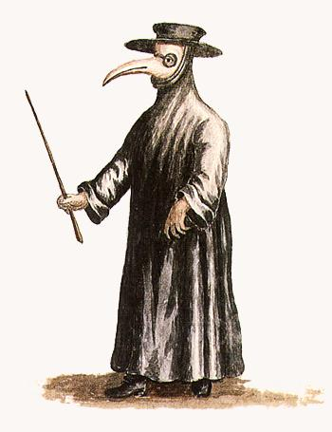
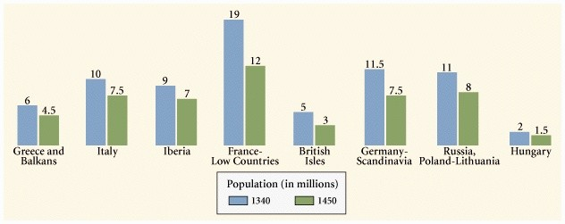
Trade leads to Death
Luxury items weren’t the only things traveling with merchants from Asia to Europe
The Bubonic Plague
Also known as “Black Death”
Infected fleas traveled on rats inside trade ships
Overall, the Plague killed between 100-200 million people

