Slide 1
American Propaganda
Walt Disney Video: “Education for Death: Hitler’s Children.”
https://www.youtube.com/watch?v=6vLrTNKk89Q
As your watching think about:
Who was the intended audience of this video and why is this significant?
What do you think a video like this would look like from the German point of view?

Slide 2
Why did the US enter the war?
Japanese attack on Pearl Harbor
December 7, 1941
Pearl harbor attack scene:
https://www.youtube.com/watch?v=bxIsVYdB0lA

Slide 3
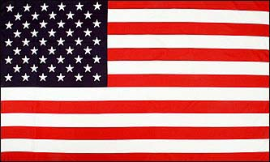
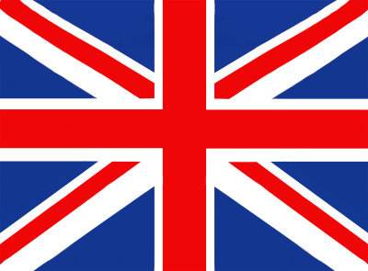
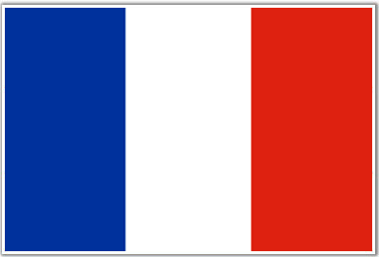
Key Allied victories in WWII

Slide 4
Pacific Theater
Battle of Midway =
turning point in the Pacific
Commander: Chester Nimitz
Americans destroyed Japanese Aircraft carriers
Destroyed over 300 Japanese planes
Japanese navy now very weak

Slide 5
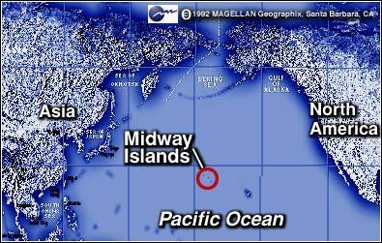
Battle of Midway
https://www.youtube.com/watch?v=N-au50GxIXw

Slide 6
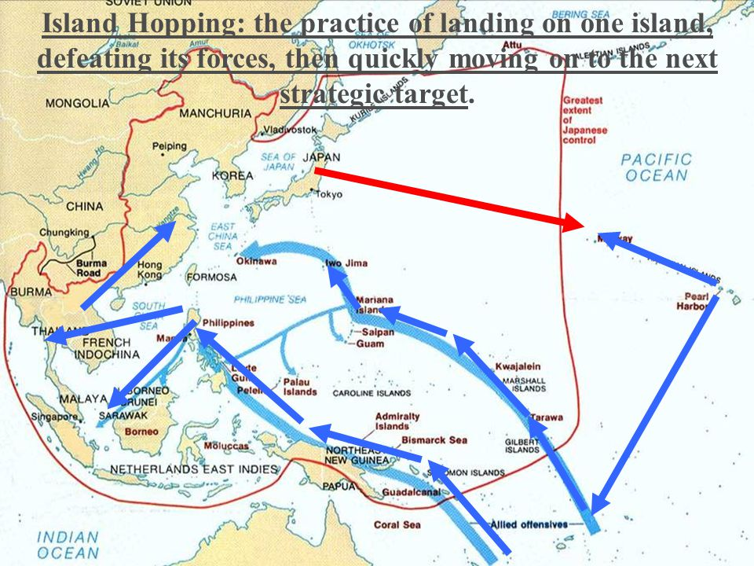
Pacific Theater
Island Hoping
Commander: Douglas MacArthur
Take the small islands between Japan and the rest of their captured territory

Slide 7
Pacific Theater
Atomic Bombs
German scientist Albert Einstein sent a letter to President Roosevelt explaining that German scientists were starting to develop Atomic bombs
Americans wanted to make one first
President Truman ordered the use of Atomic bombs on Japan (Roosevelt died of Heart attack)
Bombed two small islands : Hiroshima and Nagasaki
V-J Day (victory in Japan day)

Slide 8
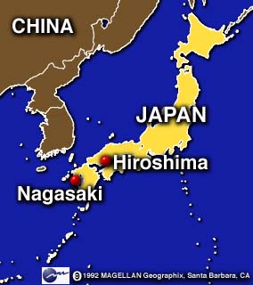
Hiroshima and Nagasaki
http://www.youtube.com/watch?v=ncq_Wye43TM

Slide 9
European Theater

Slide 10
North Africa Campaign
Italy had taken over parts of North Africa
Allies knew Italy was the weaker army
Commander: George Patton
American troops landed in Africa and made their way up through Italy

Slide 11
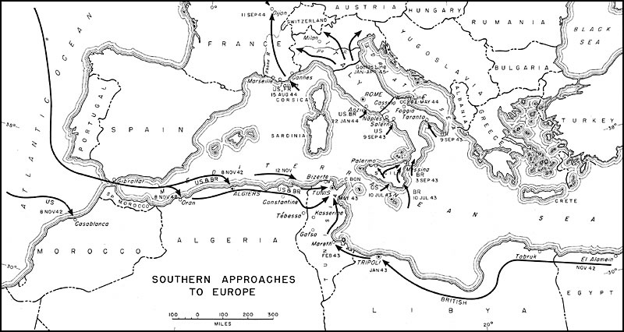
North Africa Campaign
http://www.history.com/shows/wwii-in-hd/videos/north-africa-campaign?m=512538ae162a4

Slide 12
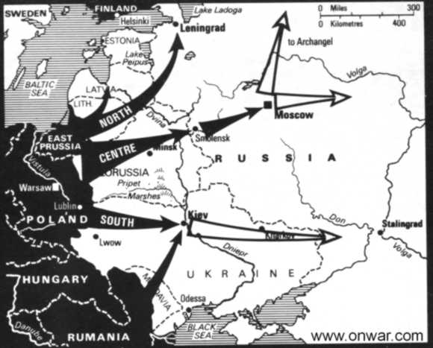
Hitler invades Russia
Hitler originally signed a Non-Aggression pact with Russia (1939)
Hitler decides to invade Russia in 1941
His biggest mistake
Now Germany fighting on two sides of the continent
Russia continues to push Germany back

Slide 13
Stalingrad
http://www.history.com/shows/wwii-in-hd/videos/world-war-ii-battle-of-stalingrad?m=518971be8380b

Slide 14
Storming the Beaches of Normandy
Roosevelt and Churchill promised Stalin they would help split up the German army by attacking German troops occupying France
Commanders: Dwight Eisenhower and Omar Bradley
Landed on the beaches of Normandy
Also known as “D-day”

Slide 15
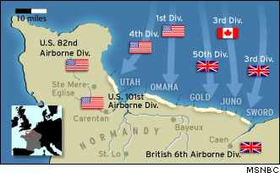
D-day
https://www.youtube.com/watch?v=h5p5j_K0CsY

Slide 16
Battle of the Bulge
Allied forces pushed Germans back to their original countries borders
Hitler sent one last offensive attack
Nicknamed the “Battle of the Bulge”
Commander: Omar Bradley
American, British, and French forces beat the Germans and continued to chase Germans back to their capital city of Berlin

Slide 17
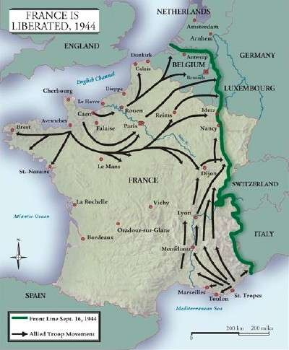
Battle of the Bulge
http://www.history.com/shows/wwii-in-hd/videos/battle-bulge?m=512538ae162a4#

Slide 18
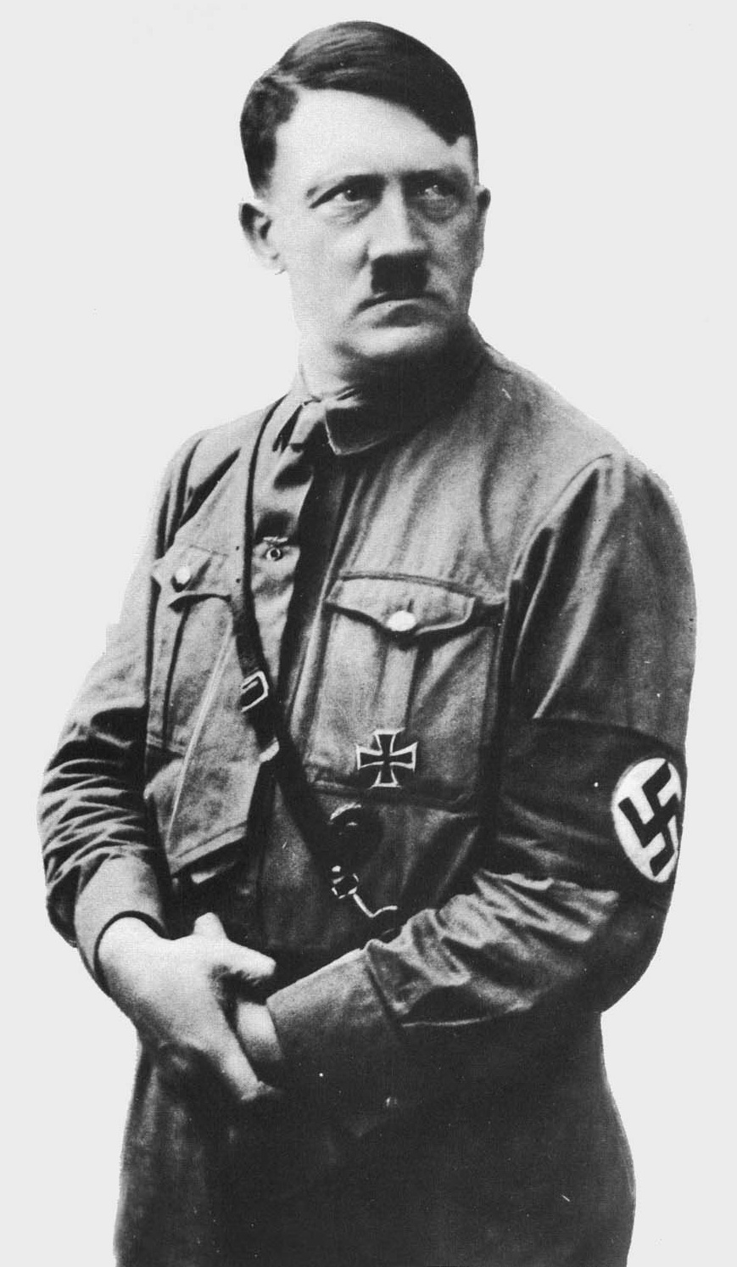
Hitler realizes his fate
http://www.youtube.com/watch?v=t7PmzdINGZk

