Slide 1
Warm up – Tuesday 3/28
Words of the Day – Inflation (economic), depression (economic)
Define the following terms
Inflation – prices increase, but buying power of $ decreases
Depression – sustained downturn in economic activity

Slide 2
Treaty of Versailles reflection
After watching the Treaty of Versailles video, explain how your country’s leader would feel about the finalized terms of the treaty
Would they mostly approve or disagree with the stipulations?
Are there any main points of the treaty your person would’ve vastly disagreed with?
Which terms would your country most agree and why?

Slide 3
Causes of World War II
RENT

Slide 4
Rise of Totalitarian Dictators
Soviet Union – Joseph Stalin
1917 Bolshevik Revolution led to Communist Soviet Union
Italy – Benito Mussolini – Fascist Party
Germany – Adolf Hitler – Nazi Party
Spain - Francisco Franco
Japan – military dictators supported by the Japanese Emperor Hirohito

Slide 5
Economic Crisis
Many European countries went away from the Gold Standard
Relied heavily on paper money
Inflation caused by over printing money to spend on armaments
Stock Market Crash of 1929
U.S. businesses went bankrupt
Bank closures
High unemployment, lack of food & shelter led to dictators being VOTED into office because they promised change

Slide 6
Nationalism (Imperialism)
Expanding Italy
1935 - Invades Ethiopia
Expanding Japan
1931 – invaded Manchuria
1937 – war with China (US economic embargo)
US Flying Tigers (volunteer pilots) deliver supplies to China and fight the Japanese
1941 – invaded Indochina

Slide 7
Treaty of Versailles
The Treaty of Versailles punished Germany for starting WWI – Hitler promised to re-build Germany to the greatness it was
Treaty included all of the following
Germany had to take blame for starting WWI
Germany had to limit the number of soldiers/tanks/planes in their military
Germany had to pay all war reparations ($33 billion U.S.)
Germany had to give up all land taken, plus more

Slide 8
Problems with the Treaty
Not fair to all who fought
Did not fix the MAIN causes of WWI
Militarism
Alliances
Imperialism
Nationalism
Put Germany into an economic depression
Left Germany with a weak central government
Weimar Republic blamed by people for causing poverty

Slide 9
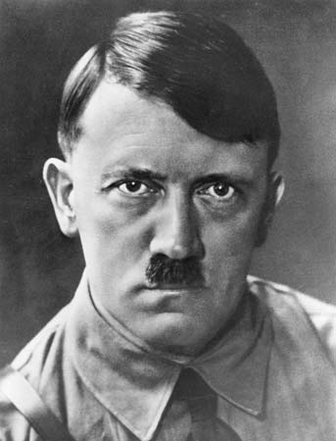
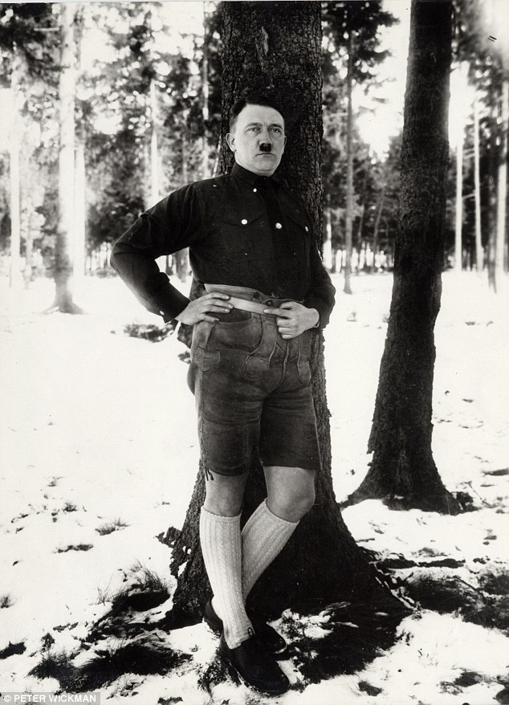
Adolf Hitler

Slide 10
Adolf Hitler
People demand change, Weimar Republic allows Adolf Hitler to be elected Chancellor of Germany
Nazi Party
Hitler replaces republic with dictatorship
Wants to build a strong country, rid the country of those not fit to breed (Jews, Gipsys, Poles, Slavs)
Ignores Treaty of Versailles stipulations
Promotes military industry to increase number of jobs
Soldiers, munitions workers, tank and plane engineers
Blames the Allied Powers

Slide 11
Hitler’s moves towards war
Expand Germany
1936 – annexed Rhineland
1938 – annexed Austria
1938 – Munich Conference (APPEASEMENT) – granted Sudetenland
1939 – Non-Aggression Pact with Soviet Union
September 1, 1939 – invades Poland (France & Britain declare war on Germany)
WWII begins

Slide 12
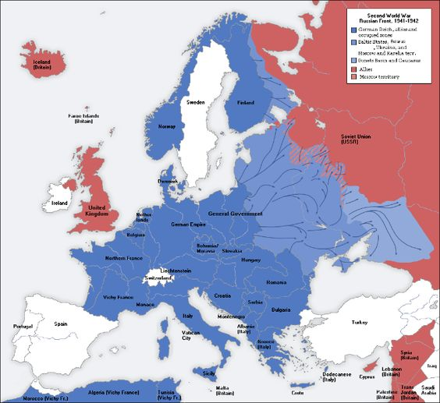
1941

Slide 13
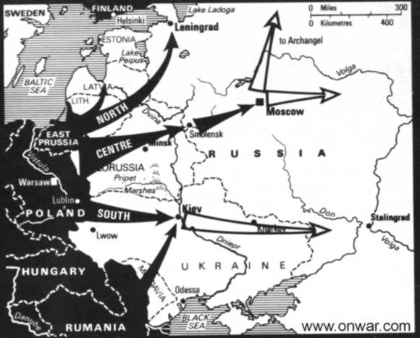
Stalingrad
http://www.history.com/shows/wwii-in-hd/videos/world-war-ii-battle-of-stalingrad?m=518971be8380b

