Slide 1
Ancient Egypt

Slide 2
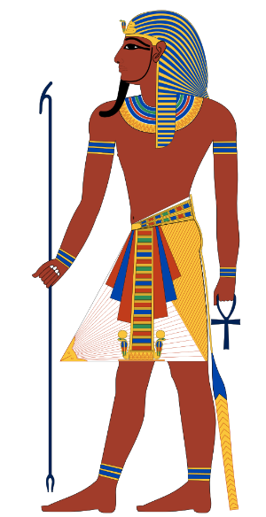
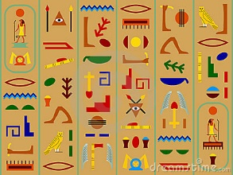
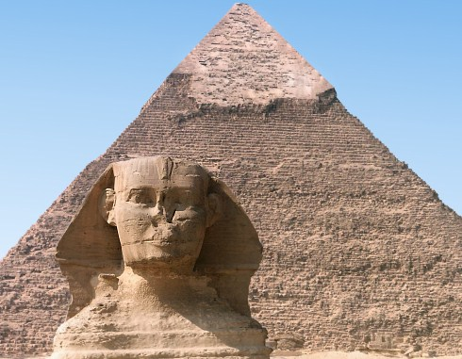
Ancient Egypt
Characteristics of Civilization
Advanced Cities | Thebes, Memphis, Nubia Cities had power over the surrounding lands
Specialized Workers | priests, scribes, builders, pottery sculptors, jewelry makers
Complex Institutions | Highly organized building projects (pyramids) Schools Temples ran by the priests
Record Keeping | Hieroglyphic writing (symbols that stood for ideas)
Advanced Technology | Papyrus paper, toothpaste Advances made in engineering, astronomy, and medicine

Slide 3
Mesopotamia

Slide 4
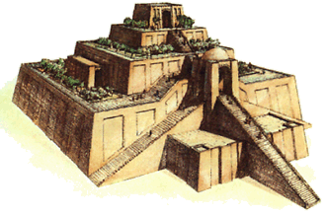
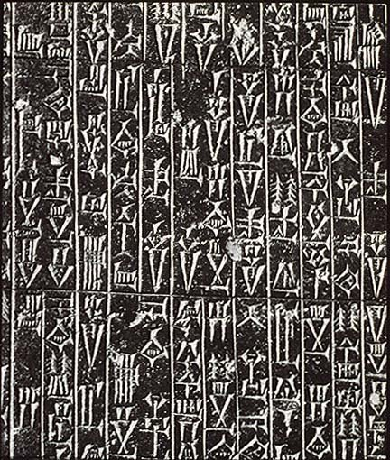
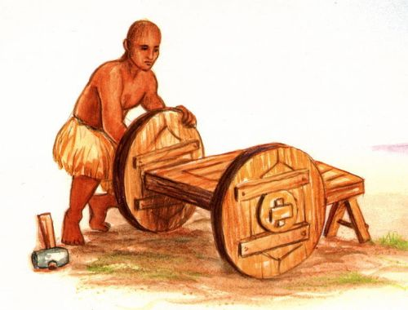
Mesopatamia
Characteristics of Civilization
Advanced Cities | Uruk, Ur, Babylon, Kish, Umma Cities had central temples called Ziggurats
Specialized Workers | Warriors, scribes, farmers, priests
Complex Institutions | Rulers created written codes of law (Hammurabi's Code)
Record Keeping | Cuneiform (the worlds first system of writing)
Advanced Technology | Wheel, sail, plow, First society to make bronze

Slide 5
Ancient China

Slide 6
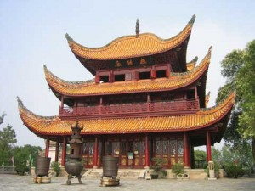
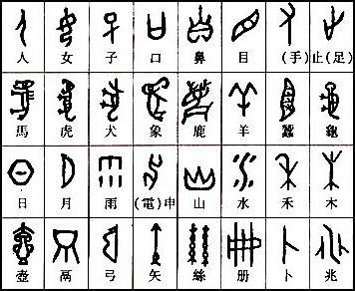
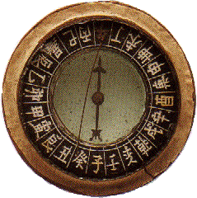
Ancient China
Characteristics of Civilization
Advanced Cities | Anyang, Zhengzhou, Yangzou, The forbidden city Cities had massive walls to protect them
Specialized Workers | Jewelry makers, sculptors, warriors, sailors
Complex Institutions | Rulers organized workers for massive building projects Dynasties (ruling families) Organized military
Record Keeping | Used pictographs Were able to keep long records with invention of paper
Advanced Technology | Paper, gunpowder, compass, Had very advanced ships

Slide 7
Indus River Valley

Slide 8
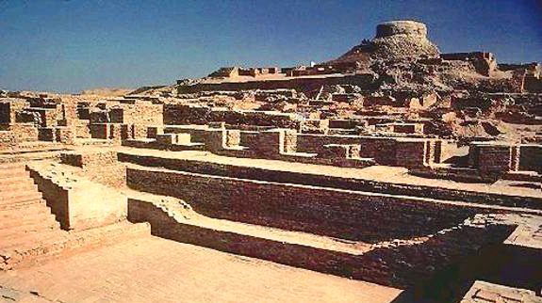
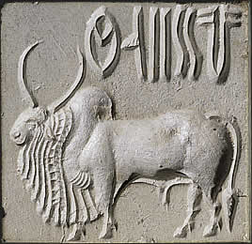
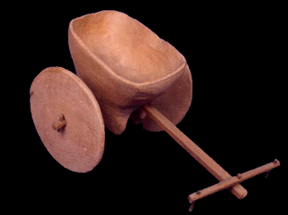
Indus River Valley
Characteristics of Civilization
Advanced Cities | Harappa, Mohenjo-Daro Neatly laid out streets and fortified areas
Specialized Workers | Pottery sculptors, weavers, farmers
Complex Institutions | Organized labor for building projects Elaborate cities show evidence of organized government
Record Keeping | Ancient writing that has not been deciphered yet
Advanced Technology | Plumbing, wheeled cart, the ruler (for measuring)

