Slide 1
Primary Sources
How to analyze sources using H.I.P.P.

Slide 2
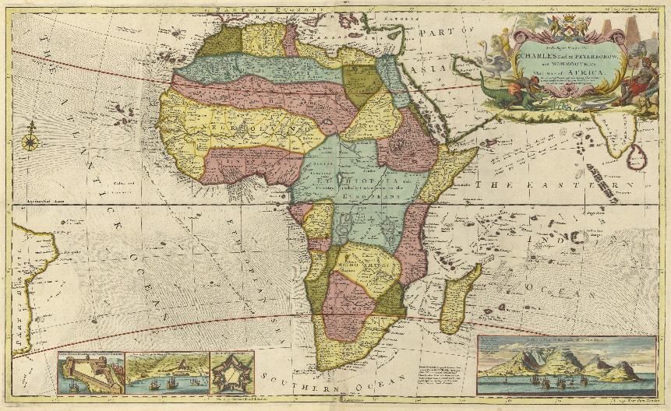
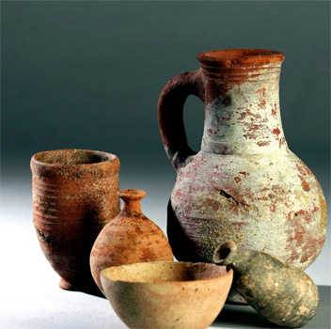
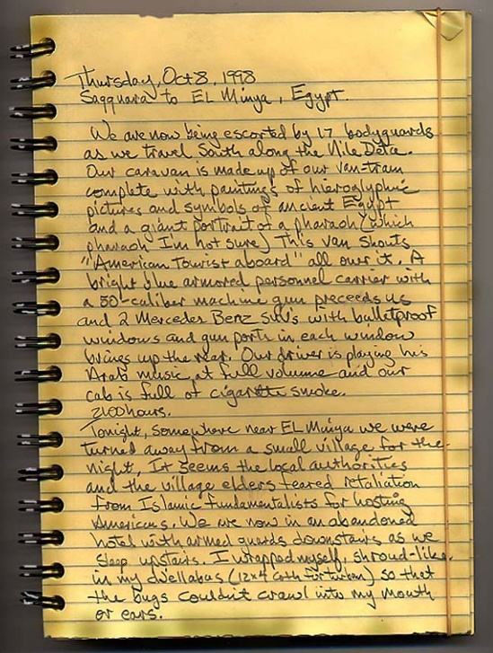
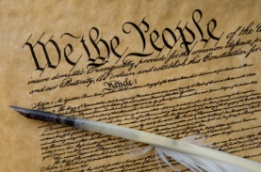
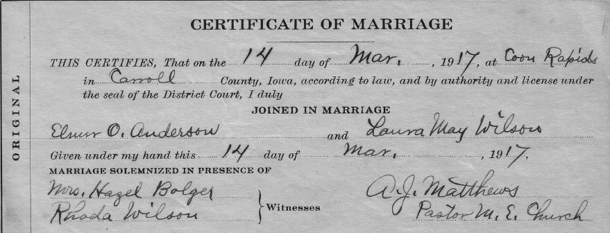
What is a Primary Source
A primary source is anything created by, written by, or described by someone who was present during the event.
Artifact
Maps/drawings
Letters
Documents
Notes:
So how do we know all about these early years, before historical documents existed? We examine the evidence….
Archeologists excavate and study traces of early settlements (they are the digger uppers). Anthropologists examine the artifacts found by the archeologists to learn about the culture of the settlement. Paleontologists look at the fossils (or bones that are naturally preserved) found at these excavation sites to determine what physiological differences there may have been between these fossils and modern man. They also examine fossils for things like evidence of how these early humans may have died or lived (also part of their culture). For example, teeth can tell a lot about what their diet may have been. Spear heads found inside the fossils or other signs of trauma may indicate a warlike culture.

Slide 3
How to analyze a Primary Source
Use HIPP
H (Historical Content): What kind of document is this, when was it made, and what is the main idea? For pictures: What is occurring in the image? Summarize the source in 1 sentence.
I (Intended Audience): Who was this document created for? Who would see it or read it?
P (Purpose): Why is the author writing this (inform, persuade, warn?) For pictures: Why did the author create this image?
P (Point of View): What can we tell about the author’s background? Gender, age, job title, etc.? Does this authors background have any effect on the tone of the primary source? (what “glasses” are they wearing)

Slide 4
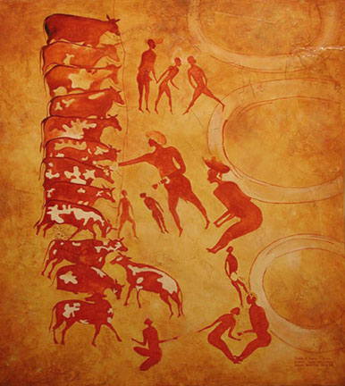
#1
H
I
P
P
The domestication of animals. Cave painting. C. 4000 BCE

Slide 5
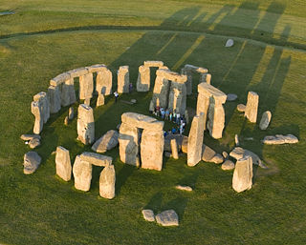
#2
H
I
P
P
“Stonehenge” Great Britain C. 3000 BCE

Slide 6
#3
H
I
P
P
“Laws of Hammurabi”, Mesopotamia 2300 BCE

Slide 7
#4
H
I
P
P
Traditions of Exemplary Women, Lienü Zhuan C. 77 BCE

Slide 8
#5
H
I
P
P
“The Bloody Massacre,” Paul Revere 1770

