Slide 1
Warm Up – Monday 1/30
Last semester we left China after studying the Tang, Song, and Yuan (Mongol) dynasties.
The Dynastic cycle continues! Draw and explain (1 paragraph) the dynastic cycle in your own words in Monday’s warmup box.
New Dynasty
Period of prosperity
Period of Decline
Period of rebellion
Loses Mandate of heaven

Slide 2
China and Japan ~1450-1750
Exploration and Isolation in Asia

Slide 3
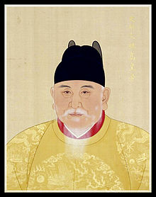
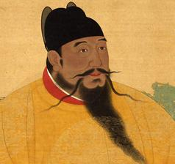
Ming Dynasty: China 1368-1644
Emperor Hongwu
Rid China of Mongol rule (Yuan Dynasty)
Passed reforms to restore prosperity and power to China
Killed government officials out of fear of conspiracy
Emperor Yonglo
Moved capital from Nanjing (south) to Beijing (north)
Experimented with exploration - led by Zheng He

Slide 4
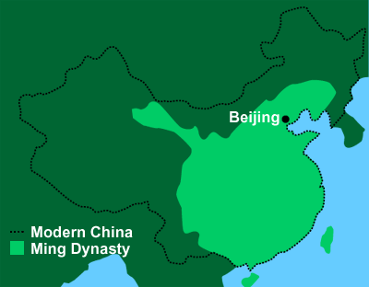
Ming Beliefs/Restoration
Erased Mongol influence from the Yuan Dynasty rule
Mongol dress & names discouraged
Promoted Confucianism
Brought back Civil Service Exam for government employee
Created national school system
Reestablished bureaucracy
Expanded size of China from previous dynasties
Restored Great Wall and expanded (keep out invaders from north)

Slide 5
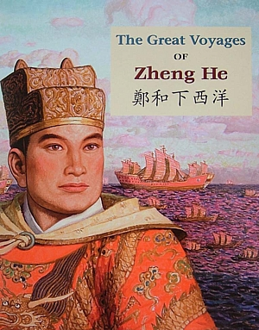
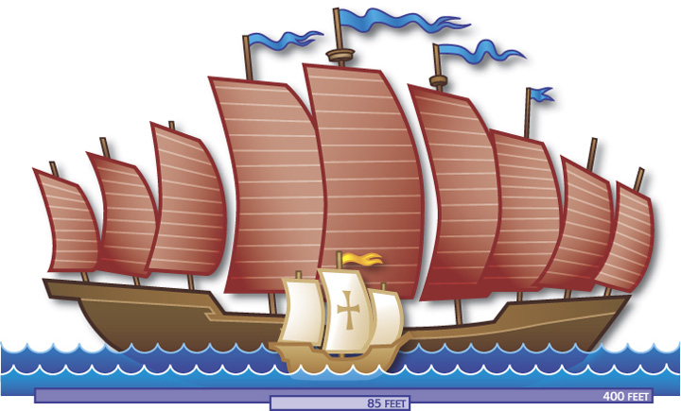
Zheng He’s travels
Went on 7 voyages in total
Traveled to India, Southern tip of Africa, Eastern Africa
40 to 300 ships traveled together on each mission
Brought gifts to wherever they traveled
Wanted to show the splendor of the Ming Dynasty
Brought back new understandings of the world
Chinese scholar-officials argued it was a waste of resources
Worried these interactions were threatening China’s social order
Were very traditional, looked down upon other cultures

Slide 7
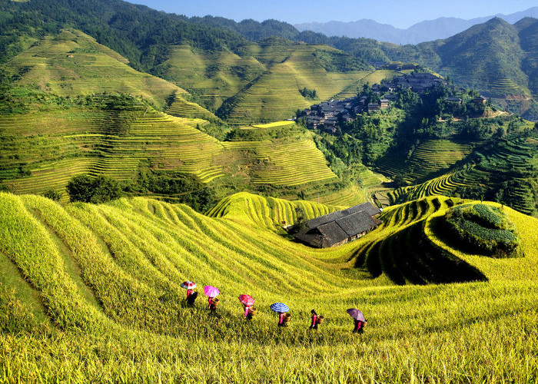
Ming isolationism
Ming rulers adopted a policy of isolation
Trade was not profitable
went against Confucian teachings
Only had a few ports open along the coast for trade
Merchants would smuggle Chinese luxuries to European countries
Demand for Chinese goods was high
Government refused to focus on Industrializing
Instead focused on increasing agricultural production

Slide 8
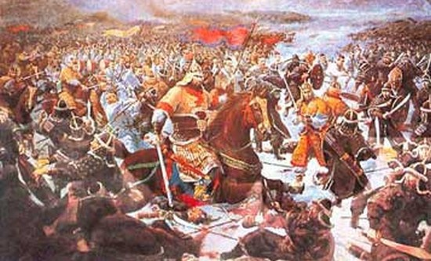
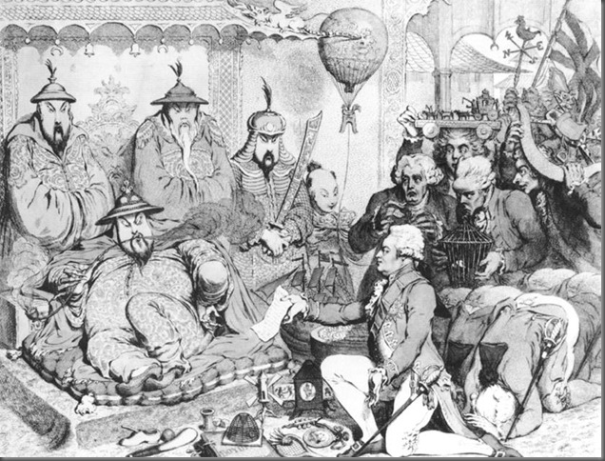
Qing China 1644-1911
Manchus invade Beijing and take over Ming China
Emperor Kangxi
First Qing emperor (longest-reigning)
Expanded China: Taiwan, Mongolia, and Central Asia & Tibet (mountains north of India)
Continued policy of Isolationism
Forced tribute (tax) upon countries who wanted to trade
Made rulers kowtow (physically bow down to the Emperor)

Slide 9
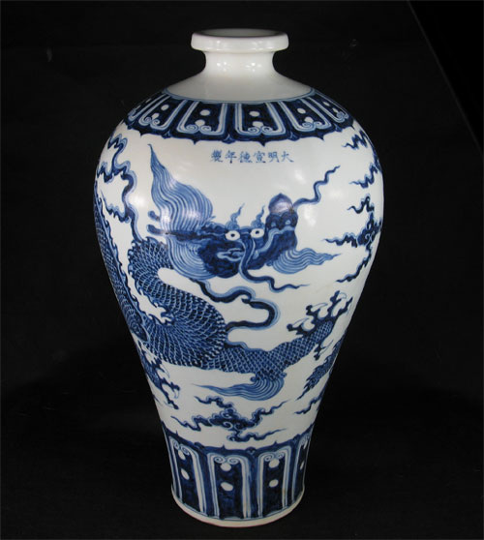
Ming and Qing society
Population boom due to agriculture
Men were heads of household
Women stayed at home, educated children
Culture stayed traditional
High quality pottery
Traditional paintings
Plays about Chinese history

Slide 10
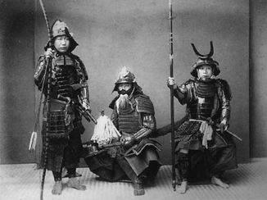
Tokugawa Japan 1600-1867
Period of war where Daimyo (wealthy landowners) fought for power
Tokugawa Shogunate 1603
Tokugawa Ieyasu – moved capital to Edo(Tokyo)
Brought stability to the region
Reestablished a strong central military government
Silk production flourished, silver became an important role in trade, banking & paper money develops
Agricultural production increased dramatically
Art and literature prospered: refined woodblock prints, kaihu (poetry), Kabuki Theater (dance-drama)

Slide 11
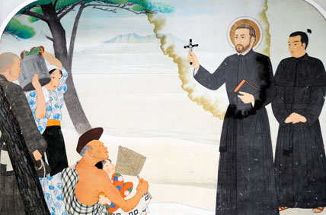
Tokugawa and trade
European explorers began arriving in Japan in mid 16th century
Brought new technologies and ideas
Muskets, cannons, tobacco, Christianity
Jesuit missionaries traveling with the merchants converted over 300,000 Japanese by year 1600
Many peasant uprisings against the government around this time
Tokugawa Ieyasu believed Christian ideals caused the rebellion
Japan closed its ports to nearly all European Countries

Slide 12
Extra Credit opportunity
Go see the new movie “Silence” in theatres now.
Write a 2 paragraph summary
One paragraph summarizing the movie
One paragraph explaining a few things you learned
Staple your ticket stub to the paper. (Don’t lose it!)
Replaces a quiz grade with a 100
Due March 6th
https://www.youtube.com/watch?v=kkuUOeP6ZFE

