Slide 1
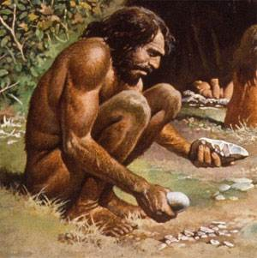
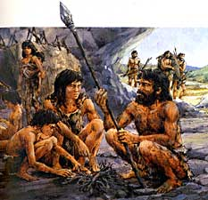
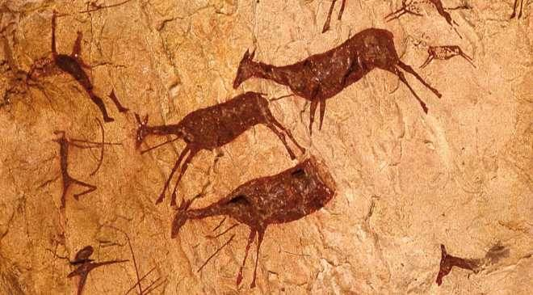
The Paleolithic Age (The “Old Stone” Age)

Slide 2
Pic #1

Slide 3
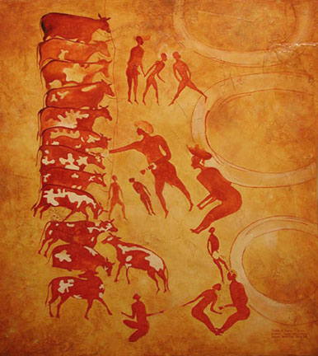
Pic #2

Slide 4
Find the differences between 1&2
Picture #1
Picture #2

Slide 5
Some differences
Picture #1
Picture #2
Hunting animals
Deer?
Using bows and arrows
Small group - men?
Herding or breeding animals
Cows?
Feeding them from their hands
Large group - Men, women, children?

Slide 6
What do you think daily life looked like in this society?
What do men do?
What do women do?
Where did people live and sleep?
What else did they eat?
What did people do in their free time?
Is life easy or hard?

Slide 7
The Paleolithic Age (The “Old Stone” Age)

Slide 8
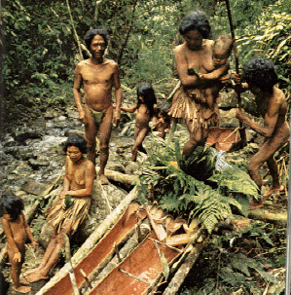
Paleolithic Man
Paleolithic = Old Stone
In the Paleolithic Era, humans lived in small groups of 20-50 people.
Nomadic - traveled around to find food. Did not live in one place.

Slide 9
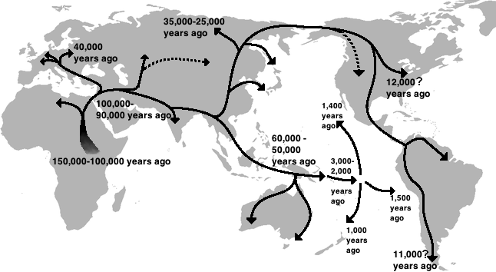
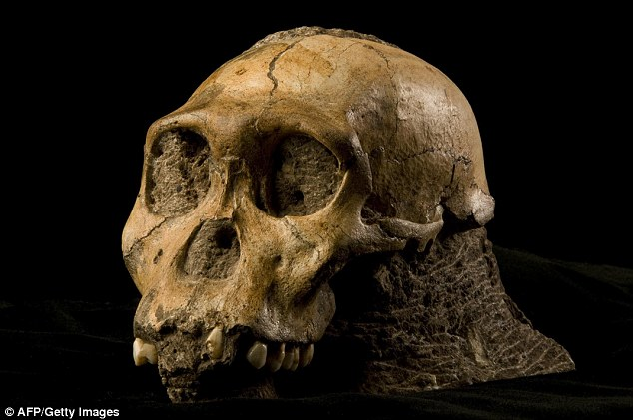
First Humans came from AFRICA

Slide 10
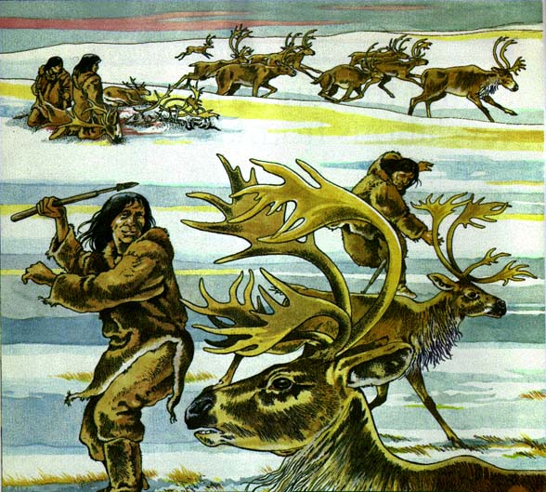
Paleolithic Man
The first humans were hunters and gatherers.
They hunted or scavenged wild animals and gathered plants for food.
They followed herds of wild animals from place to place.

Slide 11
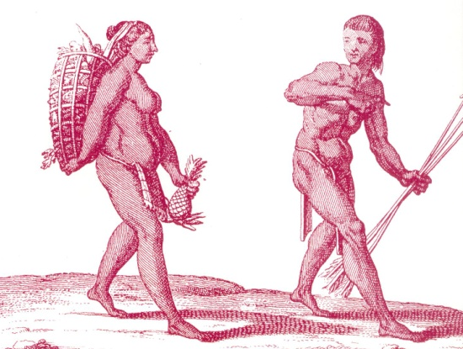
Paleolithic Man – Role of Women
Women and men had equal roles in society.
Men hunted and women gathered plants for food.
Women provided most of the food, since hunting was difficult.
Women’s status was
equal to that of men.

Slide 12
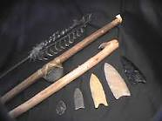
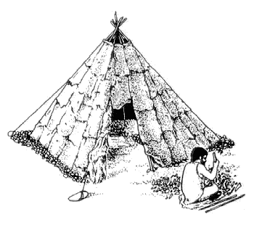
Paleolithic Man
They used simple tools and weapons made from stone, wood, or bone.
They lived in temporary shelters that could be taken down and moved quickly.

Slide 13
Discussion Questions
What is one thing you learned today?
What seems hard about living in the Paleolithic age?
What would your daily life look like as a man or woman?
If Paleolithic = old stone What do you think “Neolithic” means?
What do you think would be the easiest animal to hunt?
What do you think Paleolithic people did in their spare time?

Slide 14
Recap
What does “Paleolithic” mean?
What did they make tools out of?
What was the role of men and women? Who was more important to society?
What were some struggles of hunting and gathering?

Slide 15
The Neolithic Age (The “New Stone” Age)

Slide 16
Agricultural Revolution
The Agricultural Revolution or the Neolithic Revolution is when humans changed from being hunters and gatherers to farming and living in one place.

Slide 17
Neolithic Revolution
Instead of being Nomadic hunting and gathering, people began to plant seeds and grow food in one spot.
Growing food was less work and was a more reliable source of food.

Slide 18
Key Difference Between Hunters/Gathers and Agriculture?

Slide 19
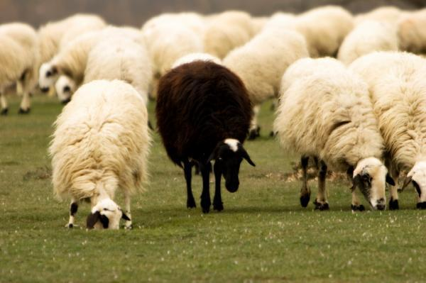
Domestication of Animals
People also began to domesticate or tame animals and raised them for food.
They used them for food or to work.
What kinds of animals do you think they domesticated?

Slide 20
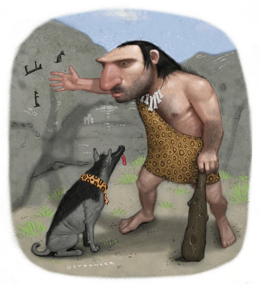
Domesticated Animals
Goats, sheep, horses, cows, dogs!
https://www.youtube.com/watch?v=mCLQ_8I1paY

Slide 21
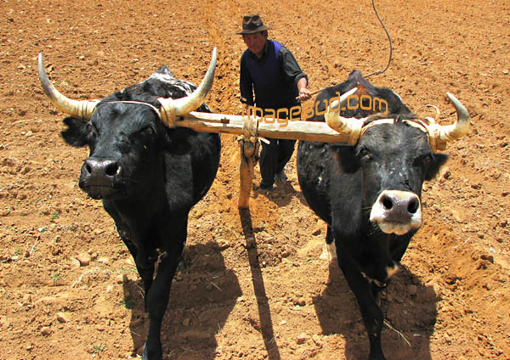
Domestication of Animals
People chose to breed animals with desirable characteristics (gentle, healthy, large, most wool or milk).
This changed the animal over time.
They did the same thing with plants, choosing to replant seeds from the best plants.

Slide 22
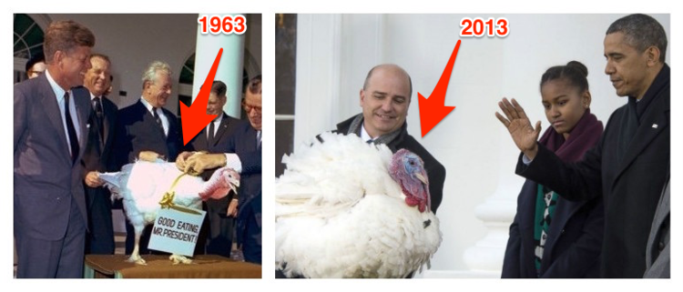
Turkey

Slide 23
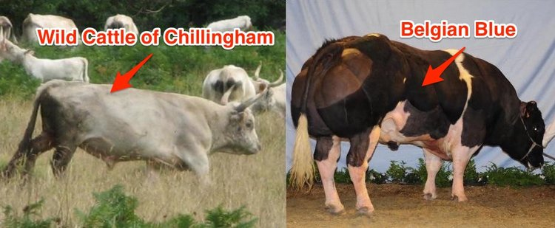
Cows

Slide 24
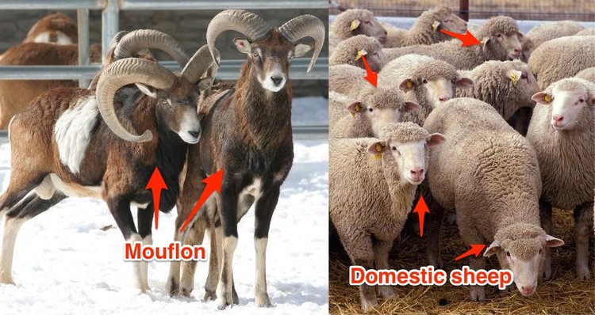
Sheep

Slide 25
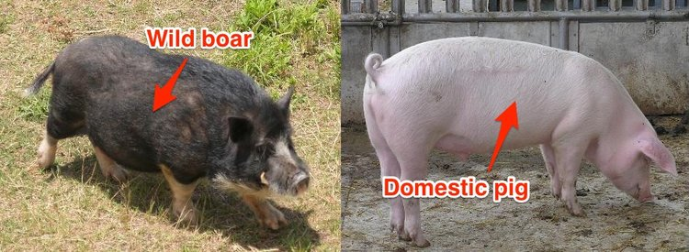

Slide 26
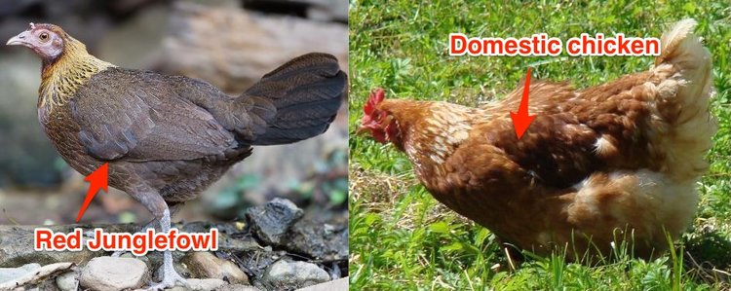

Slide 27
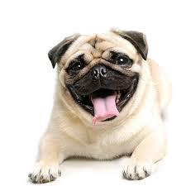
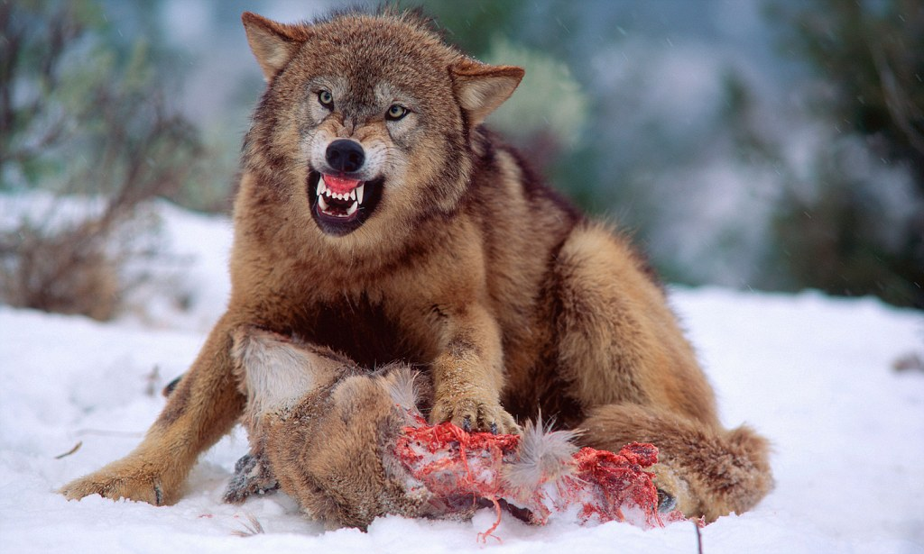
Wolves/Dogs

Slide 28
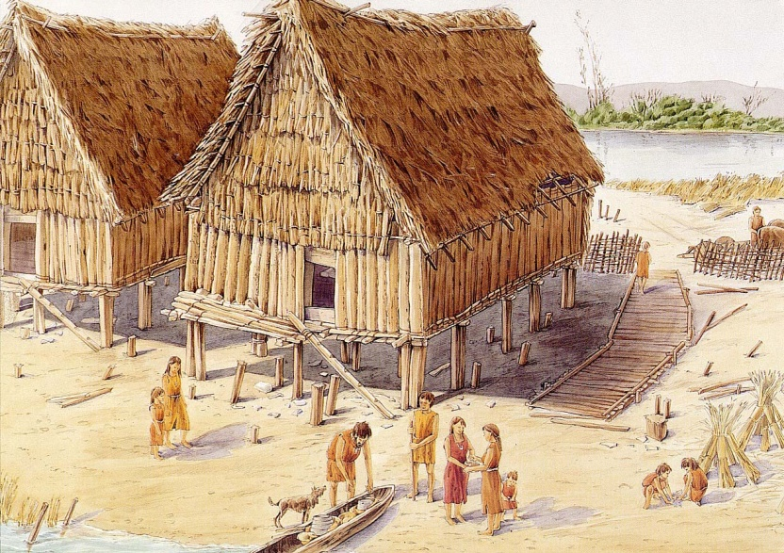
Neolithic Era
Farming required people to live in one place.
This led to permanent settlements and houses made of more permanent materials, such as brick.
Populations of settlements grew large – up to thousands of people.

Slide 29
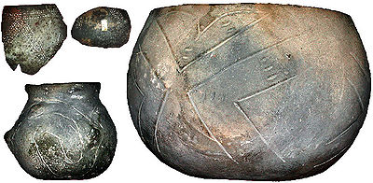
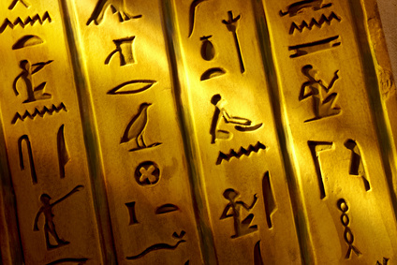
Neolithic Era
Farming took less time and provided more food than hunting and gathering.
This allowed people more free time and they developed art, architecture, culture, and writing.
*More free time= more hobbies/culture

Slide 30
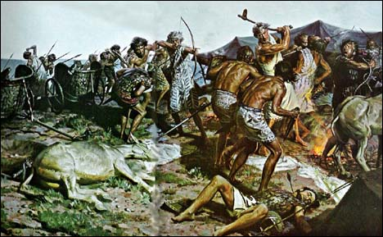
Neolithic Era
Less people were needed to grow food, so they began to specialize in skills.
People began to weave cloth, make pottery, shape metal into tools or jewelry, and trade with other settlements.
Warfare also began as groups began to try to take the stored resources of other civilizations (grain and animals).

Slide 31
Neolithic Era
The Neolithic Revolution was when humans became more like modern people.
Today, we live in societies with large populations. We specialize our jobs. We farm to get food. We have developed cultures.

Slide 32
Questions
What does Neolithic mean?
Which type of society hunted and gathered?
What does it mean to domesticate an animal?
With free time, what were people able to do?
Which are we most like- Paleolithic or Neolithic?
How has the Neolithic Revolution affected *your life*?

