Slide 1
Spread of Islam flip map

Slide 2
Materials Needed
1 piece of colored paper for mounting
Base map
1 sheet of tracing paper cut into fourths
1 pen
Colored pencils
Scissors (optional)

Slide 3
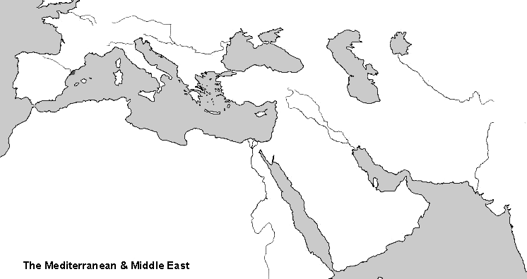
Step 1: Glue the base map onto the colored paper

Slide 4
Step 2 – Label Base Map
Directions: Students need to label the following places and bodies of water of the base map in PEN.
Mecca
Medina
Baghdad
Damascus
Cordoba
Europe
Africa
Asia
Mediterranean Sea (M. Sea)
Arabian Sea
Atlantic Ocean

Slide 5
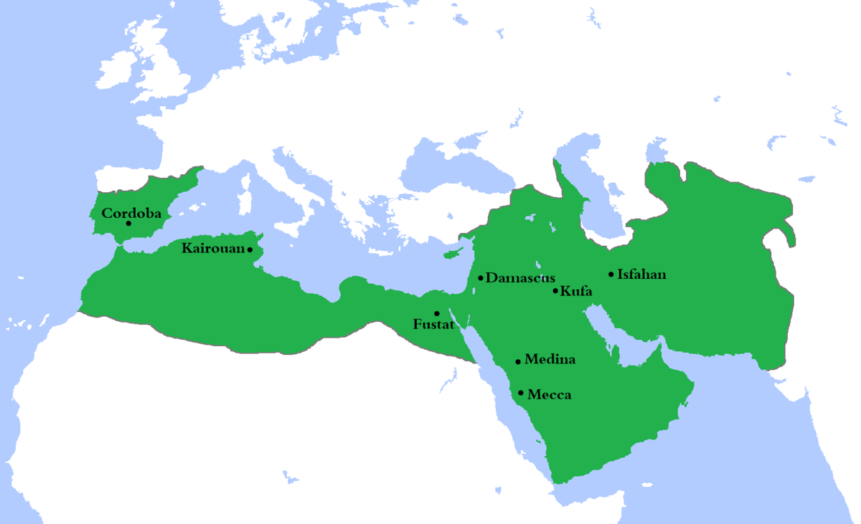
Step 3: Label
Europe
Atlantic ocean
M. Sea
Asia
Baghdad
Africa
Arabian Sea

Slide 6
Step 4: Islam under Muhammad Overlay
Lay the first piece of tracing paper over the map with the excess paper this time at the top and glue down only the excess strip allowing the rest of the tracing paper to flip freely.
Now, again in ink trace the outline of the land onto the map overlay.
Title this layer Islam Under Muhammad - 632 C.E.
Put a next to the following city: Medina

Slide 7
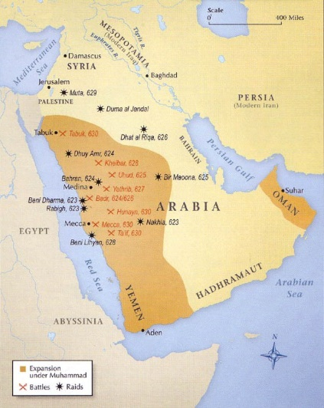
On the trace paper, color the following area – don’t rip it!

Slide 8
Step 5: Islam under The Rashidun Caliphates
Lay the first piece of tracing paper over the map with the excess paper this time at the top and glue down only the excess strip allowing the rest of the tracing paper to flip freely.
Now, again in ink trace the outline of the land onto the map overlay.
Title this layer Rashidun Caliphates - 632 C.E.
Put a next to the following city: Medina

Slide 9
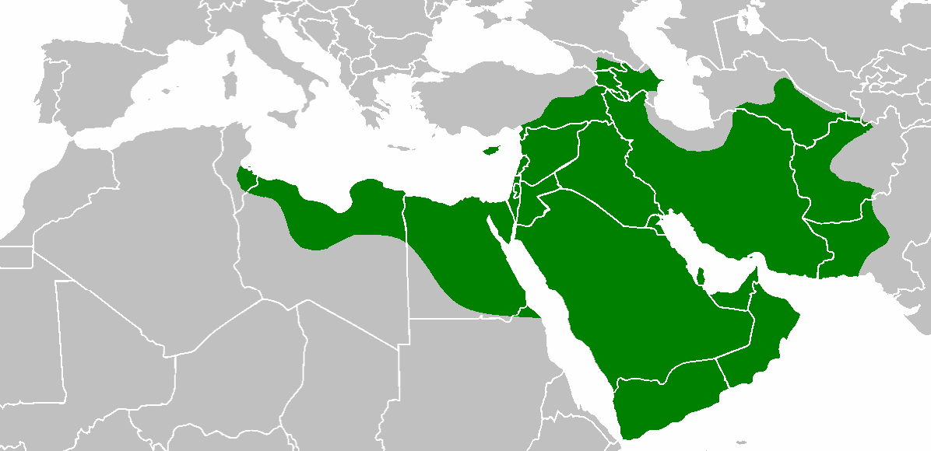
On the trace paper, color the following area – don’t rip it!

Slide 10
Step 6: Islam under The Umayyad Caliphates
Lay the first piece of tracing paper over the map with the excess paper this time at the top and glue down only the excess strip allowing the rest of the tracing paper to flip freely.
Now, again in ink trace the outline of the land onto the map overlay.
Title this layer Umayyad Caliphates: 661 -750 C.E.
Put a next to the following city: Damascus

Slide 11
On the trace paper, color the following area – don’t rip it!

Slide 12
Step 7: Islam under The Abbasid Caliphates
Lay the 4th piece of tracing paper over the map with the excess paper this time at the top and glue down only the excess strip allowing the rest of the tracing paper to flip freely.
Now, again in ink trace the outline of the land onto the map overlay.
Title this layer Abbasid Caliphates: 750-1258 C.E.
Put a next to the following city: Baghdad

Slide 13
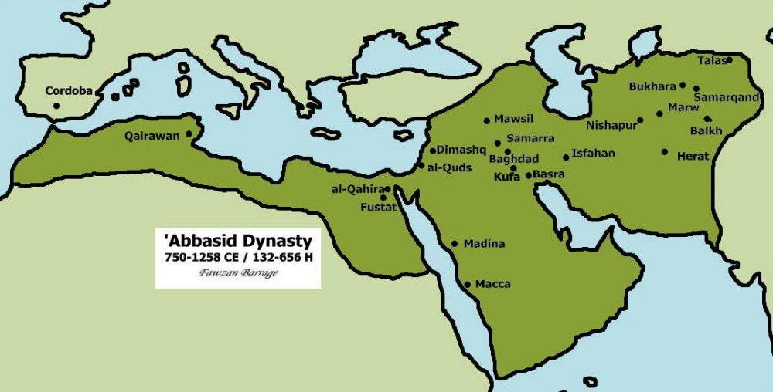
On the trace paper, color the following area – don’t rip it!

Slide 14
On the trace paper, shade this circled area a different color
Umayyad survivors
This is the area Umayyad's decedents fled to and controlled

