Slide 1
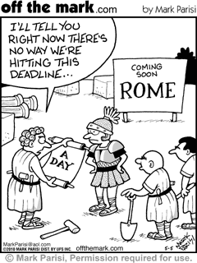
Rome, in a day!

Slide 2
Activity #1 – The Roman Republic
Using the boxes under Activity #1 on your worksheet, take notes from the corresponding readings.
Summarize the key points from the following sections
Establishment
Government structure
Patricians and Plebians
End of the Republic

Slide 4
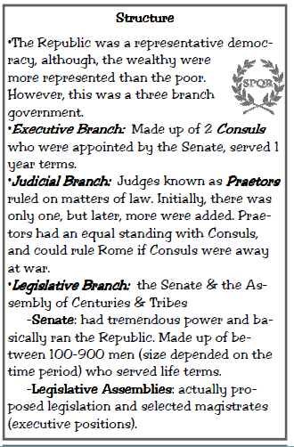

Slide 7
Roman Empire At Its Height

Slide 8
Activity #2 – Crash Course: Roman Empire
Watching Crash Course World History #10 – Rome
Follow along and take notes/define the following terms listed on your webquest worksheet under activity #2

Slide 9
Crash Course:

Slide 10
Activity #3 – Rome: Engineering an Empire
Click on the clip below, and watch from 43:00 – 49:17 (~6 minutes)
On the worksheet, answer the 4 corresponding questions using the video linked below
https://www.youtube.com/watch?v=C5obOUDyQ5s&index=3&list=PL_JUR616VuQQ8mOj9Z0PZLMoGHJ4QDaRy

Slide 11
Activity #4 - Fall of Roman Empire
Starting in the 3rd century A.D, the government in Rome began to weaken. Historians offer several explanations for this decline.
Political Weaknesses
Military Decline
Economic Problems
Invasions
Using the corresponding boxes for Activity #4, take notes summarizing the reasons for the fall of the Roman Empire

Slide 12
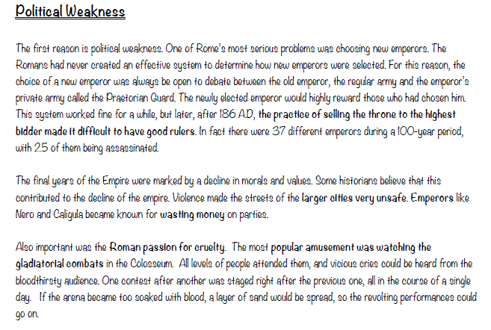

Slide 14
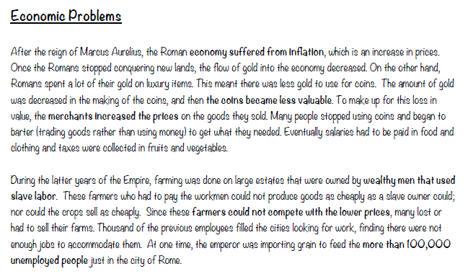

Slide 16
Activity #5 – The Roman Legacy
Romulus Augustulus is the last emperor or Rome. The Vandals are closing in on Rome in 476 CE. In his last attempts to preserve Roman legacy, Romulus seeks you out to write a short summary of Roman history. What parts do you include? Write a 3 paragraph summary of Roman history, picking out what you believe to be the most important parts. Start with the Roman Republic, include the Empire, and shed light on its eventual fall.

