Slide 1
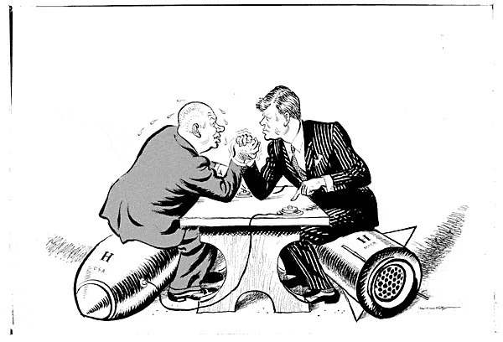
The Cold War problems already?

Slide 2
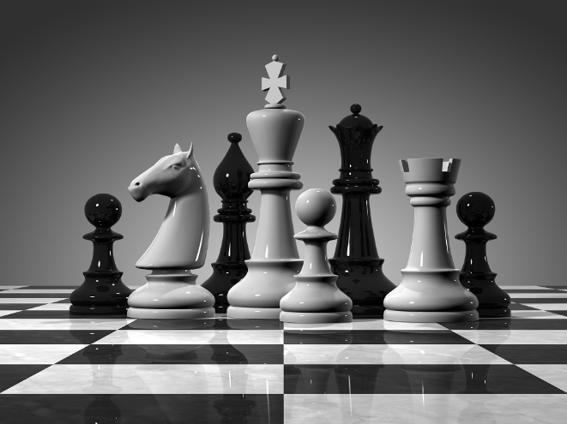
Definition
- a state of political hostility between The United States and The Soviet Union characterized by threats, propaganda, and other measures just short of open warfare.
These countries never fought specifically against one another, but participated in proxy wars to try and stop their ideals from spreading

Slide 3
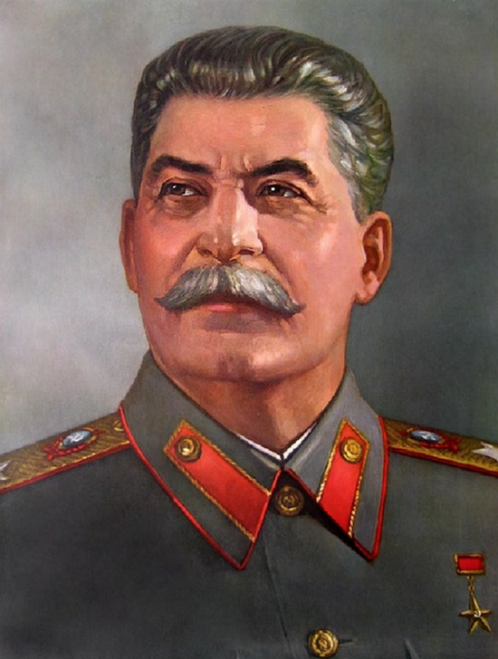
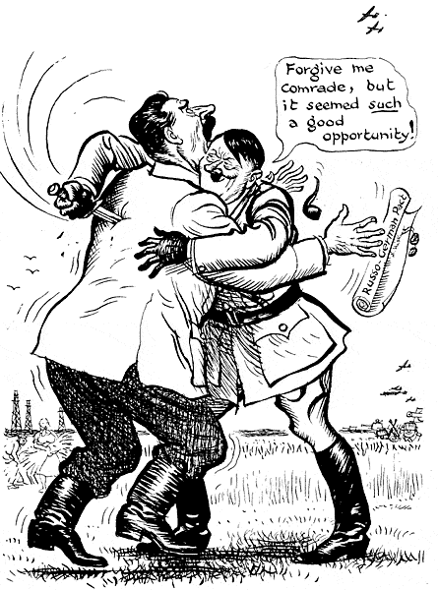
Pre-Cold War tensions
Joseph Stalin
Soviet Union communist dictator

Slide 4
Pre-Cold War tensions
Good Stalin
Fought with the Allies in WWII
Held up at the battle of Stalingrad
Drove back Germany on the Eastern Front
Joined the United Nations
Bad Stalin
Signed a non-aggression pact with Hitler pre-WWII
Communist dictator
Mad the allies didn’t attack France sooner
Wanted Eastern Europe to have “free” political elections

Slide 5
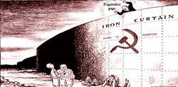
Russia’s post-WWII plan
Russia was virtually destroyed in WWII
Cities demolished
Millions dead or wounded
Economy non-existent
Not the first time this has happened to them
Stalin wanted to make sure Russia was well protected in the future

Slide 6
The Iron-curtain
In order to protect Russia, Stalin wants “free” elections in Eastern European countries
These countries just so happen to be occupied by Russian troops
These satellite states turn to communism
Become Russia’s “Iron Curtain”

Slide 7
The Iron Curtain

Slide 8
The Berlin Wall

Slide 9
Stopping Communism
Two plans were put in place to help stop the spread of communism to weaker nations
The Truman Doctrine – speech asking congress to provide foreign aid for Turkey and Greece
The Marshall Plan – proposal to congress asking U.S. to provide European countries with food, machines, and other materials needed

Slide 10
New Alliances
N.A.T.O.
North Atlantic Trade Organization
Western Europe, U.S., Canada
If any of these nations were attacked, others would have to fight
The Warsaw Pact
Warsaw Treaty Organization of Friendship, Cooperation, and Mutual Assistance
Russia, Poland, East Germany, Hungary, Czechoslovakia, Bulgaria, Albania

Slide 11
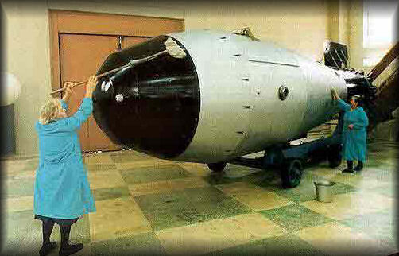
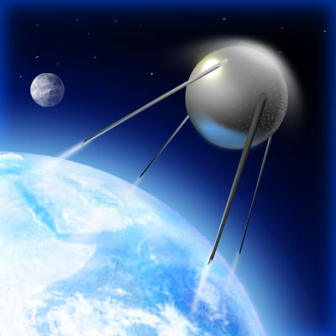
As tensions increased, defense was on the rise
U.S. and Russia begin to put more money towards scientific defense research

Slide 12
The Race to superiority
U.S. develops the Hydrogen Bomb
“H-bomb”
Russia develops H-bomb soon after
The Space Race
Russia sends first satellite into space
Sputnik
U.S. does the same soon after

Slide 13
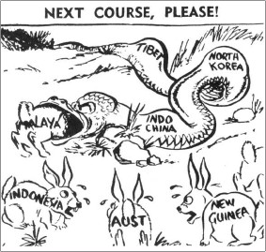
Containment
U.S. wants to stop the spread of Communism

Slide 14
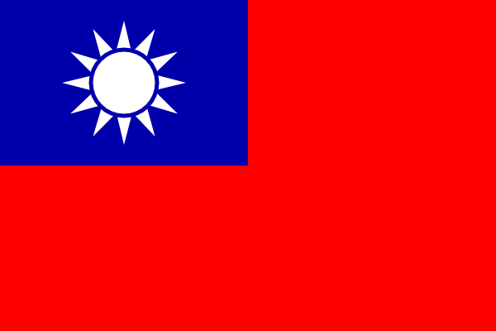
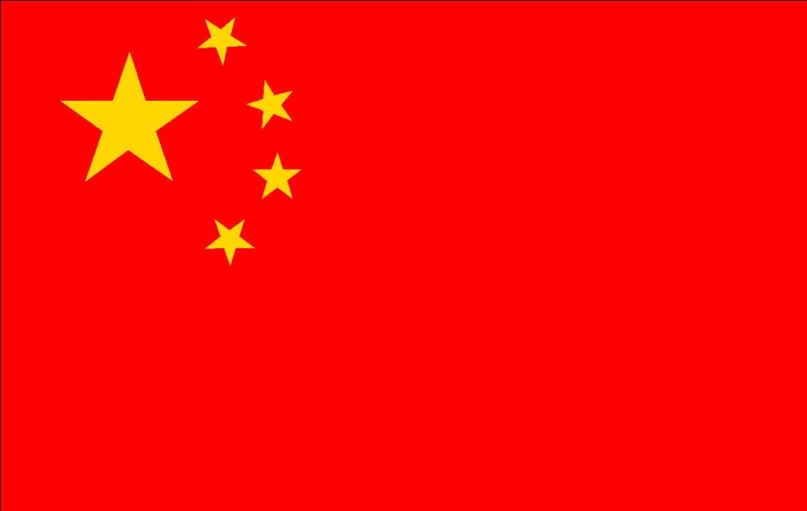
Communism in China
Vs.

Slide 15
China in WWII
China fought with the Allies against Japan during WWII
Like Russia, most of the country was in turmoil before WWII
Civil war – Nationalist party vs. Communist party
WWII united these two parties to fight together to hold off Japan

Slide 16
Before WWII
The war could not hold the two groups together – too much bad blood
Early 1900’s – China aims to modernize
Construct modern factories, build up an army and navy, reform education
Two groups rise up to fight for power
Nationalists vs. Communists
Bloody battles – split the country in two

Slide 17
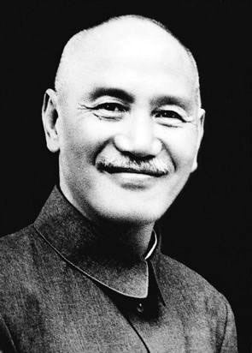
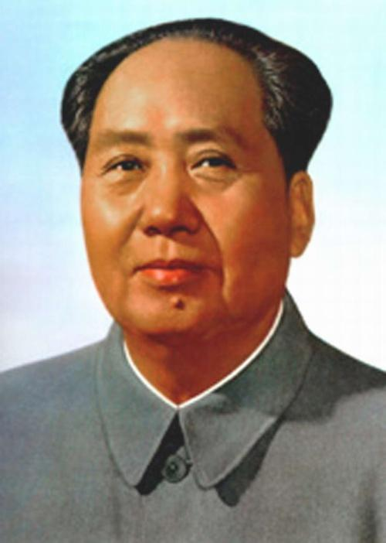
Fighting between these two parties continued following World War II
Nationalists
Leader: Jiang Jieshi
Area: Southern China
Supported by: U.S.
Communists
Leader: Mao Zedong
Area: Northern China
Supported by: U.S.S.R.

Slide 18
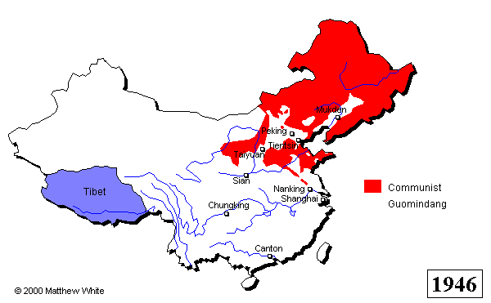
Communist expansion
http://filebox.vt.edu/users/bgilkers/digitaltimeline/chineseexpand.gif

Slide 19
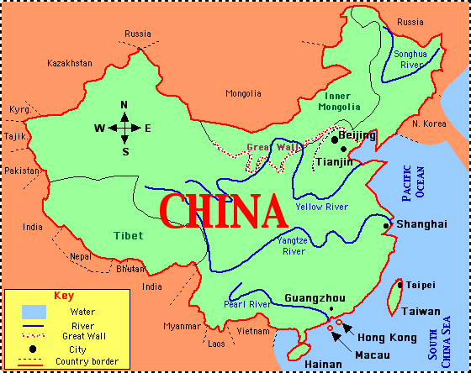
Communists Prevail in China
Nationalists forced to retreat to island of Taiwan
The republic of China
Communists controlled the mainland
The People’s Republic of China
Mao Zedong is named dictator
25% of the worlds population is now under communist rule

Slide 20
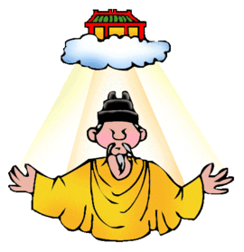
The Mandate of Heaven
Mao continued to move north, taking over Mongolia and other weak nations
Mao believed he had the “Mandate of Heaven” – the right to restore China as a powerful nation

Slide 21
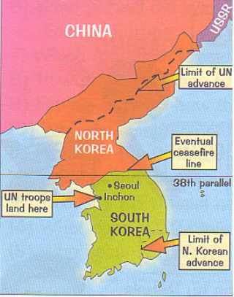
The Korean War
Containing communism

Slide 22
Korean War Summary
After WWII, Korea split into two nations
North Korea – Communist
South Korea – Non-communist
North Korea wants to become more powerful communist nation
Attacks South Korea: Summer 1950
General Douglas MacArthur: Commander of U.N forces helping South Korea

Slide 23
Korean War continued
MacArthur drives North Koreans back to Chinese border
Chinese (Communists) feel threatened – jump into war on North Korean side
“We face an entirely new war” –MacArthur
Calls for Nuclear attack
President Truman gets rid of MacArthur

Slide 24
Korean War legacy
Lots of back-and-forth fighting for the next two years
Two sides agree to a cease-fire agreement July 1953
North Korean stays Communist
Leader: Kim Il Sung
Son: Kim Jong Il
Grandson: Kim Jong Un
South Korea – economically thrives under dictatorship

Slide 25
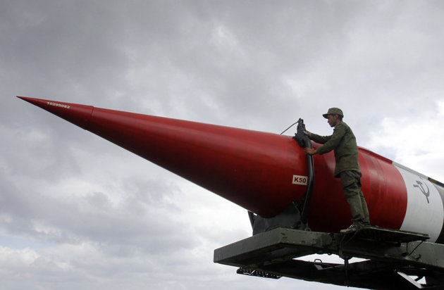
Cold War around the World

Slide 26
Taking sides
The Three Worlds
1st World – The U.S. and its allies
2nd World – The Soviet Union and its allies
3rd World – Newly developing countries with no affiliation with U.S. or U.S.S.R.
With Communist revolutions spreading, Third World Countries were starting to “pick a side”

Slide 27
Cold War hot spots

Slide 28
Problems in the Middle East
Another focus of the U.S. and Russia was the Middle East
Eisenhower Doctrine
U.S. promised to send military forces to help any Middle Eastern country that ask for help to fight communists

Slide 29
Soviets in Afghanistan
The scramble for influence pressed on in the Middle East
Afghanistan was once a communist country that was falling to rebel forces
Mujahideen
The U.S. wanted to secure Afghanistan for themselves
Provided the rebels with weapons to fight the soviets

