Slide 1

World Religions and Trade Map Flipbook

Slide 2
Purpose
The purpose of this assignment is to visualize how trade routes facilitated the diffusion of culture.
What is cultural diffusion?

Slide 3
Materials Needed
1 piece of colored paper for the base
1 map
1 sheet of tracing paper cut into fourths
2 Colored pencils
Scissors
glue

Slide 4
Step 1 – Base Map
Directions: Students need to label the following places and bodies of water of the base map in red PEN.
Europe
Russia
China
India
Japan
Africa
Spain
Atlantic Ocean
Pacific Ocean
Indian Ocean
Mediterranean Sea
Arabian Sea
Bay of Bengal

Slide 5
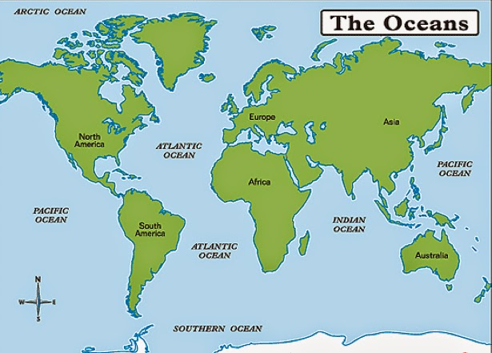
Label the oceans
Med sea
Arabian
sea
Bay of
Bengal

Slide 6
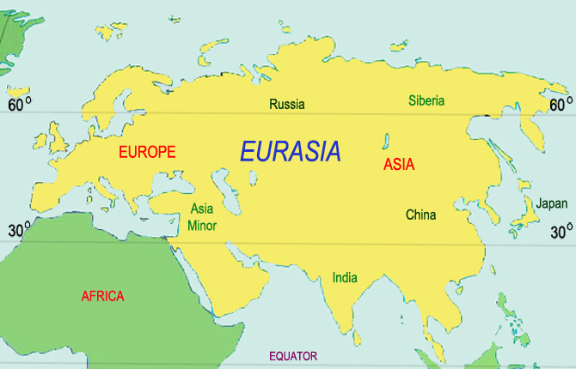
Label the land masses
Spain

Slide 7
Step 2: Color and Glue Base Map
Students should color the land green and the water blue after labeling the bodies of water and places indicated on slide 3.
After the map has been colored and labeled, students should center the map on the colored paper

Slide 8
Step 3: First Overlay: Spread of Buddhism
Lay the first piece of tracing paper over the map with the excess paper this time at the top and glue down only the excess strip allowing the rest of the tracing paper to flip freely.
Now, again in black pen trace the outline of the land onto the map overlay.
Title this layer Spread of Buddhism in black
Label the following cities: Sri Lanka, Paliputra, Chang’an, Bejing in black
Then mark arrows showing the direction of its spread in red pen.

Slide 9
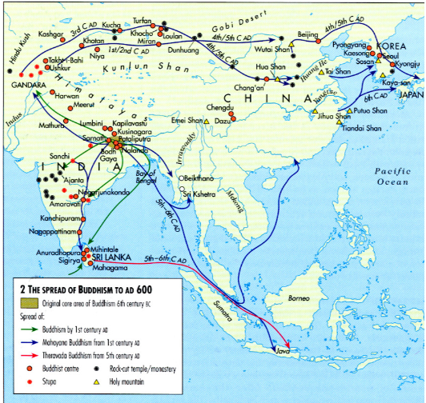
Label the following cities: Sri Lanka, Paliputra, Chang’an, Bejing.
Beijing
Chag’an
Paliputra
Sri Lanka
http://qed.princeton.edu/images/c/c7/The_Spread_of_Buddhism_to_AD_600.jpg

Slide 10
Mark arrows showing the direction of its spread.
Then look at this site. It’s cool! http://www.eduplace.com/kids/socsci/books/applications/imaps/maps/g6_u7/index.html
http://www.learner.org/courses/worldhistory/support/activities_7.pdf

Slide 11
Step 4: Second Overlay - Spread of Christianity and Judaism
Lay the second piece of tracing paper over the map with the excess paper to the right and glue just the excess strip securely so the rest of the tracing paper is free to flip back.
Now, in black pen trace the outline of the land from the base map onto the tracing paper overlay.
Title this layer SPREAD OF CHRISTIANITY AND JUDAISM
Label the following cites: Alexandria, Rome, Constantinople, Jerusalem in black
Consult the map on the next slide (slide 8) to color the areas where Christianity and Judaism spread. Draw the arrows to indicate how these religions expanded (slide 9) in red pen.

Slide 12
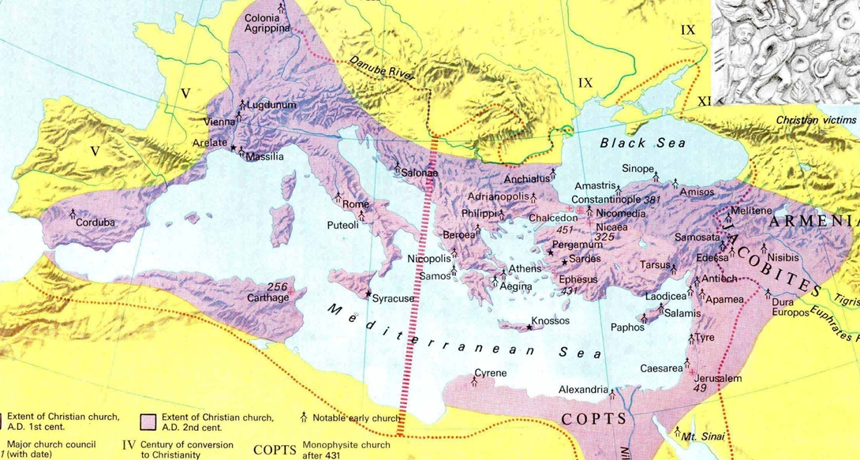
Label the following cites on your overlay: Alexandria, Rome, Constantinople, Jerusalem
Rome
Constantinople
Alexandria
Jerusalem
http://www.bible.ca/maps/maps-ancient-churches-200-500AD.jpg
On the overlay, color the areas where Christianity and Judaism spread.

Slide 13
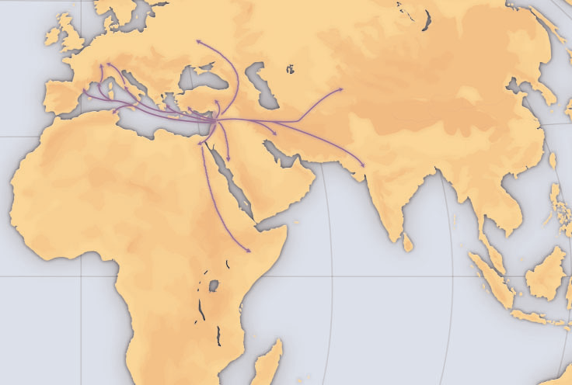
Label the Spread of Christianity and Judaism
http://www.learner.org/courses/worldhistory/support/activities_7.pdf
Draw the arrows to indicate how these religions expanded.

Slide 14
Step 5: Spread of Islam Overlay
Lay the third piece of tracing paper over the map with the excess paper this time on the left and glue down only the excess strip allowing the rest of the tracing paper to flip freely.
Now, again in black pen trace the outline of the land onto the map overlay.
Title this layer SPREAD OF ISLAM
Label the following cites: Medina, Mecca, Damascus in black.
Now, using the map given to color in the areas that Islam spread and mark arrows showing the direction of its spread in red pen.

Slide 15
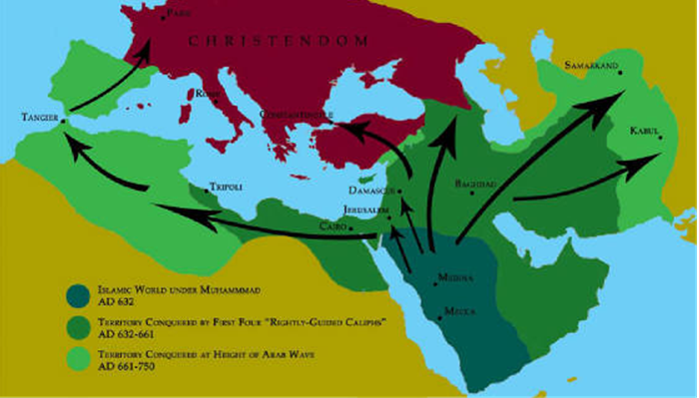
Label the following cites on your overlay:
Medina, Mecca, Damascus
Damascus
Medina
Mecca
On the overlay, color in the areas that Islam spread and mark arrows showing the direction of its spread.

Slide 16
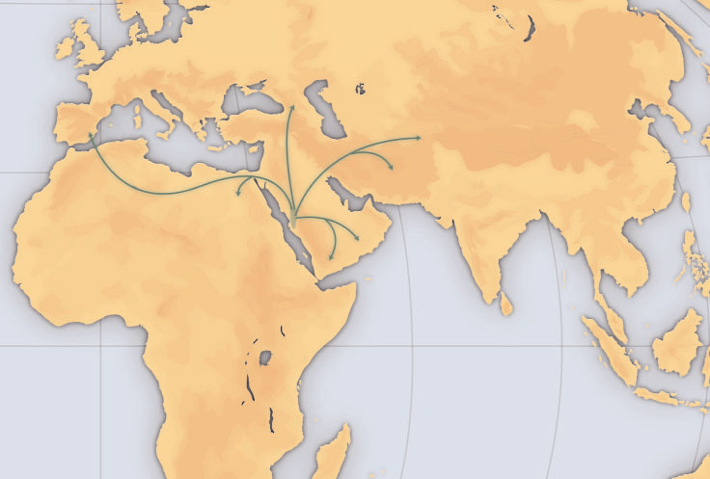
Mark arrows on the overlay showing the direction of its spread.
http://www.learner.org/courses/worldhistory/support/activities_7.pdf

Slide 17
Step 6: Silk Road and Indian Ocean Trade Basin Overlay
Lay the fourth piece of tracing paper over the map with the excess paper this time at the bottom and glue down only the excess strip allowing the rest of the tracing paper to flip freely.
Now, again in ink trace the outline of the land onto the map overlay.
Title this layer Silk Road and Indian Ocean Trade

Slide 18
Silk Road and Indian Ocean Trade Basin Overlay
Label the following cities along the Silk Road: Alexandria, Rome, Constantinople, Antioch, Bagdad, Dunhuang
Label the following cities in the Indian Ocean Trade Basin: Aden, Malacca, Calcutta, Guangzhou
Label bodies of water: Indian Ocean, Atlantic Ocean, Pacific Ocean, Arabian Sea, Bay of Bengal, South China Sea, Mediterranean Sea
Label landforms: Gobi Desert, Himalaya Mountain Range
Do not color this map. In Red follow the path indicating The Indian Ocean Trade Route and in black trace the Silk Road Trade Route. Create a key at the bottom of the overlay.

Slide 19
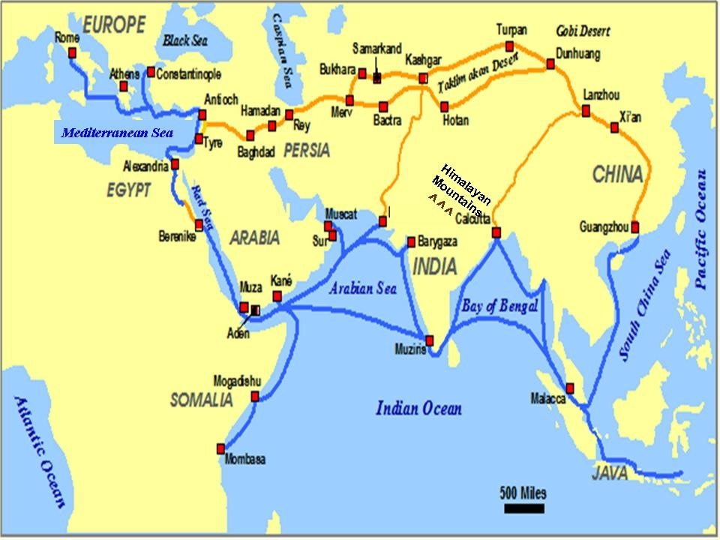

Slide 20
Reflecting on world religion map:
How did trade affect the spread of religion?
After completing all the overlays discuss the importance of Constantinople in regards to trade?
Why were empires throughout history competing for this location?
Discuss the role of geography and cultural diffusion in trade.

